Slide 1
Can electrons be local?
Emerging models for local electricity supply and market access
Presentation to CEL members
10/9/2025
Felix Wight
Commercial Director, Connected Response
Non-exec director, Repowering London
felixwight@connectedresponse.co.uk

Slide 2
Key distinctions
Private network/ public network
Physical/virtual metering
Rural/urban
Domestic/non-domestic
Licensed/license exempt
Metering/settlement
MPAN/meter

Slide 3
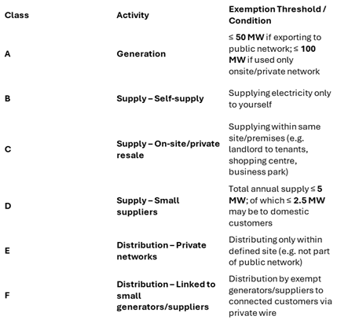
License exemptions
Notes:
Even if license exempt, there are practical and administrative challenges to interfacing with the licensed electricity system

Slide 4
Industry interfaces
Metering- DCC, DCDA
Industry flows- DTN
Industry codes- BSC, SEC, REC, CUSC, DCUSA
Network charges- BSUoS, DUoS, TNUoS, BSC costs
Policy costs- RO, FiT, CfD, WHD, Capacity Market
Other participants- MOPs, Suppliers
Notes:
Even if license exempt, there are practical and administrative challenges to interfacing with the licensed electricity system

Slide 5
Operational requirements
Billing systems
Customer service
Contract management
Procurement
Legal services
Meter installations
Network maintenance
Notes:
Even if license exempt, there are practical and administrative challenges to interfacing with the licensed electricity system

Slide 6
Retail cost breakdown
Component | % of Bill | £ / year (on £1,200 bill) | Cumulative %
Wholesale Energy | 35% | ~£420 | 35%
Network Costs (TNUoS + DUoS + losses) | 23% | ~£276 | 58%
Balancing Costs (BSUoS + imbalance) | 7% | ~£84 | 65%
Environmental & Social Levies | 15% | ~£180 | 80%
Supplier Operating Costs & Margin | 15% | ~£180 | 95%
VAT | 5% | ~£60 | 100%
Notes:
Wholesale costs are only 35% of the retail cost

Slide 7
What is local electricity supply
Notes:
Creating direct relationships between demand and generation- physical or commercial
Not all models are technically supply- some involve creating local electricity markets or supply facilitation

Slide 8
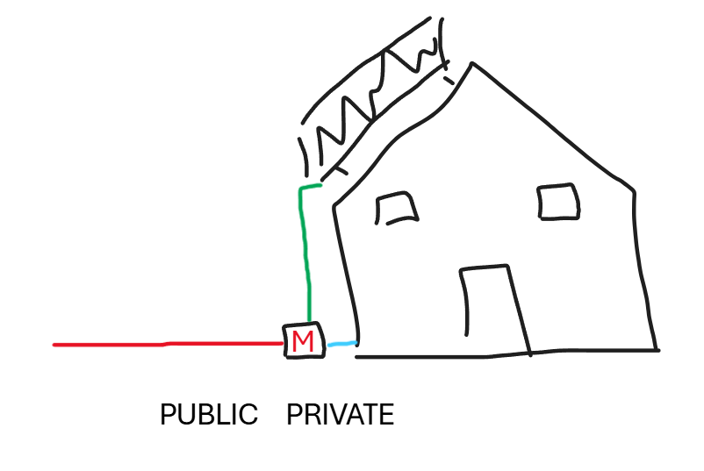
Notes:
The big 6 vs the 1.6 million

Slide 9



M
PUBLIC
PRIVATE

Slide 10
Local supply models for houses

Slide 11
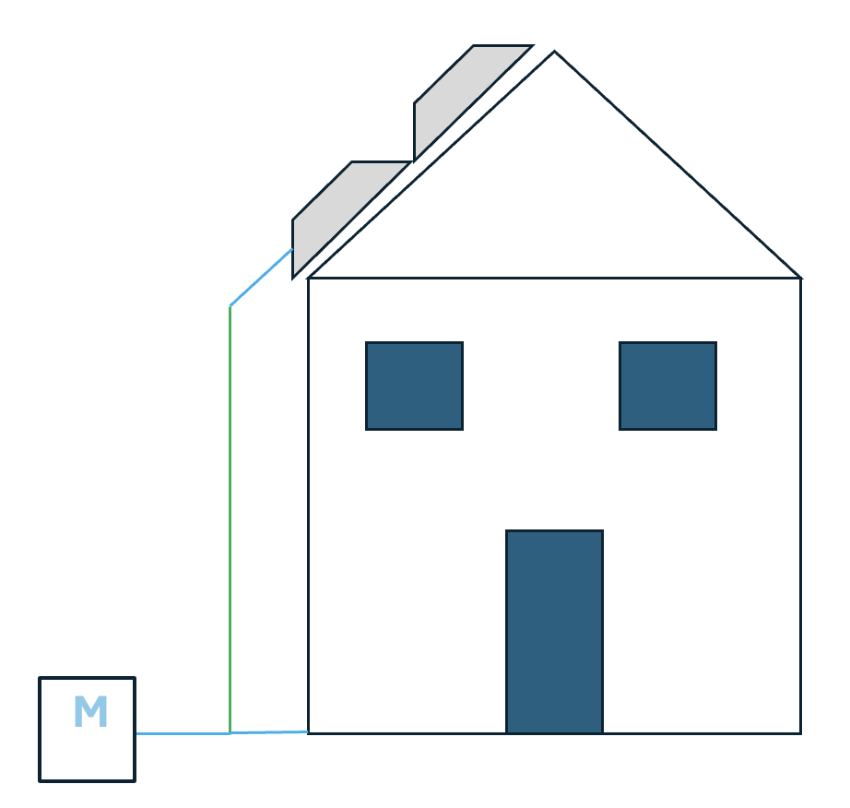
M
PUBLIC
PRIVATE

Slide 12
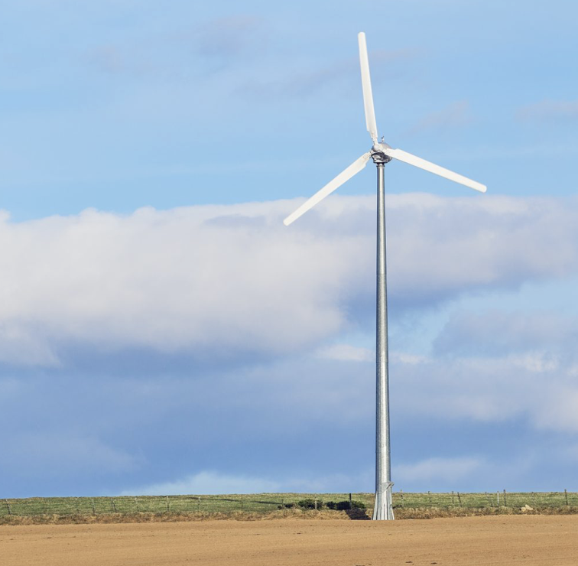
+20
License exempt generation:20kWh
License exempt demand:20kWh
Licensed import:10kWh
-15
M
PUBLIC
PRIVATE
-5
-10
-10

Slide 13
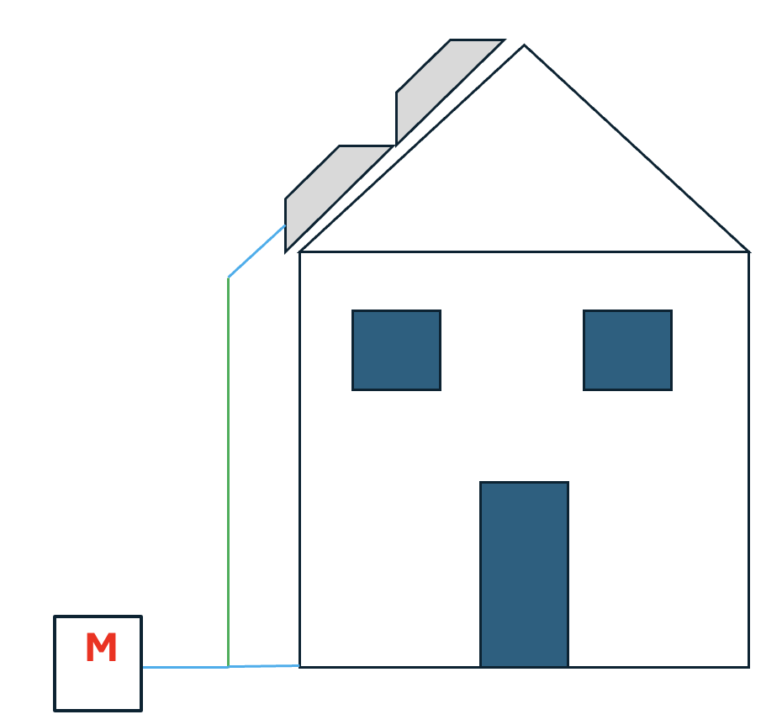
PRIVATE
M
PUBLIC
PUBLIC
PRIVATE
PUBLIC
PRIVATE
PUBLIC
PRIVATE

Slide 14
BSC Modification P441
Raised by Green Energy UK on behalf of Energy Local in July 2022
‘Minded to’ position agreed in June 2025
Public consultation expected September 2025
Provides clarity on network charges relating to ‘complex’ metering arrangements
Requires half hourly metering data
Not all households need to sign up
Applicable to domestic and non-domestic customers
Technically limited to demand and generation behind same primary or secondary substation
Notes:
Energy Local

Slide 15
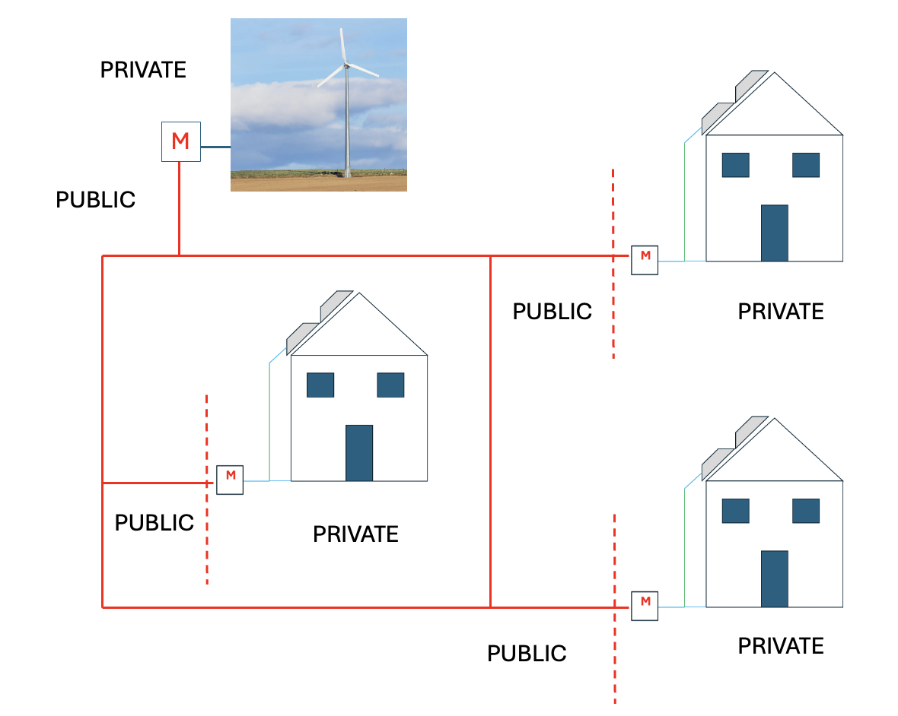
License exempt generation:20kWh
License exempt demand:20kWh
Licensed import:10kWh
VIRTUAL METER
+20
-15
-5
-10

Slide 16
Local supply models for flats

Slide 17
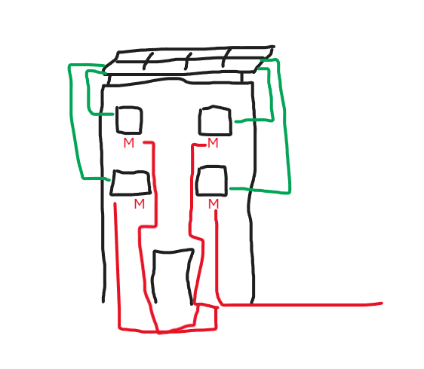
Private wire- solar splitting
Static or dynamic splitting of communal solar
Requires physical connection from solar inverter to flat for connection ‘behind the meter’
Provides access to solar independently of choice of supplier
Solar usage billed separately from grid electricity
Can provide improvement to flat EPC rating
Operational example: Solshare

Slide 18
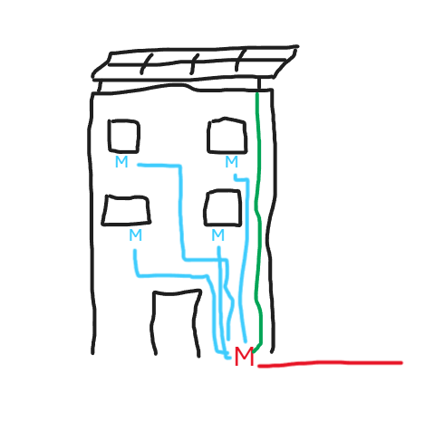
Private wire- communal meter
Physical ‘boundary’ meter measures total import and export from the block
Flats typically have new sub-meters fitted to measure individual consumption (replacing existing smart meter in retrofit scenario)
Solar and grid electricity can be billed separately or combined
Can be more difficult for customers to change supplier as all supply is via the communal meter
Operational example: Emergent Energy

Slide 19
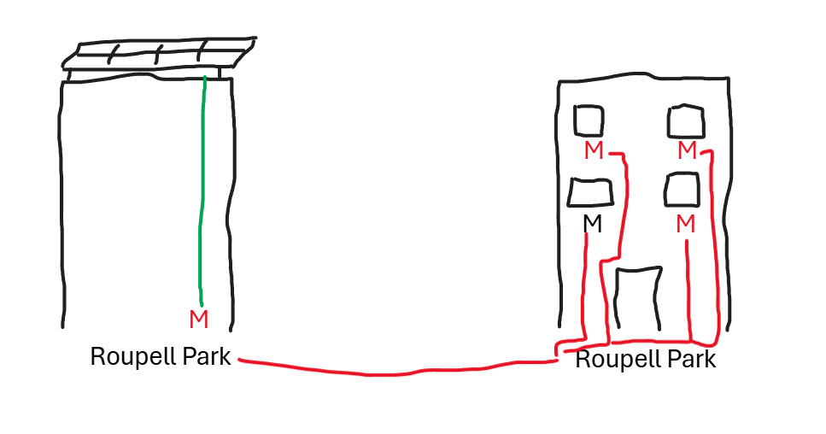
Virtual meter
Virtual meter
Virtual meter measures total import and export from participating customers on a half hourly basis
Existing SMETS smart meters can be used
Solar and grid electricity can be billed separately or combined
Requires a licensed supplier to provide billing services and ‘top up’ grid electricity
Operational example: Energy Local Roupell Park

Slide 20
BSC Modification P455
Raised by Emergent Energy in June 2023
Implemented September 2024
Allows data from sub-meters on private wire networks to be used for settlement
Simplifies the industry interfaces required for supply on private wire networks
Domestic and Non-domestic

Slide 21
Non-domestic local supply models

Slide 22
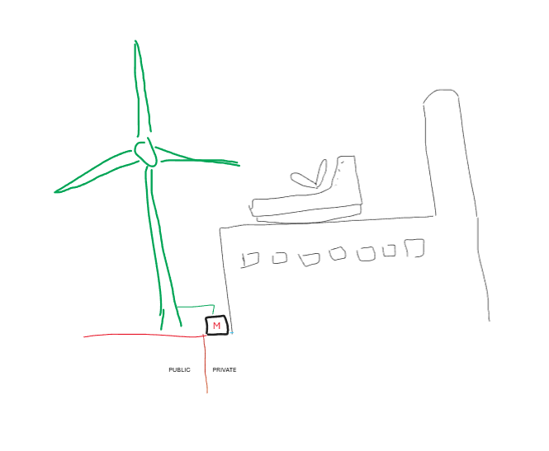
Notes:
Non-domestic on-site generation

Slide 23
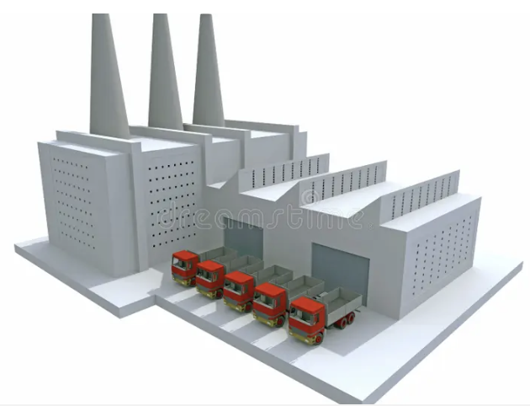
M
PUBLIC
PRIVATE

Slide 24
PRIVATE
M
PUBLIC

Slide 25
M
M
PRIVATE
PUBLIC
PRIVATE

Slide 26
BSC Modification P442
Raised by Urban Chain in July 2022
Implemented February 2025
Creates new role of ‘Exempt Supply Notification Agent’
Enables license exempt generation to recover policy and network costs through a credit mechanism
Non-domestic (currently)
Not limited by distance

Slide 27
Risks to consider
Operating costs
Customer recruitment
Network maintenance
Meter requirements
Volatility in wholesale costs
Changes to regulation of license exempt supply
Changes to BSC
Notes:
Make sure you respond to the P441 consultation

Slide 28
Opportunities
Adding value to existing installations
New build developments
Shop around for P442 PPA options (Renewable Exchange Urban Chain, PPAYA, Tem)
Forthcoming P441 consultation
Notes:
Make sure you respond to the P441 consultation

