Slide 1
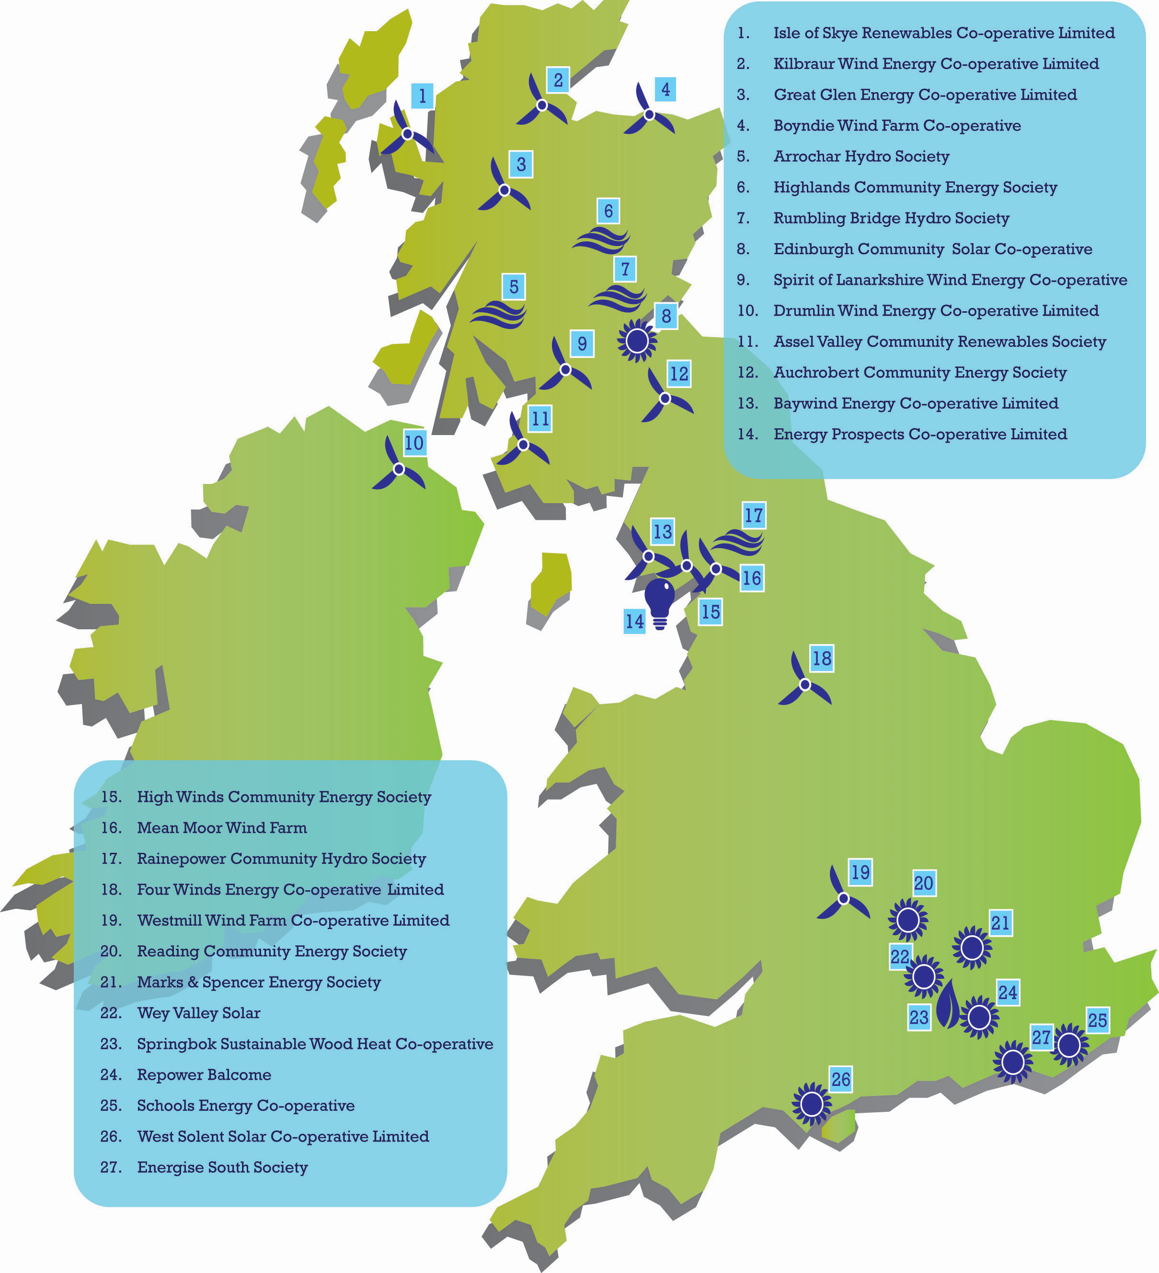
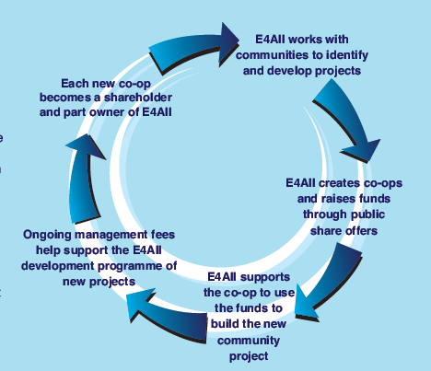
Energy4All – citizens working together

Slide 2
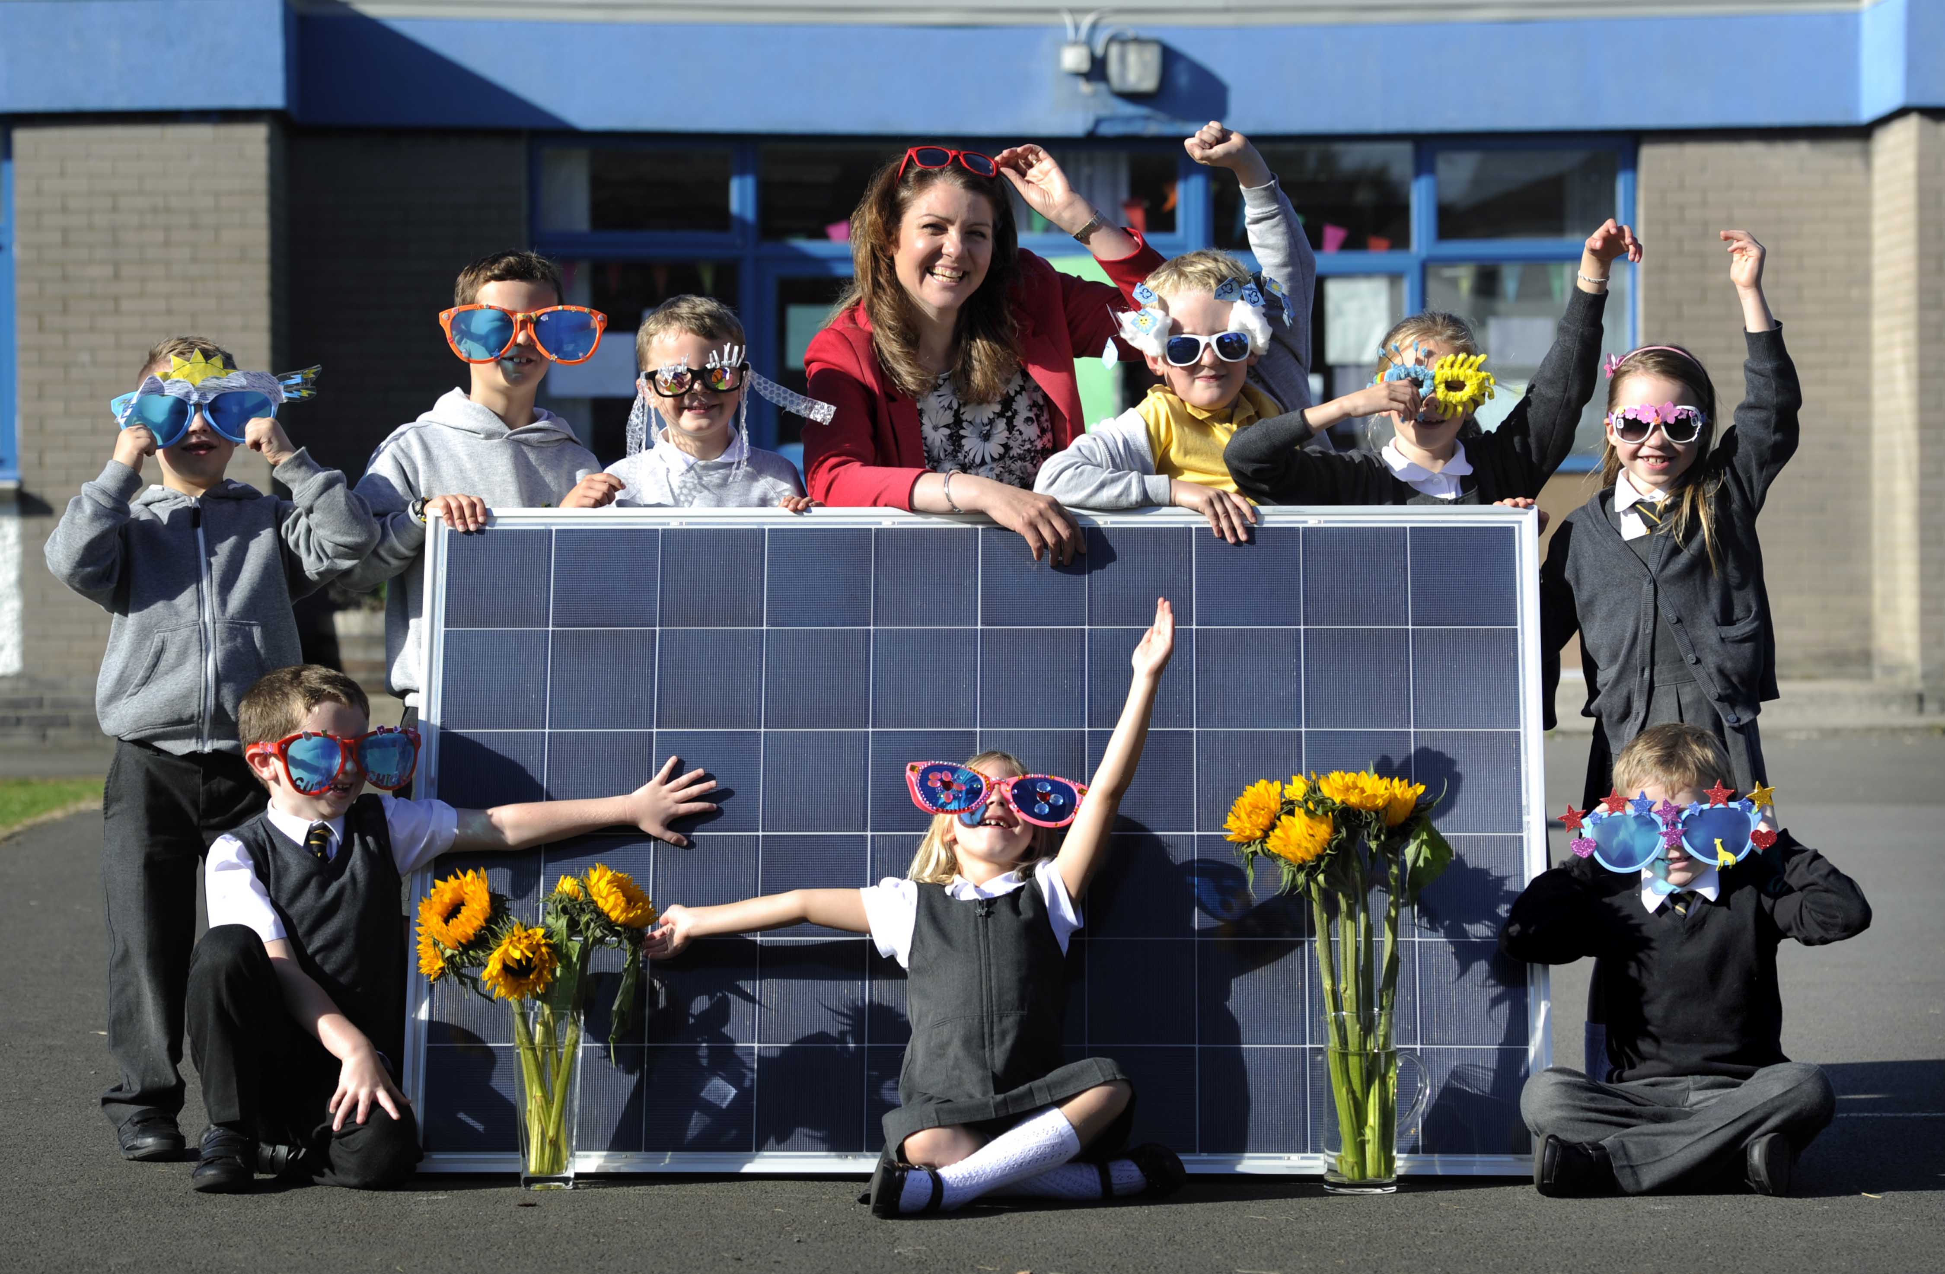
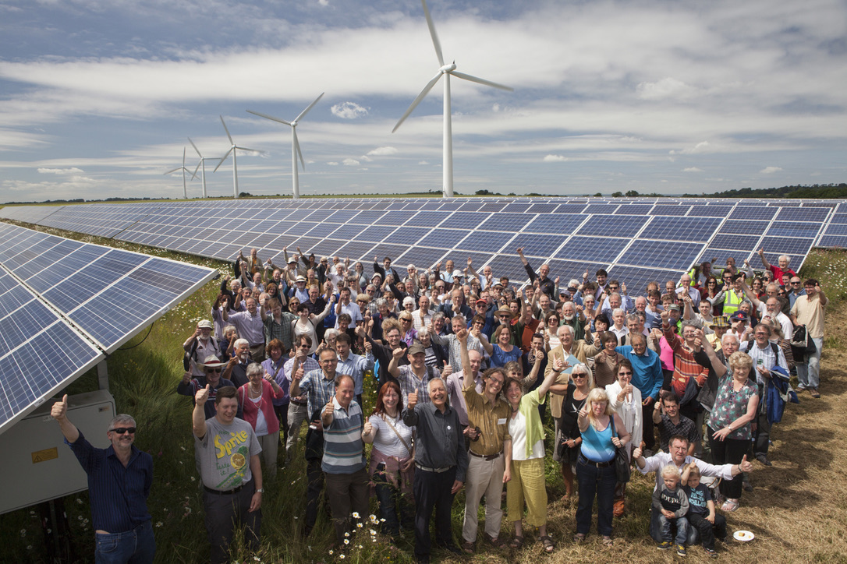
Finance from local people

Slide 3
Why cooperative finance?
Social acceptance for the energy transition
Sharing surplusses with members and local community
Building a sense of community
Retaining money within the local community
Control - £100 vs £1m
Cutting out the intermediaries
Innovative

Slide 4

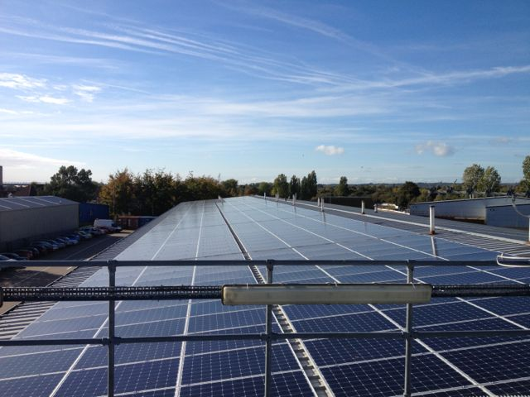
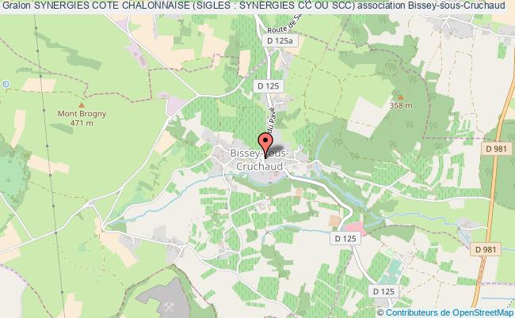
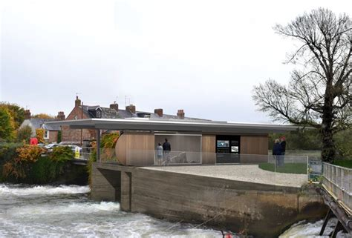
Councils and cooperatives

Slide 5
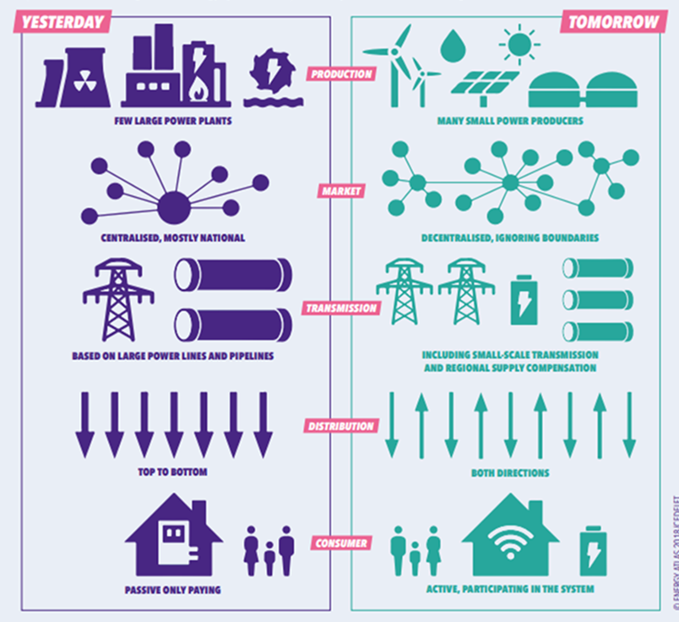
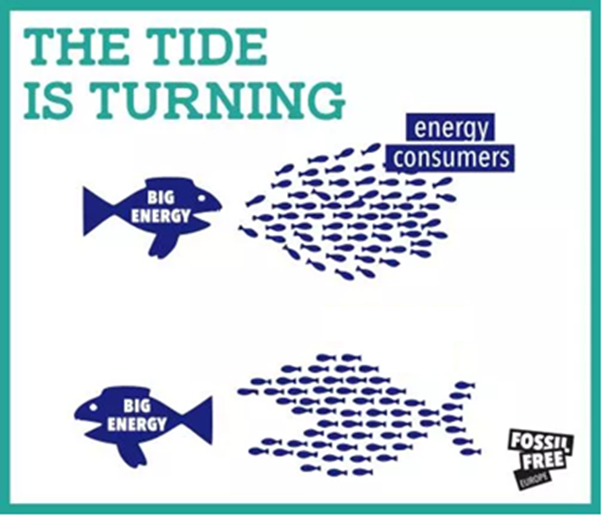
Energy cooperatives in the future

Slide 6
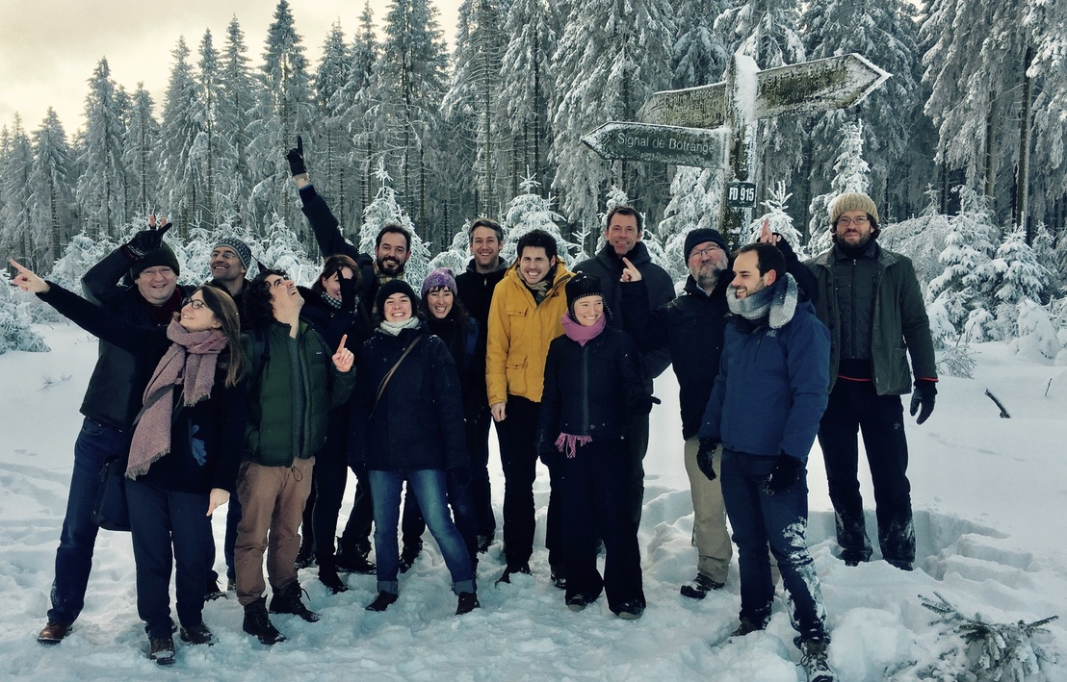
Its (much) more than money

