Slide 1
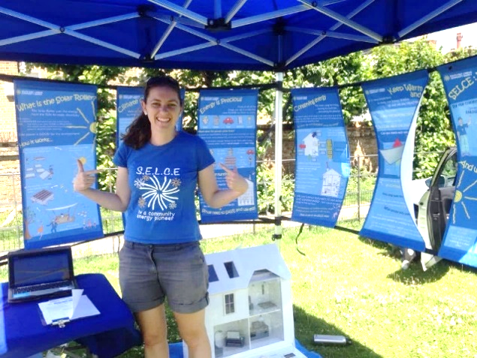
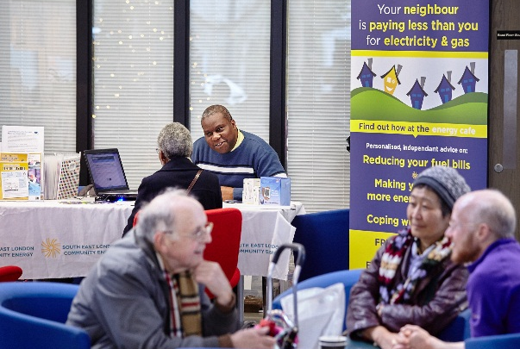
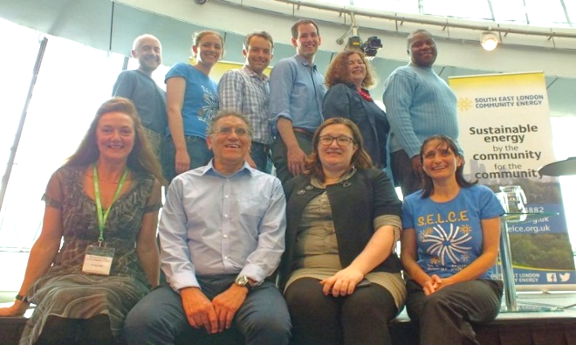
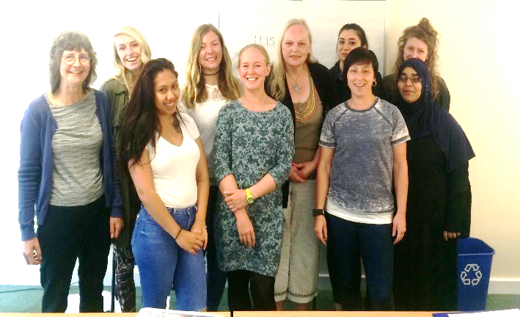
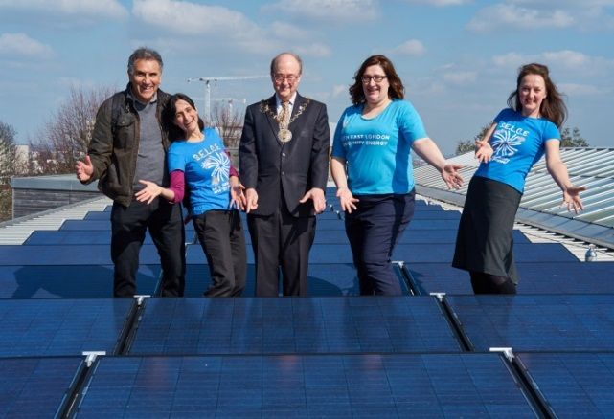






Scaling up!
South East London Community Energy

Slide 2

About South East London Community Energy
We are a group of skilled Greenwich and Lewisham residents who share a vision
A low carbon future in which everyone can access affordable energy to meet their needs and has a voice in how that is produced
Formed in 2014
14 Solar sites across Greenwich and Lewisham
Over 7000 volunteering hours
Last winter only we achieved:
Energy advice for 280 residents at our energy cafes
35 workshops held on energy saving tips (over 450 people attended)
20 training sessions for front-line workers (over 200 attendees)

Slide 3

Scaling up Solar
Worked with local councils, Lewisham and Greenwich
Schools
Leisure centres
Community hubs (Churches)
Grant funded projects through Lewisham Community Energy Fund
Support sites that wouldn’t have been viable otherwise
Partnering/engaging with local organisations
Climate Action Lewisham
XR Lewisham
Clean Air for Catford
Universities

Slide 4
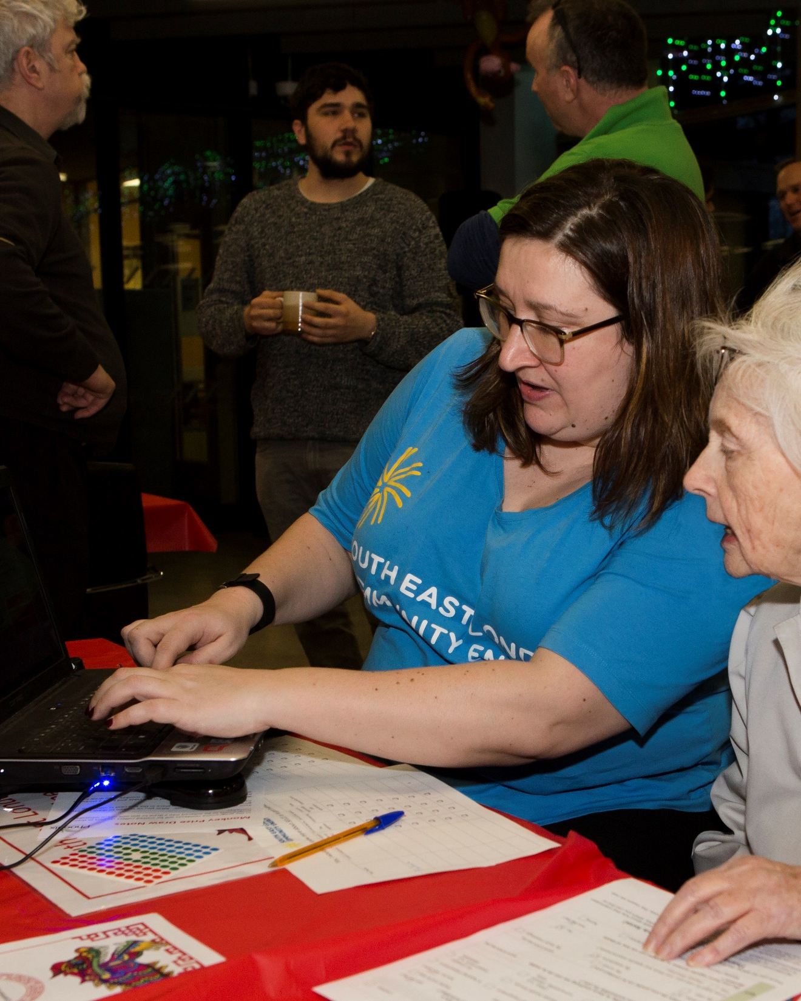
Furthering Fuel Poverty Alleviation
Range of projects targeting “hard to reach”
Empowering elders
Parent power
Community partners are key
Charlton Athletic Community Trust
ECO Project
Local authorities
Training programmes to establish a local hub
Training frontline workers
Notes:
Parent Power: visited 115 low income families in their homes,
providing tailored advice
fitting 782 energy and money saving ‘light measures’.
led by a parent who previously volunteered to support the Parent Power project and who gained a professional qualification in domestic energy advice.
ECO Project: Lewisham council funded pilot phase of the project, and makes ECO Flex declarations. Work with vetted and reliable energy efficiency installers. total of 77 households have benefitted from money and energy-saving measures. These include loft and cavity wall insulation, replacement boilers, under-floor insulation, internal wall insulation and ventilation systems. A pipeline of 183 households is set to benefit from work in the coming months.

Slide 5
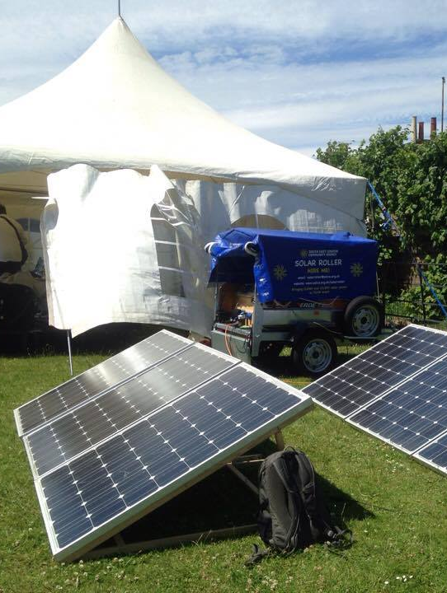
Innovations in Service Offerings
Our old revenue streams are becoming less reliable
Removal of FiT subsidy
Increasingly restrictive ECO funding eligibility
Being agile & reactive
Flexibility within our services to tackle COVID-19 pandemic
Energy cafes moved online
Diversifying our services
Future Fit Homes
LED-ing the Way
Strengthening & growing our partnerships
Co-op Community Energy
Inputting into local authority climate emergency plans
Notes:
Strengthening & Growing Partnerships: Already good at working collaboratively within the community energy sector. Worked with CREW on collective solar purchase, and learning from them for LED project which we are working on with SE24. Also joined the network of CEL and CEE sharing invaluable knowledge, experience and sector news. Now we are focusing on developing our partnership further with the Co-operative movement (Co-op Community Energy), people that are interested in things other than just energy (tackling social inequlality, etc) and improving our relationships with our local authorities who have supported us this far – inputting knowledge into local climate emergency plans and acting as client-facing organisation with grassroots engagement from local people.

Slide 6
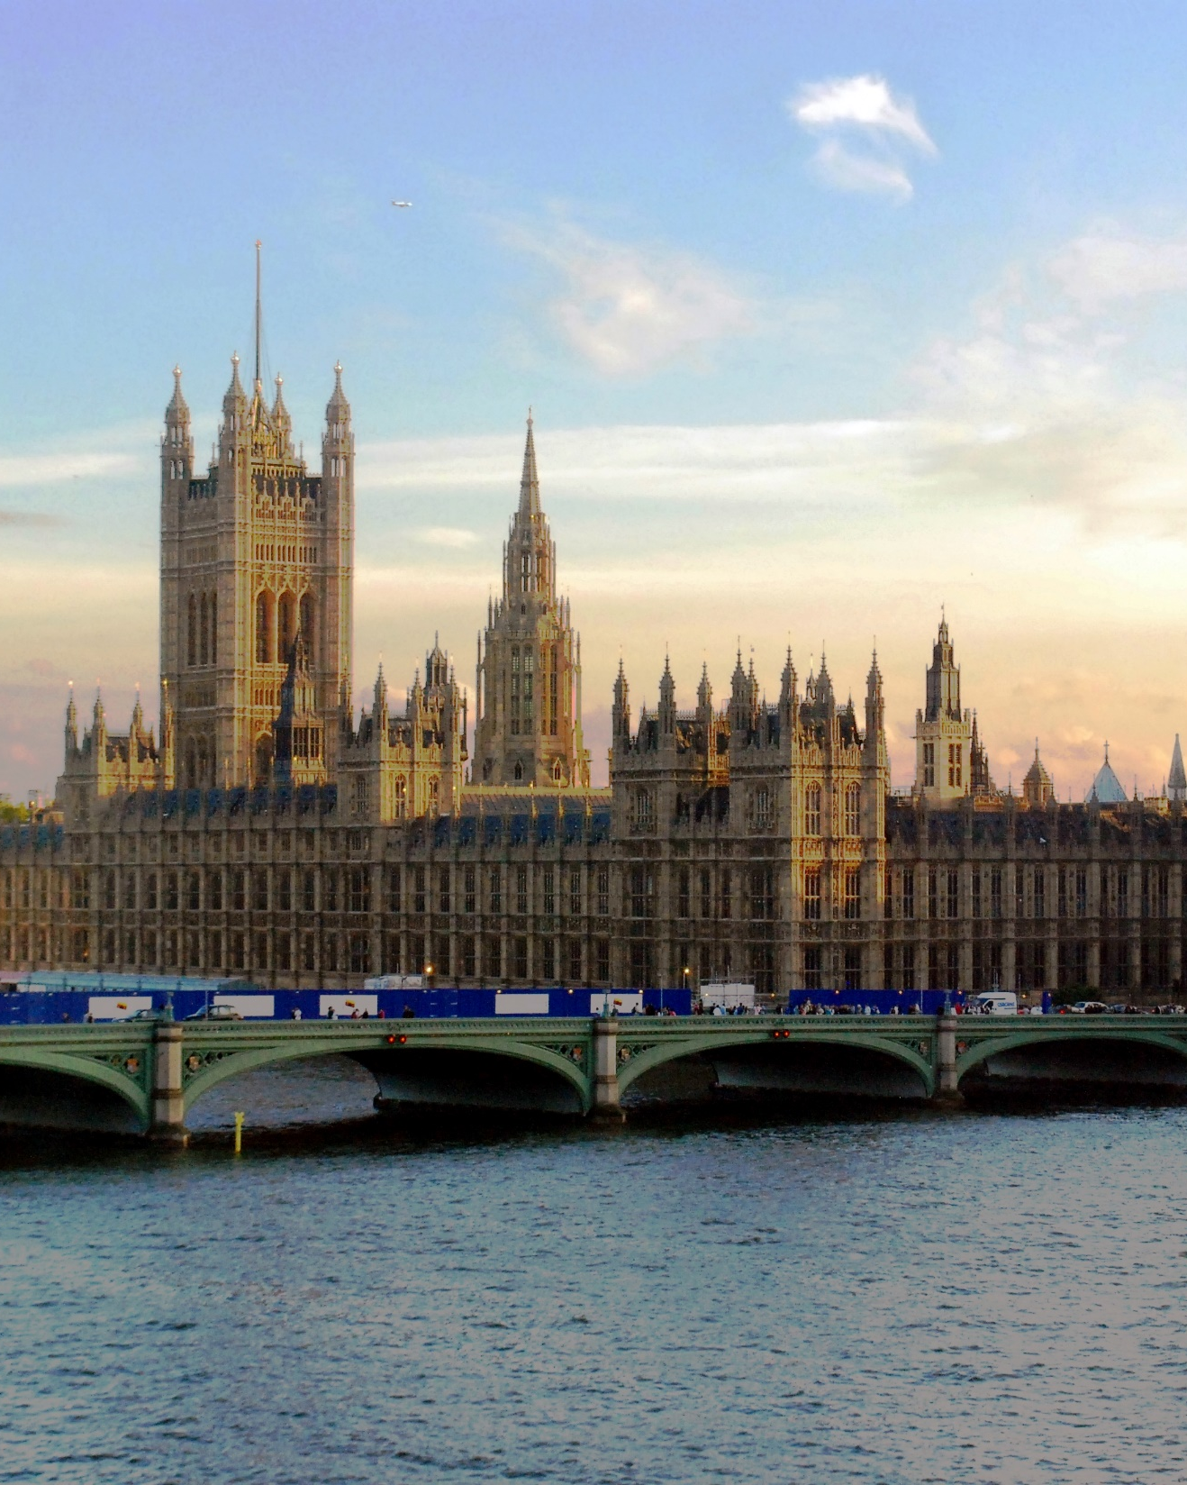
The Policy Landscape
Nationally, strong interest in community energy
London Community Energy Fund
Community Energy is Local
Lewisham Community Energy Fund
Lewisham Climate Action Plan published
Greenwich Climate Action Plan being developed
Actions for community energy enterprises:
Climate change Citizen’s Assembly
Engage local councillors
Know your MP well
Complete your annual review in a format that relates to local authority targets & send it on!
Actions for local authorities:
Understand where CEEs can reduce burden on local authority departments
Ensure you have a community energy officer, or climate emergency officer engaged with your local CEE
Seek to engage CEEs in policy consultations

