Slide 1
Participation and inclusion
Dr Afsheen Kabir Rashid MBE
June 2020

Slide 2








Family of Coops - Community building
- Operationalise core programmes to address climate emergencies
- Build on partnerships to develop innovation projects
670 kW
of installed rooftop solar capacity
£710,000
Shares and debt invested into the community
~84 young people
trained and received paid work experience
144 tonnes
of CO₂ emissions avoided each year
£196,000
Community Fund ringfenced for the local area
Notes:
Quotes to match data / impact
Reorder

Slide 3
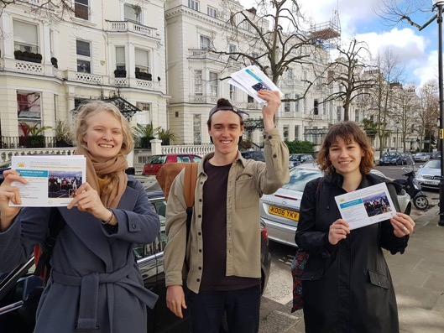
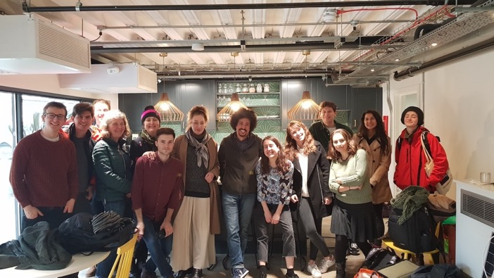
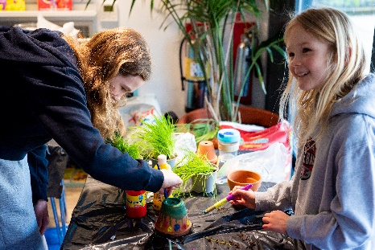
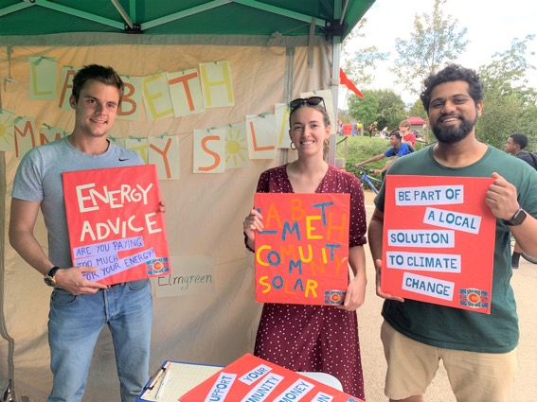
Community movement building - building an empowered network of volunteers - local ownership and control - connect people, inspire action, share knowledge

Slide 4
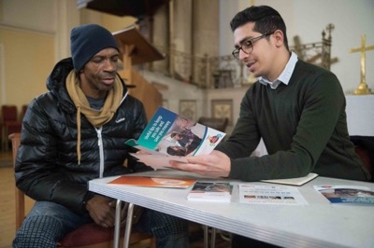
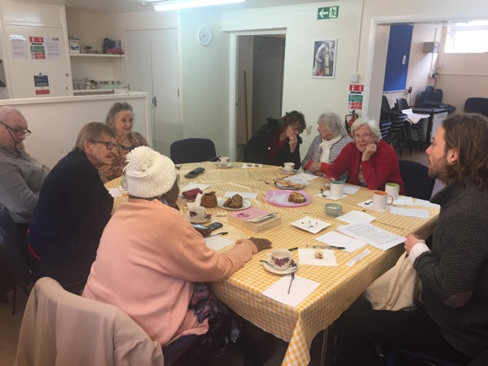
Community Champions – community support service - Locally rooted - Shape our response to the coronavirus crisis - Promoting our community support service

Slide 5



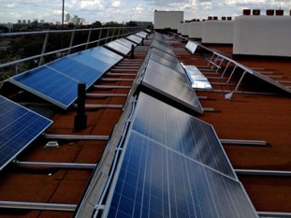
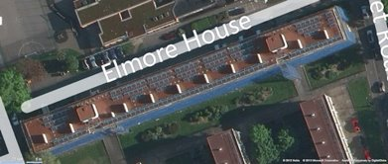
Community Champions – innovation trials Community Urban Neighbourhoods Internal Trading of energY – (CommUNITY) – partnership with EDF
Virtual’ microgrid where power is locally produced, traded and consumed​
Ofgem sandbox​
Residents are projected to save 10-20% on their electricity costs​
37 kWp community-owned solar PV array ​
Brixton Energy has an export PPA with EDF​
​
Phase 1 - ​
4 households (30% of eligible customers)​
Applicable to both pre-payment and credit meters
Smart phone app for residents to share or sell solar energy ​
Solar energy is priced lower than their existing tariff ​
Participants are receiving credit on their accounts​
​
Phase 2 - Battery storage in development​
Battery to be installed (24 kWh storage capacity)​
Operating at a community scale ​
Increase savings to resident by higher usage ​
Potential to provide networks services

Slide 6
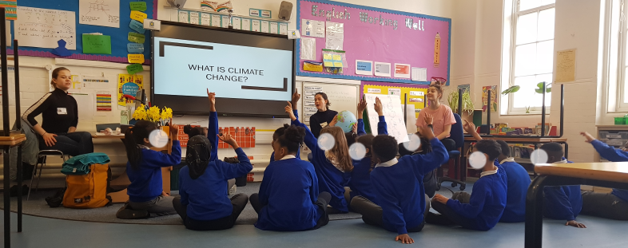
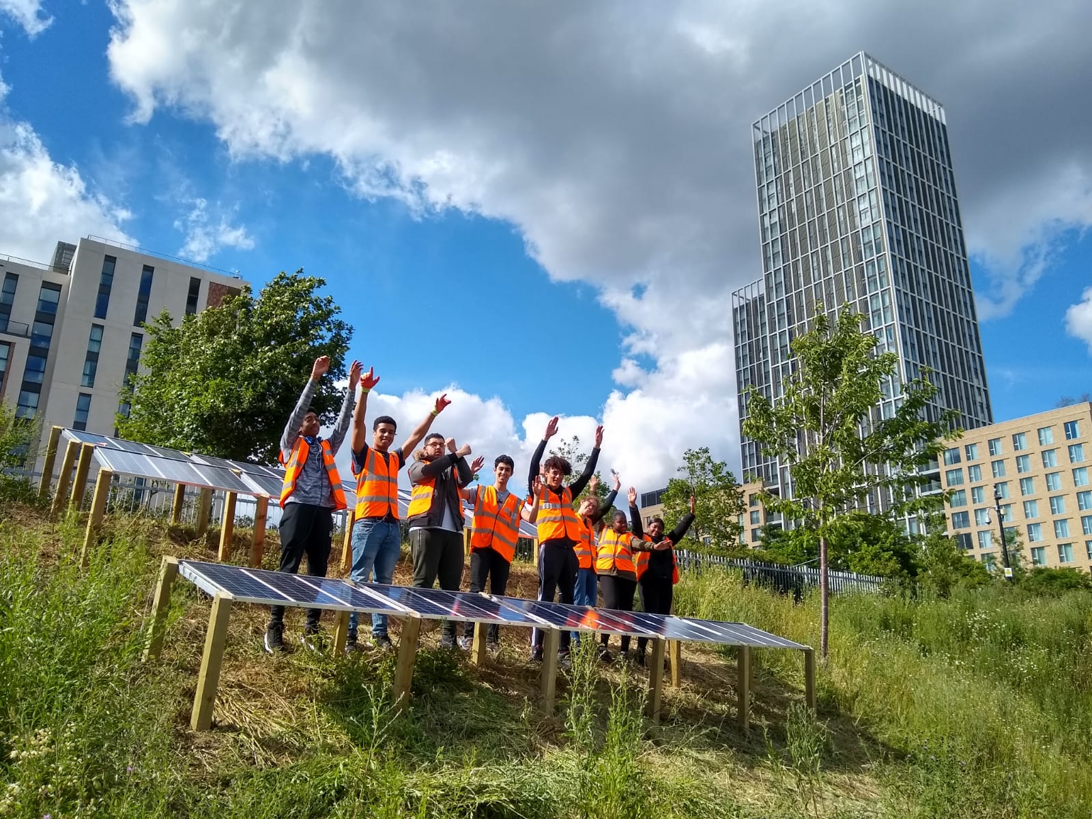
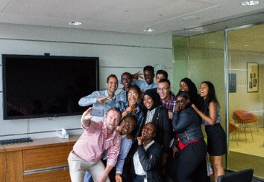
Education and Training Programme Flagship youth training programme – AQA accredited scheme School workshops – linked to curriculum Theatre project for primary school children – pilot in Hackney

Slide 7
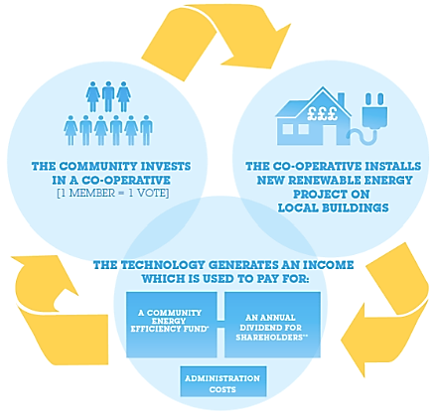
Governance Community Benefit Societies Model - £1 membership
Core principles – community owned, control and benefit
Democratic - one member one vote
Inclusive – local residents can join with a nominal £1 membership fee.
Community shares – offer local green investment

Slide 8
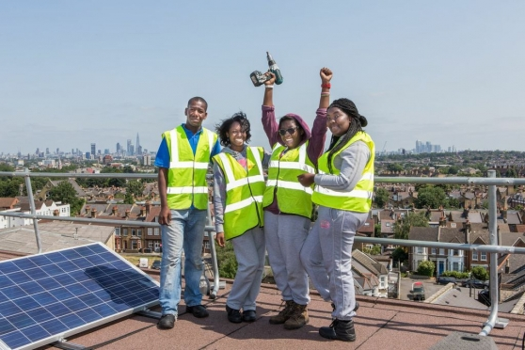
Thanks for your time
Dr Afsheen Kabir Rashid MBE
Co-founder Director & CEO
+44 (0) 7834686264
Afsheen.Rashid@Repowering.org.uk
@RepowerLondon

