Slide 1

CREW Energy Clean Energy – Community Power

Slide 2
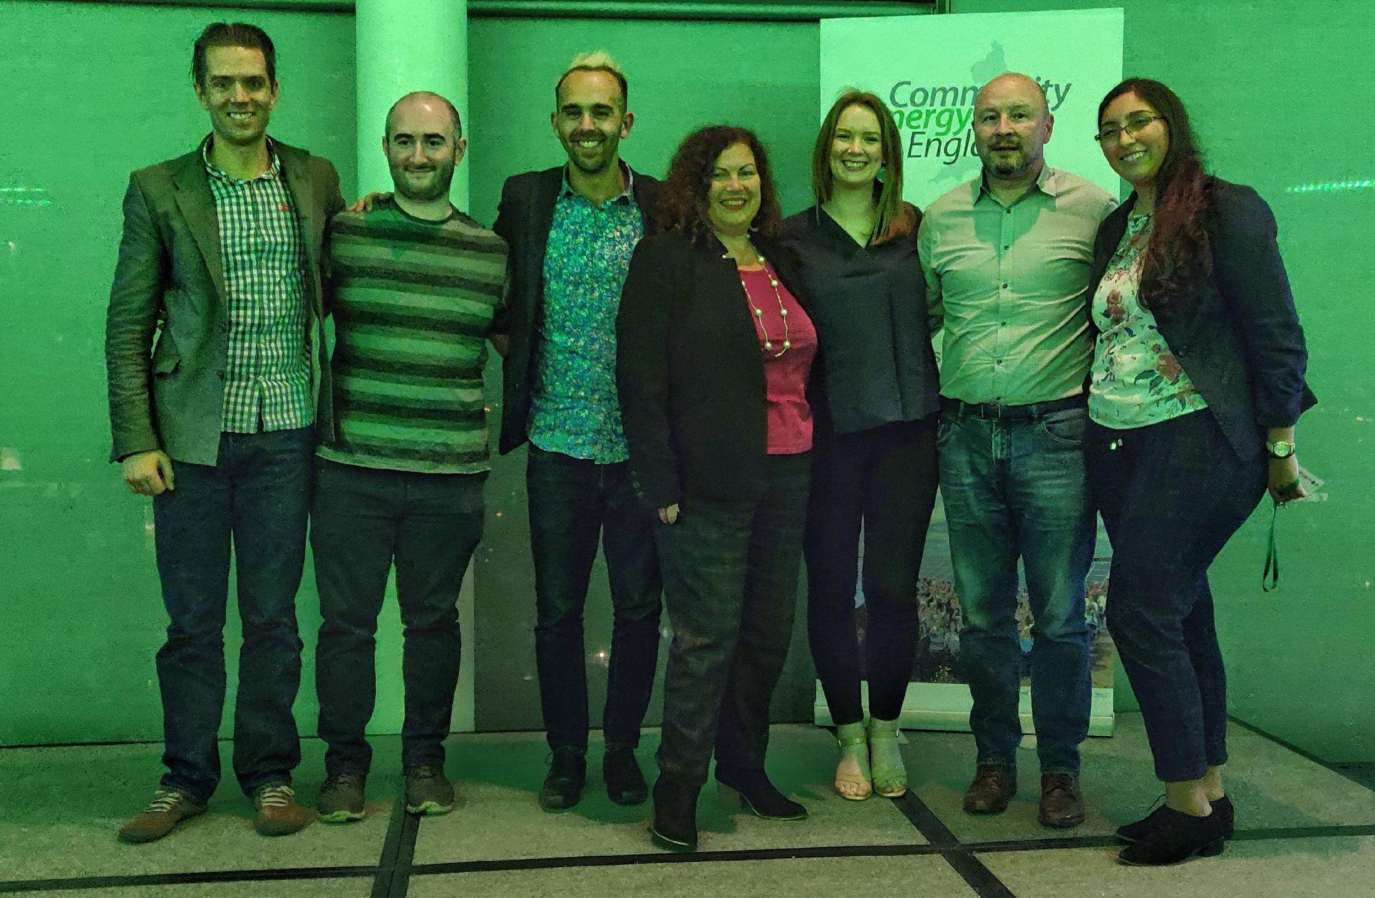
Who are CREW Energy
CREW Energy is a SW London bencomm trying to make London a greener and fairer place to live and work.
2017: First project was LED lighting at DRCA in Battersea.
2018: A building management system and LED lighting at Devas Club. CREW Solar collective purchase domestic scheme.
2019: 3 ICEF projects with BMS, heat transfer solutions, solar PV and storage and LED lighting.
2020: £100k of Next Gen funding to develop community owned renewable heat projects. Two sites in the pipeline.
Notes:
CREW has experience of delivering retrofit projects that help businesses undertake energy-saving initiatives, that they would otherwise lack the experience, skill, capacity and finance to undertake individually. This has resulted in operating cost savings, available to recycle into direct service delivery, as well as saving carbon emissions
Through our fuel poverty and energy transformation work, we help Londoner’s reduce their carbon emissions and energy bills creating more resilient and environmentally aware communities

Slide 3
Next Gen Fund
Power to Change have funded 11 groups to develop the next generation of community energy models.
Solar, Storage and Trading | Gloucester CEC | Lockleaze loves solar
Renewable Heat | Green Fox | CREW Energy
Green Homes | Burnside CE | Plymouth Energy Community
EV’s and Charging | Brighton Energy Coop | Nadder CE
Flexibility | Bath and West CE
LED lighting | Chester CE
Data | Carbon Coop

Slide 4
So it is not just about solar
LED lighting- Perhaps the most straight forward to model and delivery.
Save 50-90% energy compared to traditional bulbs.
Reduce O&M costs as running hours are 6-30 time longer.
Building Management Systems(BMS)- allowing buildings to time and zone their heating requirements.
Typical saving of 25%.
Ability to monitor things like CO2 and moisture to keep buildings healthy.
Insulation
Quicks wins like loft insulation
Solid wall is harder but innovations are on the way.
Heat transfer Solutions- we are working with a product that reduces energy consumption by 20%+

Slide 5
So it is not just about solar
Energy Assessments- CREW is training two people to be DEAs and one to a NDEA.
EV charging- BEC are about to install 10 points at Brighton Uni.
Car clubs- Nadder Community Energy in Wiltshire.
Community Land Trusts- Plymouth Energy is working to delivery community lead net zero carbon housing.
Flexibility Services- BWCE has partnered with Stemy Energy to offer behind the meter solutions to local their Local DNO.

Slide 6
Next Gen and heat pumps
Our project aims to delivery in three areas:
Heat pumps to civic and commercial buildings
Heat pumps to blocks of flats
Heat pumps to domestic clients.
Innovations:
Heat shifting to optimise pricing and CO2 emissions and to provide DSR.
Heat metering to minimise credit risks and to support the economics of a project.

Slide 7
Community Energy
Community Energy is a about learning, sharing and partnerships- so don’t be afraid to ask for help.

Slide 8
Contact CREW Energy
Email
Toby@crewenergy.london
Web
www.crewenergy.london
Social Media
@CREWEnergyLDN

