Slide 1

Community Energy in a Community Emergency
City Hall London Thursday June 2019

Slide 2

Community Energy Action in Camden Tanuja Pandit, PUNL
27 June 2019

Slide 3


Community Energy Benefits
Reduction in carbon emissions
Discounted electricity
Community ownership
Surpluses used for other community projects
Community cohesion, resilience and wellbeing

Slide 4
PUNL’s Purpose
Vision
Camden & Islington to become carbon neutral
Mission
Empowering North London residents with ownership
& understanding of clean energy generation &
reduced energy consumption through:
Investing in clean technologies
Energy awareness and fuel poverty workshops
Returning surpluses to the community
Giving our volunteers and members fulfilling and meaningful opportunities to contribute

Slide 5

PUNL Achievements
19kWp system on listed church in Highgate
30kWp system at Caversham Group Practice in Camden
LED projects and fuel poverty workshops
Developed strong relationships with Islington and Camden Council Energy teams
The project pipeline is strong with 7 pre-registered sites of which we expect 3-4 will complete before 31 March 2020

Slide 6
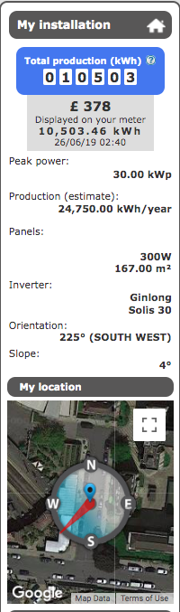
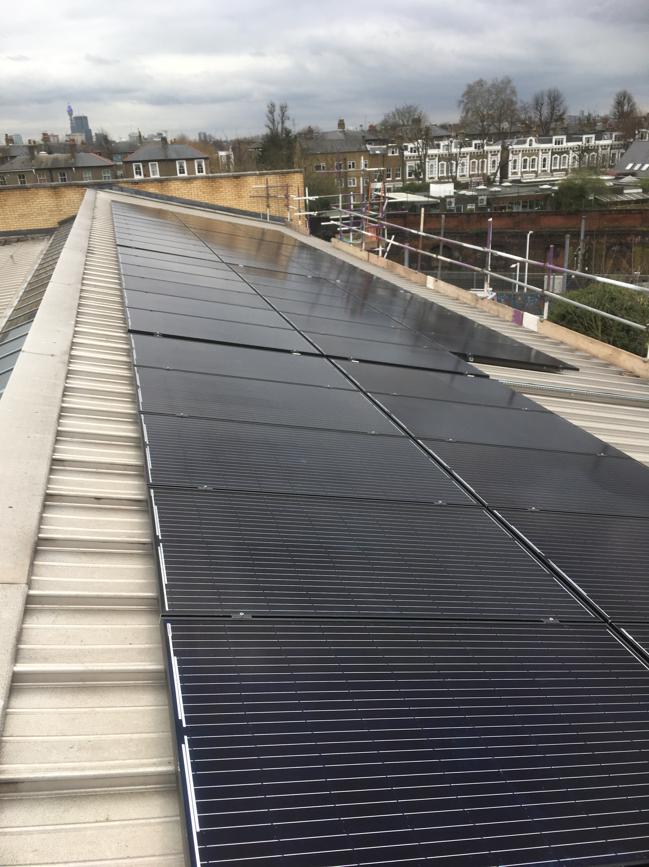
Caversham PV Solar - installed and commissioned on 22 March 2019
Carbon savings @ 26th June
> 3.7 tonnes

Slide 7
Pipeline of PV Solar Projects
Project | Borough | Estimated size in KWp | Status
Elizabeth House Community Centre | Islington | 10kWp | Installation/Self-funded
Lux & Kentish Town City Farm | Camden | 35kWp/11kWp | Passed feasibility/legal issue re lease@Lux & seeking grant funding at KTCF
Muswell Hill Golf Club | Haringey | 30kWp | Detailed feasibility underway/Pre-registered for FiT
Kentish Town School | Camden | 34-50kWp | Pre-registered for FiT/Seeking approval from school and governors; seeking funding for feasibility grant
Hampstead School | Camden | 50kWp | Initial feasibility/Pre-registered for FiT/Seeking feasibility grant
Haverstock School | Camden | 50kWp | Initial feasibility/Pre-registered for FiT/Seeking feasibility grant
Kilburn Grange School | Camden | 30kWp | Initial feasibility/Pre-registered for FiT/Seeking feasibility grant
Morepeth School | Bethnal Green | > 50kWp | Initial feasibility
Paradise Park Childrens’ Centre | Islington | c.7-10kWp | Applied to ICEF for PV solar feasibility and efficiency measures with XCO2
Dixon Clark TMO | Islington | c.20-30kWp | Applied to ICEF for PV solar feasibility, private wire feasibility and efficiency measures with XCO2

Slide 8
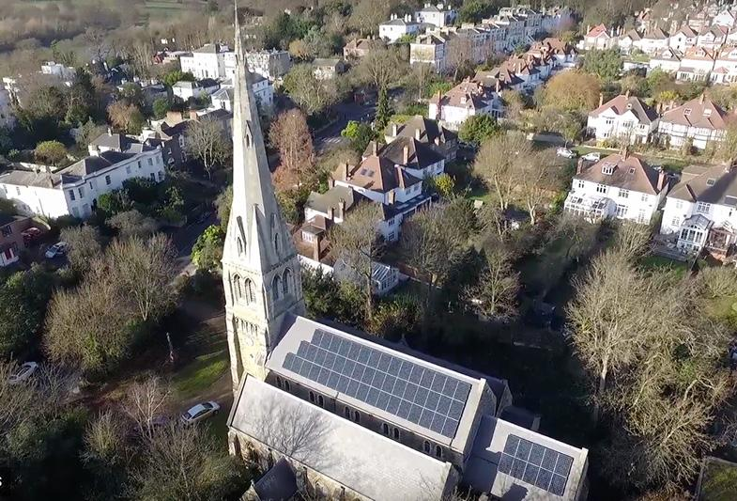
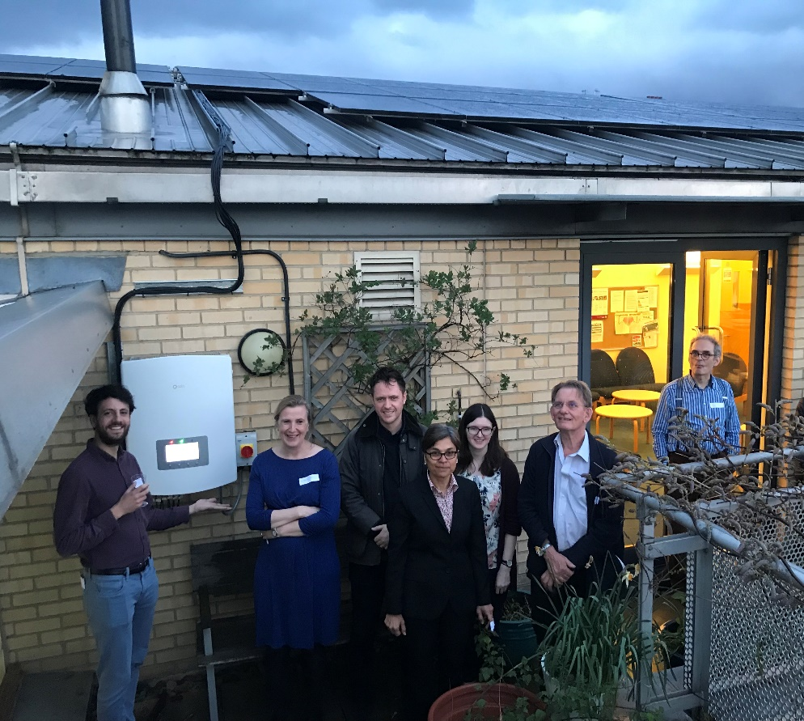
St Anne’s Church,
Highgate
Caversham Group Practice,
Camden
Notes:
In 2016 PUNL installed a 19kWp system on the south-facing roof of St Anne’s. a Grade II listed church in Highgate. We had a grant for the feasibility study and raised £30k of community funding through a share offer.
As you can imagine the daytime consumption is low but the purpose of this project was to leverage more daytime community activities with provision of renewable energy and to serve as a signal to the community about the benefits of renewable energy.

