Slide 1

Community Energy in a Community Emergency
City Hall London Thursday June 2019

Slide 2
Welcome
Syed Ahmed, Chair
Community Energy London

Slide 3
Community Energy London
Network of around 30 groups active in the development of community energy projects around the capital
Monthly meetings held at City Hall – regular briefing events and workshops
Member network, collaboration and ‘hand-holding’ new groups
Working in partnership with Greater London Authority (GLA) on the London Community Energy Fund (LCEF) - £400,000
Local authority carbon offset funds – community energy capital support programmes
CEL seeking further funding over 2020/2021 to expand activities to support community energy growth in London
www.communityenergy.london
New CEL Officer – Hannah Short

Slide 4
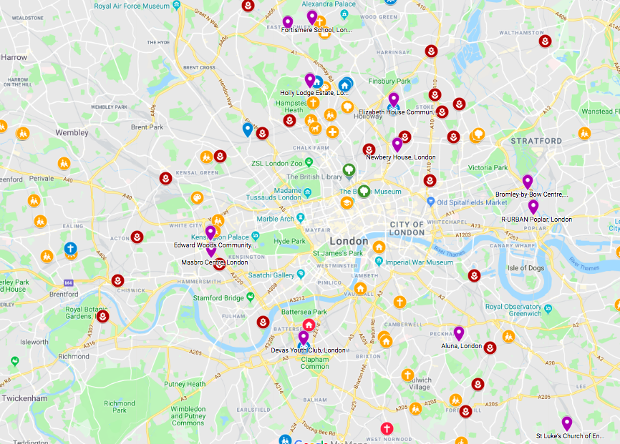
CEL Project Map – www.communityenergy.london

Slide 5
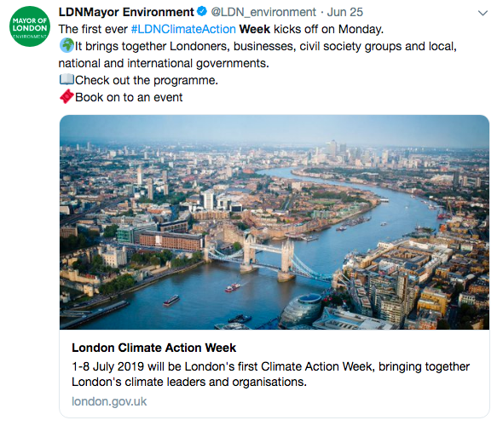

Slide 6

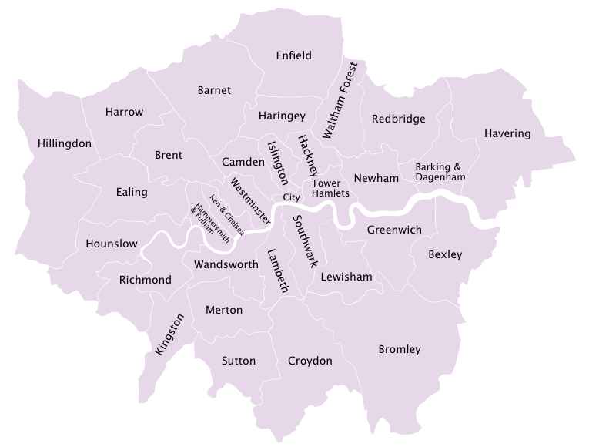



Community Energy in Climate Emergency: Taking Action in
North-South-East-West London
2 July Haringey
4 July Kensington
4 July Kensington
1 July Tower Hamlets
2 July Walworth
Full details of all events at www.communityenergy.london

