Slide 1
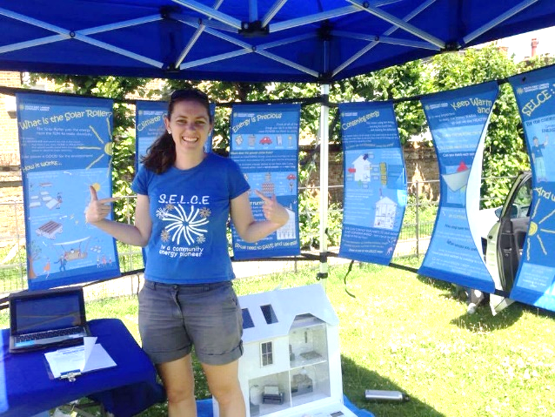
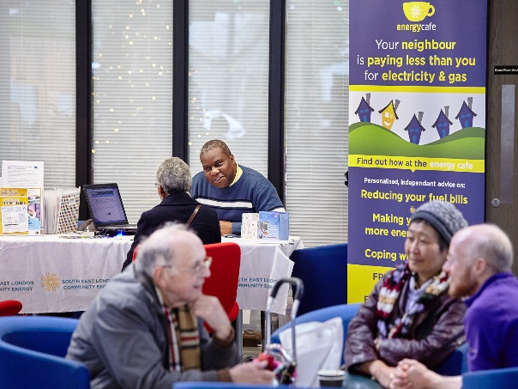
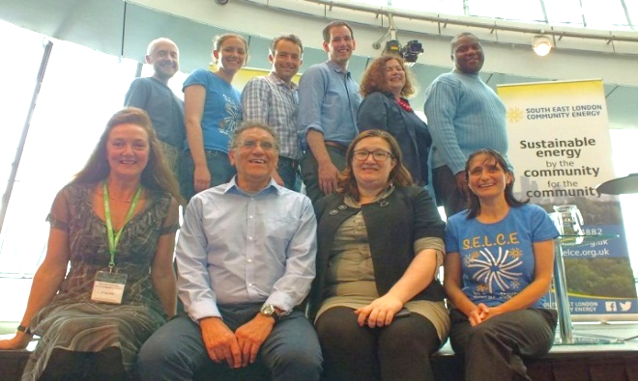
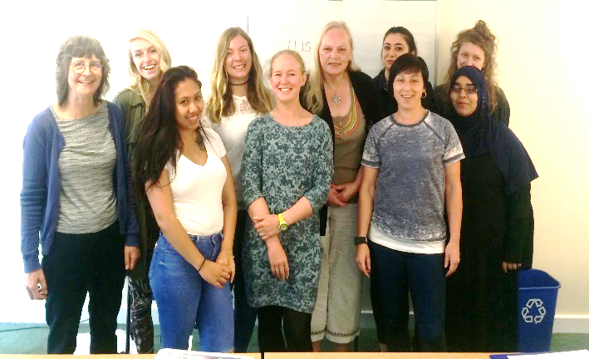
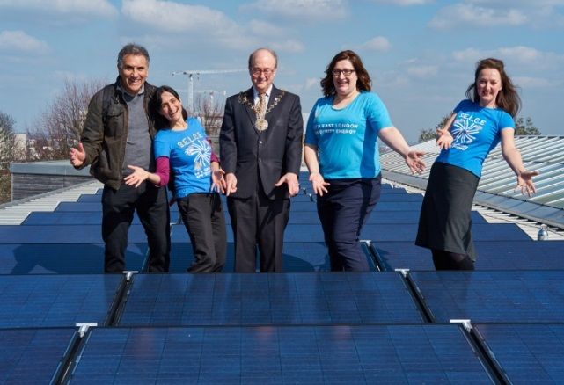







South East London Community Energy: an exemplar of social innovation

Slide 2
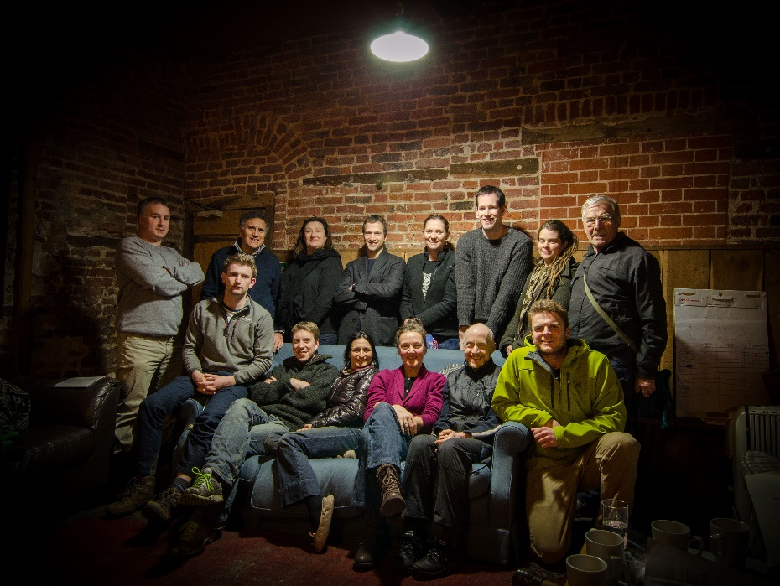
Origins

Slide 3
About South East London Community Energy
We are a group of skilled Greenwich and Lewisham residents who share a vision;
A low carbon future in which everyone can access affordable energy to meet their needs and a has voice in how that is produced
The first public meeting was in March 2014 followed shortly after by the first directors’ meeting
We registered as a Community Benefit Society in June 2014
Over 7000 volunteering hours thus far

Slide 4
Vision and Mission
Our Vision
A common vision for the energy future of South East London brought the founder members together. That vision is of a sustainable energy future where energy is generated from renewable sources and used efficiently. A future where everyone has access to the energy they need at an affordable price, and has a voice in how it is produced.
Our Mission
We collaborate with local residents, businesses and organisations to reduce fuel poverty, and develop financially, socially and environmentally sustainable projects which increase energy efficiency, produce local renewable energy, and accelerate the transition to a low carbon energy generation system.

Slide 5
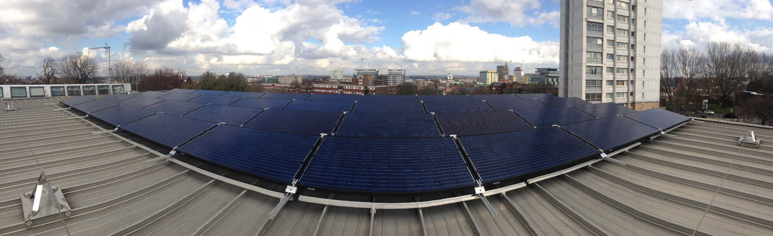
Innovation in Renewable Generation

Slide 6






SELCE raises £369,000from investors through a Community Share Offer
This is used to purchase 329kWp of solar panels go on 7 local schools,
The returns from The Feed in Tariff allow SELCE to
Repay investors with a 4% return
Pay for maintenance, repair and insurance
Put a small fund aside for fighting fuel poverty in SE London
£
The Schools will purchase solar electricity from SELCE at less than half the cost of electricity from the grid
Any surplus electricity is exported to the grid and sold to an electricity supplier.
A government subsidy known as the Feed in Tariff is paid to SELCE for every unit of electricity generated (regardless of whether it is used by the school).

Slide 7

Our projects to date
Share Offer 1
Mulgrave School 49.5kWp
Charlton Park Academy 49.5kWp
Horniman School 49.5kWp
Ashmead School 49.5kWp
Share Offer 2
Alderwood School 49.5kWp
Deansfield School 49.5kWp
Bannockburn School 29.5kWp

Slide 8

Benefits
Our panels generated a total of 229,747 kWh. This is enough to power almost 75 homes.
This means 80.4 ktonnes of CO₂e have not been emitted into the atmosphere.
The schools have saved over £13,000 in reduced electricity costs.
Local residents made a small return on their investment and benefitted from the warm fuzzy feeling

Slide 9
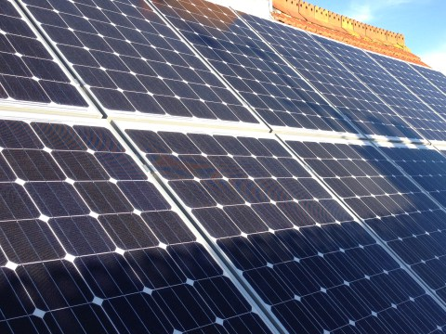
Social Innovation
It enables involvement
Low cost finance
Ability to engage residents in controversial propositions
Use of community sector strategies to engage sites that could best benefit
Reaches the parts that the commercial sector will never reach
Much more difficult following the drop in the Feed in Tariff
Some technological innovation particularly with regard to finding ways to enable supply of residents from a single generation source
But difficult to finance technological innovation via a community share offer

Slide 10
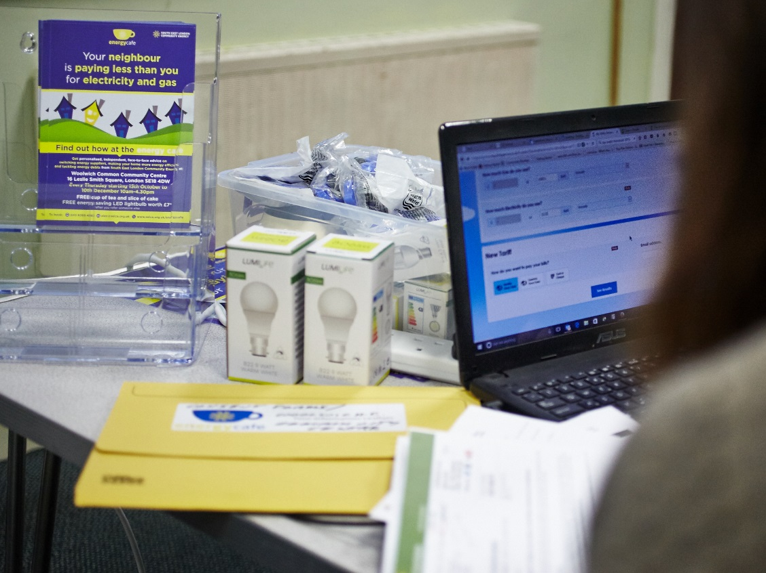
Innovation in Energy Justice

Slide 11

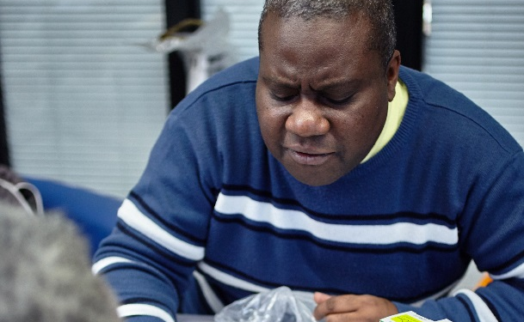

Advice, Workshops, and Training
Use of community sector strategies finding new ways reach the fuel poor and enable the best support for the least funding. Last winter:
Energy Cafes: 280 energy café clients
Workshops: money saving tips to 479 people at 35 workshops
Front- line Worker Training: Awareness raising for 213 front line workers at 20 training sessions
Working as part of a SE London partnership that includes Charlton Athletic Community Trust, Thinking Works, Groundwork London to deliver a wrap-around service
£197,477 of funds for tackling fuel poverty brought into the borough

Slide 12



Parent Power
Parent Power is an innovative programme that uses the intelligence that exists in the school community to identify households in extreme fuel poverty in order to provide tailored peer- lead assistance to them designed to engage the most vulnerable households.
visited 115 low income families in their homes,
providing tailored advice
fitting 782 energy and money saving ‘light measures’.
led by a parent who previously volunteered to support the Parent Power project and who gained a professional qualification in domestic energy advice.

Slide 13
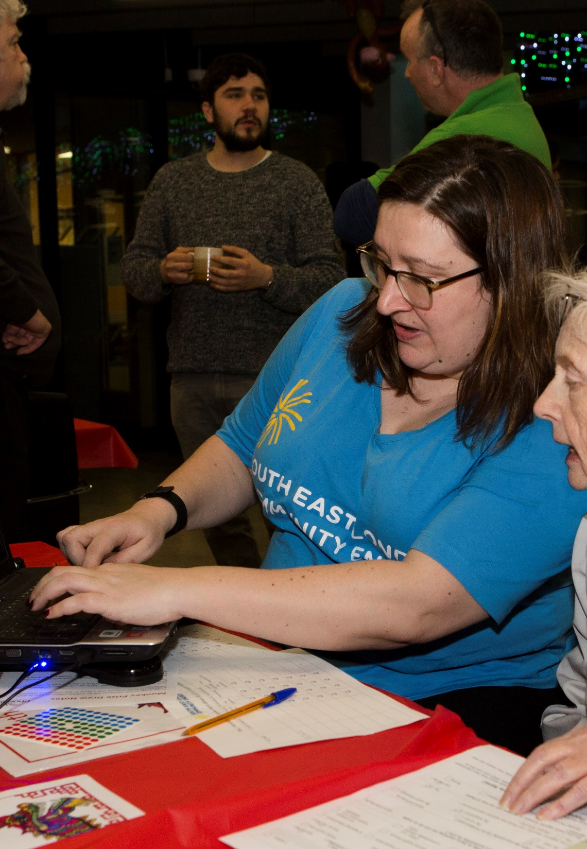
Outcomes
Identified £142,163 in financial savings during advice sessions spread over 3 subsequent years
49 switched energy provider during advice session each saving an average of £279. 227 clients pledged to switch following advice session
55 applications to the Warm Home Discount or 44 to Watersure
Supported 32 clients in debt

Slide 14
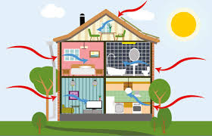
Innovation in Energy Efficiency

Slide 15

ECO Project
Aims to enable Lewisham residents living in fuel poverty to access fully funded energy efficiency measures
3 Partners
Retrofit Works: Contractor who does the work
Selce: Identifies people eligible for funded measures
Lewisham Council: Funds pilot phase of the project and makes ECO flex declarations
Ultimate goal: Self sustaining business model. RW gives Selce referral fees and that enables Selce to continue to employ someone to generate and process leads
So far, a total of 173 households have benefitted from money and energy-saving measures. These include loft and cavity wall insulation, replacement boilers, under-floor insulation, internal wall insulation and ventilation systems. A pipeline of 139 households is set to benefit from work in the coming months.
We are confident that this provides an innovative model for community action to meet our core aims of combatting climate change and tackling fuel poverty through a self-sustaining social enterprise model.

Slide 16

Future Fit Homes
A service for people who are ‘able to pay’ for energy efficiency improvements and who need support with the retrofit process
Working in partnership with Retrofit Works (a cooperative of local contractors)
Provides a range of services including
A home energy audit. Simple or Full
Retrofit Coordination (project management of retrofit process) and referrals to a vetted local contractors
Thermal imaging of home
DIY and Info workshops
A team of Lewisham Champions trained
Interested? Contact eliza@selce.org.uk

Slide 17
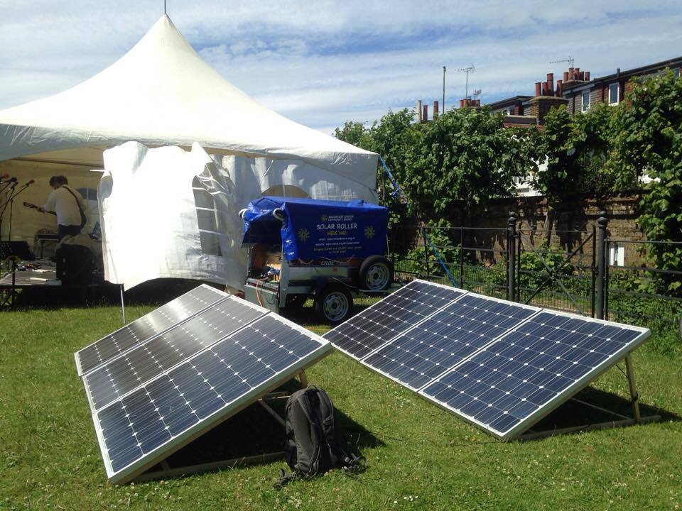
The Solar Roller: A mobile, solar-powered generator

Slide 18

Collective Purchase
11 residents signed up to ‘Collective Purchase’
Partnership with CREW

Slide 19
Summary
There is an assumption that transforming the energy sector is a question of creating the right policy environment
There is always a need enable the most vulnerable in the community to benefit.
There is always a need to reach the parts that the commercial sector cannot reach
We work best in partnership – invite us to be part of your journey to a smart, distributed, low carbon energy system

Slide 20

South East London Community Energy
020 8269 4882
Giovanna@selce.org.uk
www.selce.org.uk

