Slide 1







RetrofitWorks:
Retrofit at scale and the role of Community Energy
27th June 2019

Slide 2
The key ingredients to retrofit at scale:
Every home renovated to high performance
Target standard up for debate
Every person that lives in or works in a home must have access to accurate knowledge
Every lead/opportunity is pounced on
Joined-up services/comms - public/private
Whole House Plan
Exceptional execution (towards the WHP)
Exceptional service
Meaningful national campaigns to raise profile of retrofit

Slide 3
Challenges in the retrofit of a single home
Retrofit strategy (whole house)
Detailed design
Budget
Simple economic payback?
Need to reduce this payback
(Finance?)
Procurement / value for money
Translating design for the contractor
Communication between all parties
Cost control
Quality Assurance
Warranties and Guarantees
Operation and Maintenance Guidance
(Performance feedback)
the offer
No retrofit expert on the team
All jobs should be reviewed

Slide 4
Trust
Impartial
Biased
Energy Audit
Specification
Finance
New Layout Design
Planning
General
Contractor
Process Management
Doing
Training
Specialist Installer
Measuring
Work Quality
Self Certification
House Performance
Notes:
All elements of the retrofit process must ‘sing’ such that minimum spend occurs and maximum saving is achieved. All parts must work together in terms of technical know how and process management.
Be aware of the bias line – it does exist – if you tell people which side of it you are on they

Slide 5





There is no market for ‘retrofit’……..
Customers
The offers are narrow and unattractive
Not aware of measures and benefits
No confidence in supply chain to deliver
Advocates
Practitioners
Local Charity
/ Council etc
Want to drive change
Struggle to identify customers
No defined, reliable, local supply chain
Local economy?
Have the capabilities but limited confidence in the market
Don’t invest
Don’t promote
Could use some help to deliver
Finance
Needs confidence in outcomes and ability to deliver to invest

Slide 6
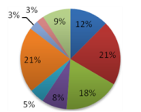
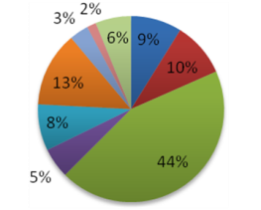
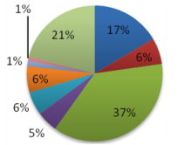
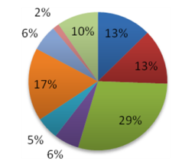
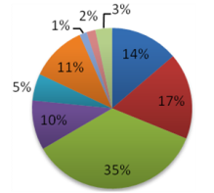
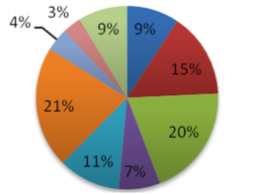
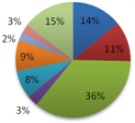
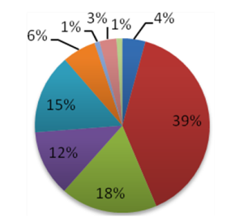
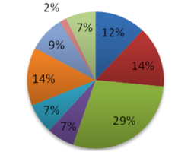
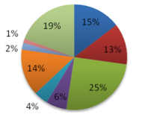
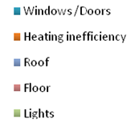
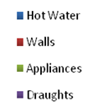
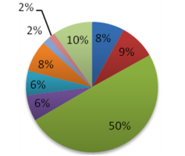
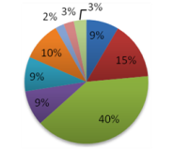
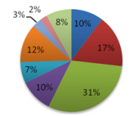
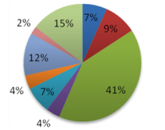
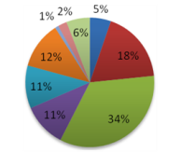
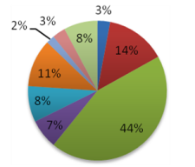
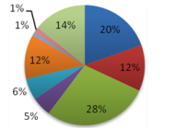
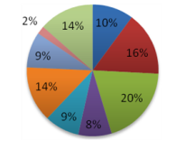
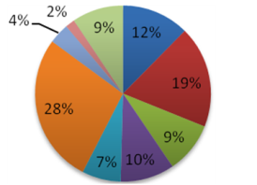
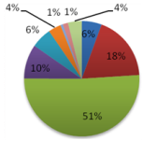
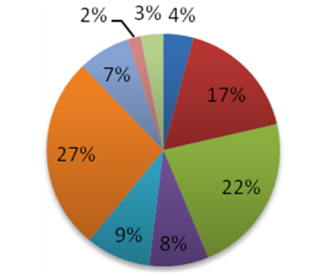
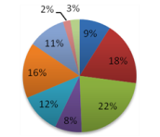
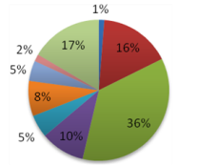
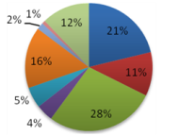
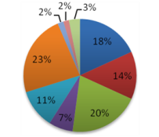
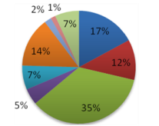
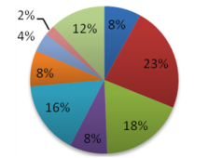
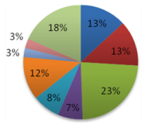
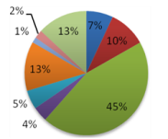
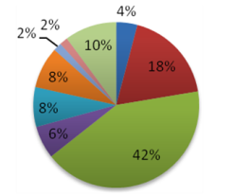
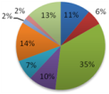
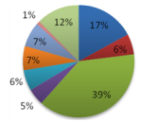
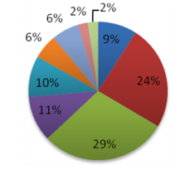
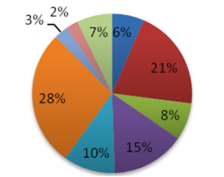
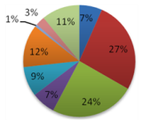
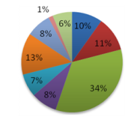
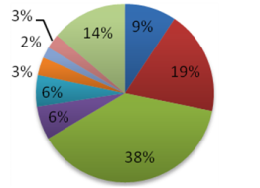
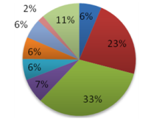
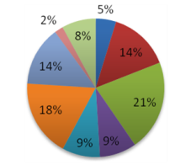
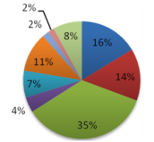
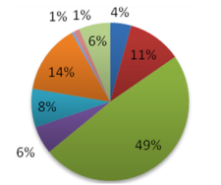
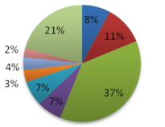
Every home is unique

Slide 7
RetrofitWorks Model inception – ‘Bottom up’

Slide 8
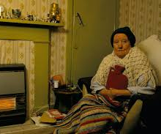





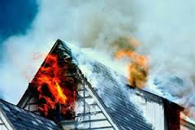
Model components
Buildings
Clients
Advocates
Local Charity
/ Council
Architect
Lettings Agent
GP
Social Worker
Green
Group
Online tendering portal
Access to finance and grants
CPD / Training
RetrofitWorks machinery
% payment agreed by all
Practitioners
Vetted Supply Chain

Slide 9




The role of Community Energy Groups

Slide 10
Member Roles
Functions in the Customer Journey
Service Navigator
Watcher
Approver
Retrofit Coordinator
Energy Assessor
Installer / other delivery aspect
Advocates
Feed in leads
Retrofit Scheme Host
Practitioners
Seeking work through the cooperative
Seeking support
Can bring customers for work they cannot deliver

Slide 11

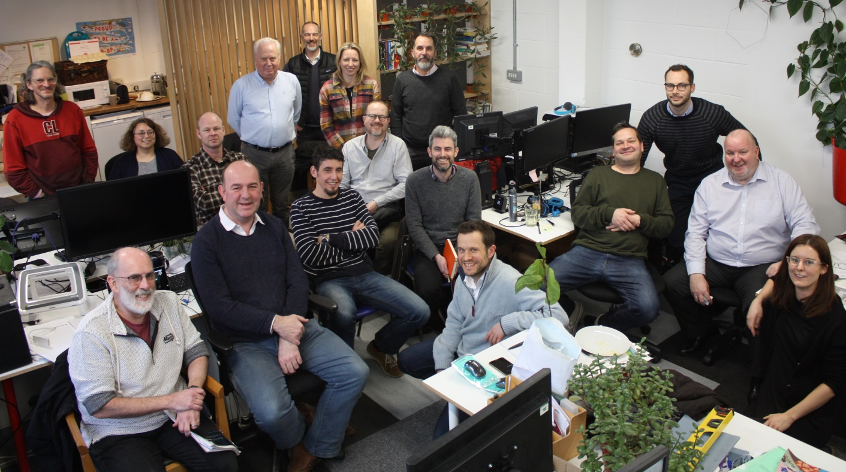
The Retrofit Coordinator
The custodian of the truth
Energy competent
Design expertise
Commercially savvy
PAS 2035

Slide 12
Customer journey:
Retrofit Coordinator
Advocate
Deliverer
Approver
Watcher
Council
RetrofitWorks
Practitioner Members
3rd Party Adviser?
ECO Provider
Council
Generate a lead
Generate a lead
Generate a lead
Assign Retrofit Coordinator
Assign Retrofit Coordinator
Energy Assessment
Energy Assessment
Energy Assessment
Variants are many, inc.:
The Advocate taking on some of the management and technical roles
Other community orgs acting in this capacity
Practitioner members bring existing customers
Pricing Survey
Pricing Survey
Estimated prices, range of Member companies
Estimated prices, range of Member companies
Select Member companies to tender
Select Member companies to tender
Member visit site, final quote
Member visit site, final quote
Retrofit review
Retrofit review
Retrofit review
Select delivery team
Select delivery team
Input work programme
Input work programme
Records uploaded as required
Records uploaded as required
Approve
Approve
Audit

Slide 13
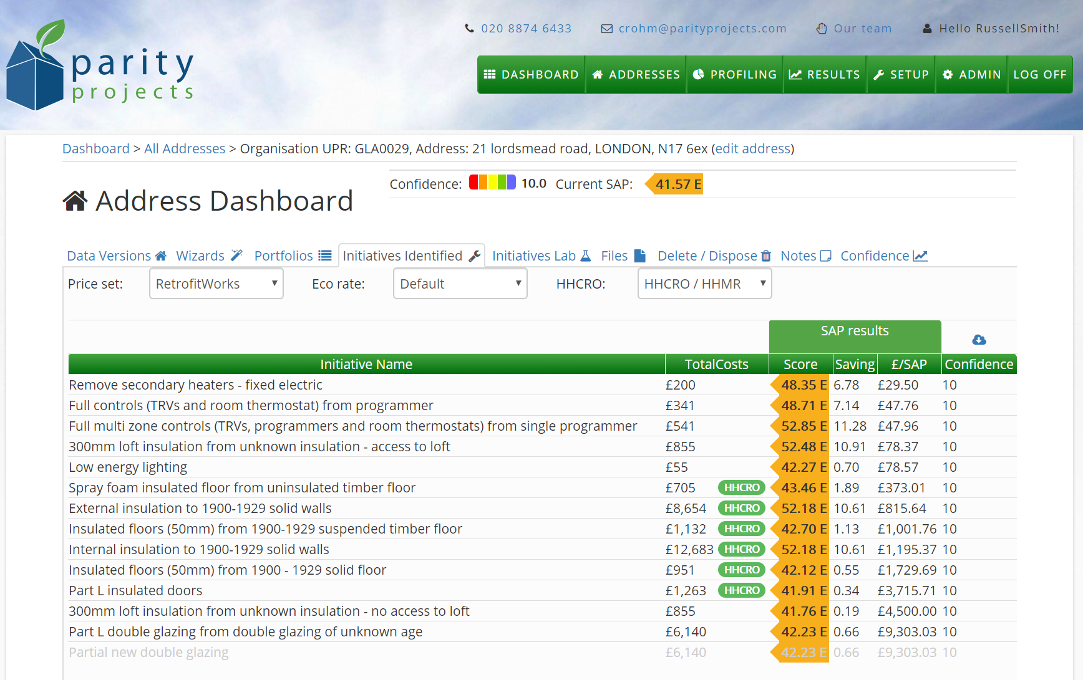
Customer journey: the energy bit
Generate a lead

Slide 14
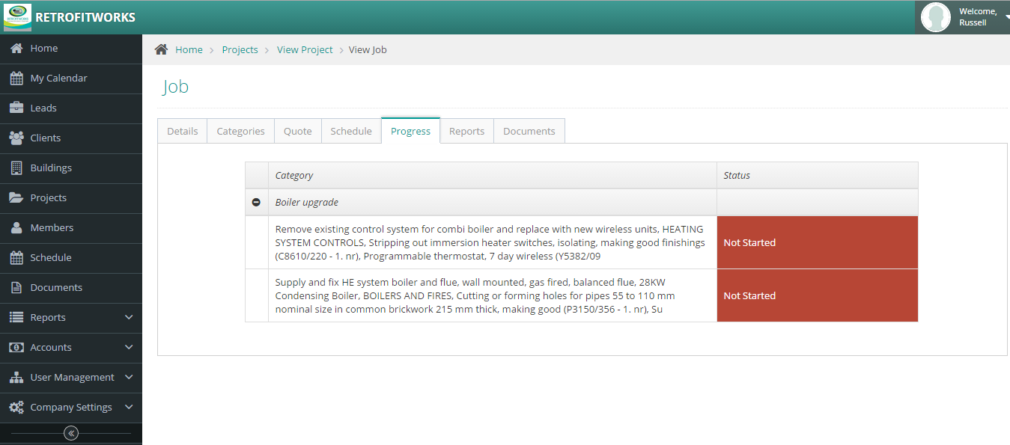
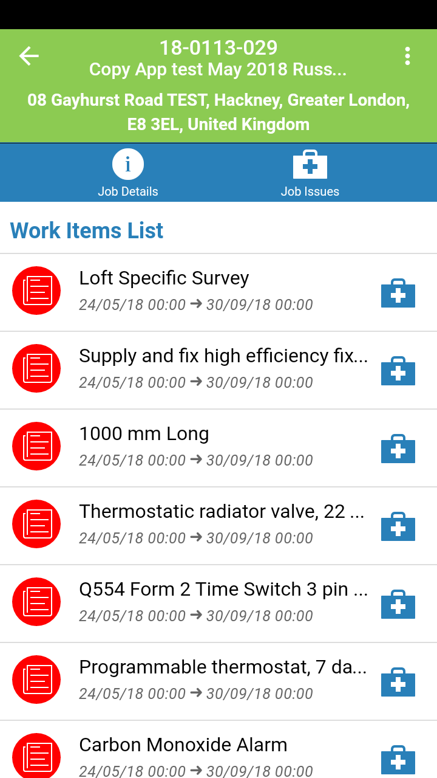

Smart phone app:

Slide 15
Eligibility:
Affordable Warmth criteria under ECO
or Flexible Eligibility for ECO (borough specific)
For eligible households in London boroughs:
GLA has £4,000 per property available for circa 1250 homes:
Energy related measures – judgement based on analysis
Damp and indoor air quality issues can be funded in advance of energy works
We apply ECO funding first if applicable, reducing GLA input (currently running at 50%)
Some other boroughs have other funds e.g. Merton C.O.F.
>50% vulnerable customers
<5% drop out rate
Lessons transferred to A2P market

Slide 16


Slide 17











BEIS Supply Chain Pilots
Warmer Sussex
Transforming
London’s
Homes

Slide 18




Data - the buildings
Properties:
EPCs, Ordnance Survey, census, crowd sources, targeted improvement

Slide 19
Data – the occupants

Slide 20



Householder Digital Interface

Slide 21

www.retrofitworks.co.uk
info@retrofitworks.co.uk
@retrofitworks
0330 123 1334

