Slide 1
LED
Community Energy Projects
Notes:
Why LEDs make a great community energy project?
How you make the business model work?
What are the challenges involved?

Slide 2

Why LEDs?
15GW used for lighting across UK at peak time in December
29% of total UK demand (52GW)
Switching to LEDs could reduce energy demand of country by 15%
Still small fraction of total stock of lightbulbs
Notes:
Why are LEDs important?
Simple easy change, that has immediate effect, they have much longer life and do not contain mercury

Slide 3
Financial Model
Energy Services Agreement
Sell lighting not lights
Notes:
No FIT or RHI available for lighting
If the site can't afford the expense of replacing their lighting themselves then how will it be paid for
Energy Services Agreements (ESAs)
performance-based contracts
service provider agrees to finance, develop and deploy energy efficiency/renewable energy projects for clients without any upfront capital expenditures
the client agrees to pay back the project costs through energy savings realized on utility bills over the ESA term

Slide 4
Financial Model
Energy Services Agreement
Sell lighting not lights
Loan paid back from portion of money saved each month
Notes:
Contract states that they must use energy efficient LEDs, not old bulbs. Also, must monitor their bills and report on savings to supplier (i.e. community group)

Slide 5
Financial Model
Energy Services Agreement
Sell lighting not lights
Loan paid back from portion of money saved each month
After end of contract term customer retains all savings
Notes:
Contract states that they must use energy efficient LEDs, not old bulbs. Also, must monitor their bills and report on savings to supplier (i.e. community group)

Slide 6
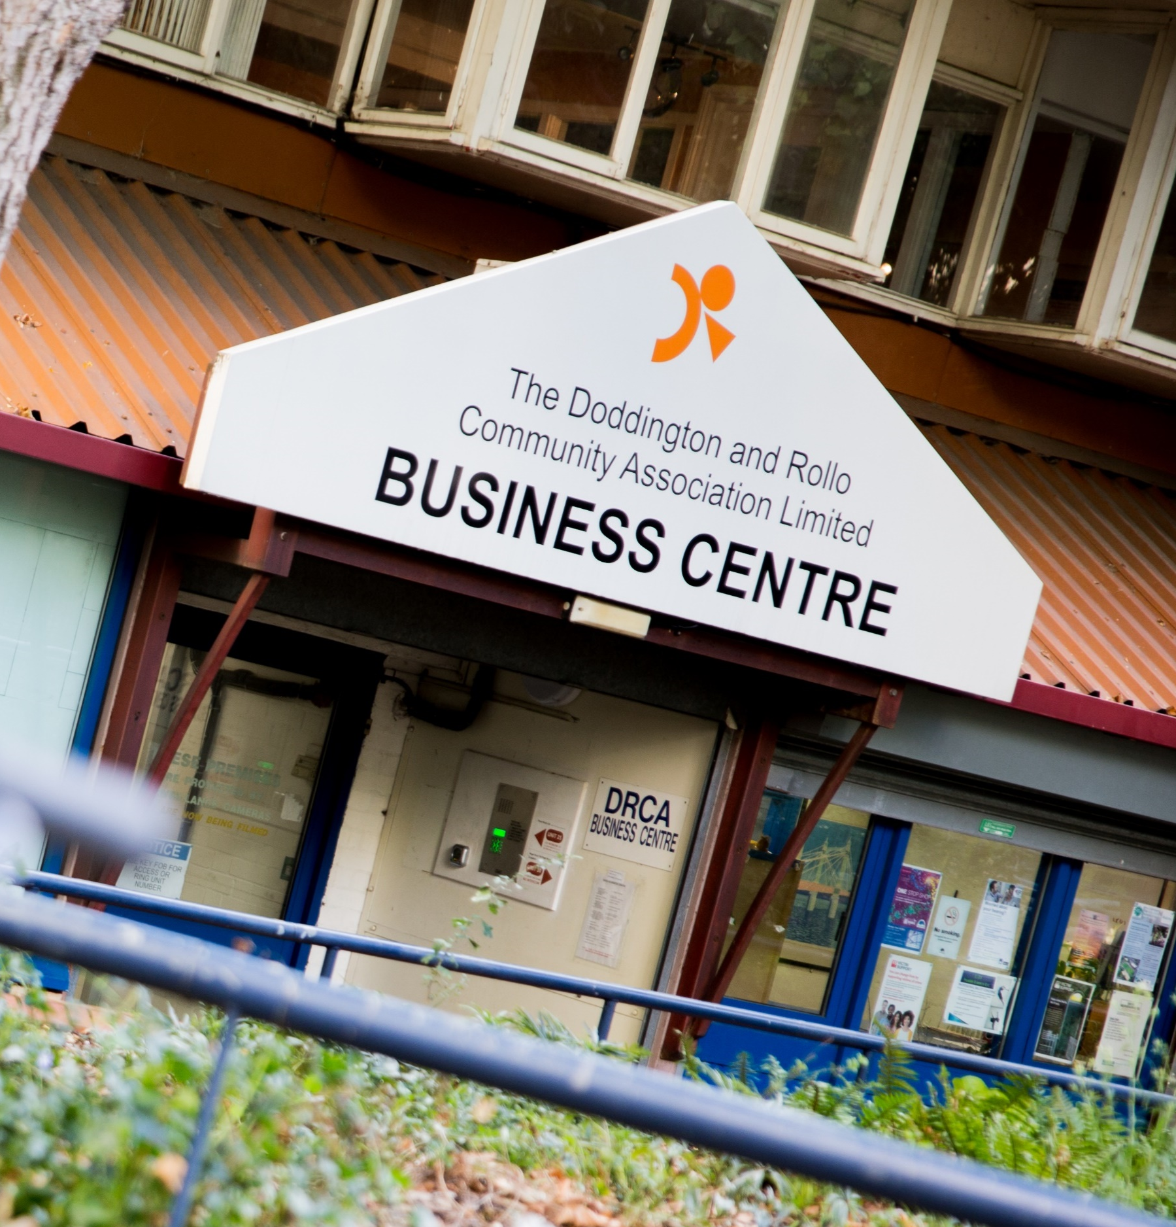
Example: DRCA
Doddington & Rollo Community Association, Battersea
Over 550 lights with motion sensors
Installation cost £22k
Reduced bills by average of £600 / month
10 year contract term
Notes:
2nd project at Devas Youth Club. Set up funded by LCEF, capital expense covered by grant

Slide 7

Advantages
Cheap
  Low capital expense
  Typically doesn’t need a share offer
Simple to install
Minimal paperwork
  Don’t need planning permission etc.
Financial model does not rely upon government subsidies
Notes:
Capital expense can be covered by loan, grant or possibly crowd sourcing donations.

Slide 8
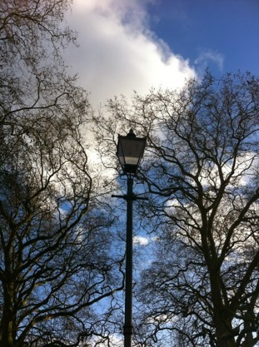
Challenges
Requires sites with large demand for lighting
  Lighting bills need to be sufficiently large that switching to LEDs generates significant savings
Custom bulbs / fittings
  Escalates prices quickly

Slide 9
Get in touch
http://crewenergy.london
info@crewenergy.london
Twitter: @CREWenergyLDN
Instagram: @CREWenergyLDN

