Slide 1


Ealing Schools Solar Programme

Slide 2

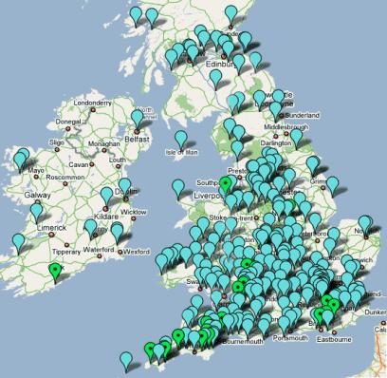
About Transition
Practical, local action on climate change, energy and food security
‘The power of just doing stuff’

Slide 3



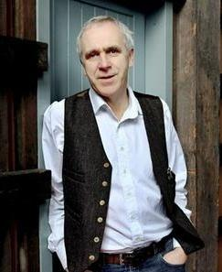


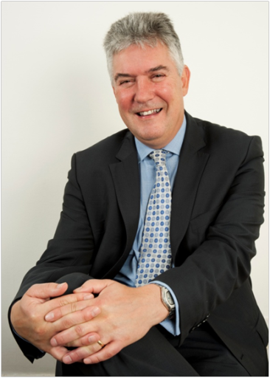

Raising Awareness

Slide 4
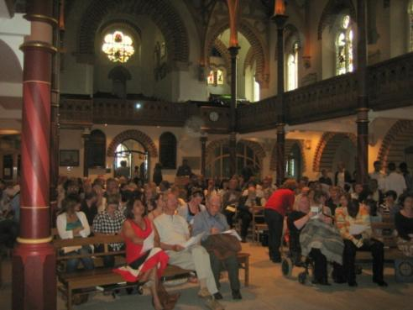
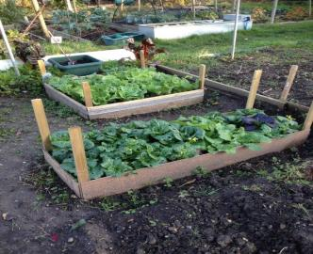
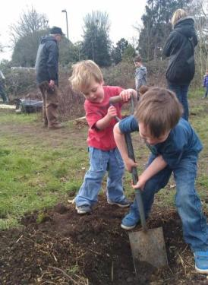
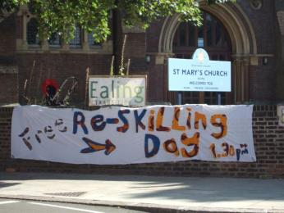
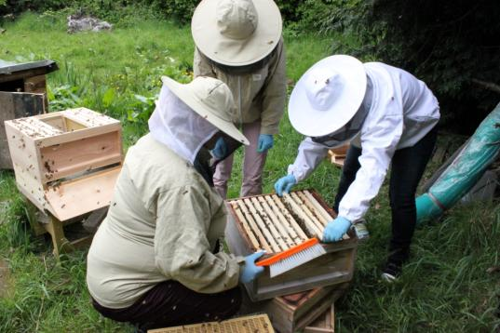
Building Community and Resilience
Reskilling events
Community Garden
Community Orchards
Community Bees
Environmental hustings

Slide 5



Ealing Schools Solar Programme

Slide 6
How it Works
3 x £15,000 grants from London Community Energy Fund programme – de-risking the exploratory phases, structural surveys etc
Share issue: £640,000 raised. Investors receive 4.5% return
Schools buy the electricity they use at circa 9p/kWh (vs typical 13p – and rising!) - fixed
Most of the power needs to be used by the school – typically we provide about a third of their annual usage
No council expenditure except small amount of officer time (sustainability, energy, schools, legal teams)
Standard legal agreements / licences with Ealing Council
Expert partners in administration, project management and installation means Ealing Transition can concentrate on community engagement, fundraising etc
SEC is the legal entity for grants. It is also not-for-profit – any surplus is shared among the schools.

Slide 7
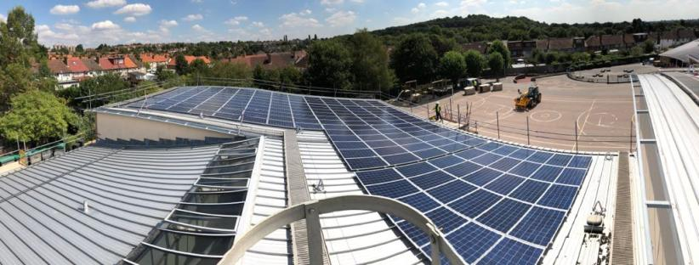
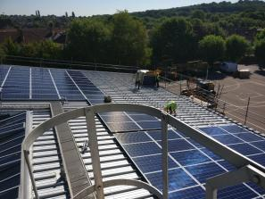
Horsenden Primary – 50 kWp August 2018

Slide 8
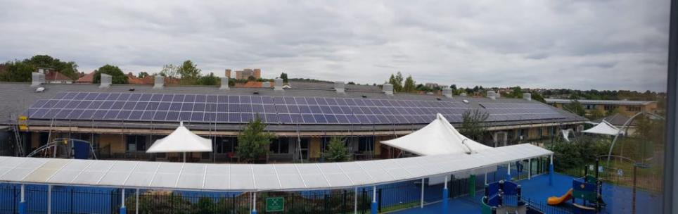
Mandeville School – 50 kWp August 2018

Slide 9
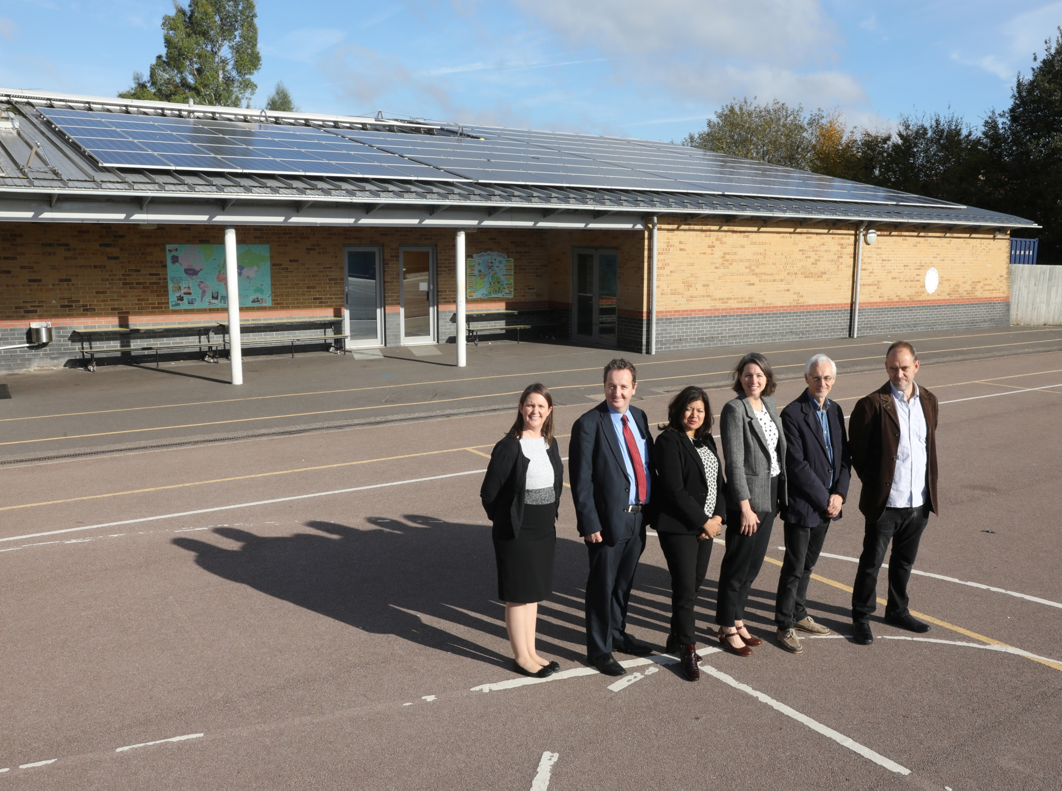

Slide 10
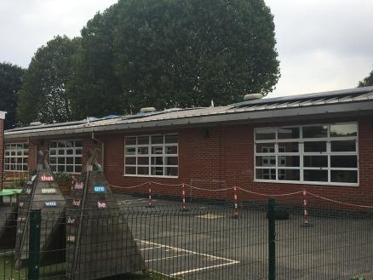
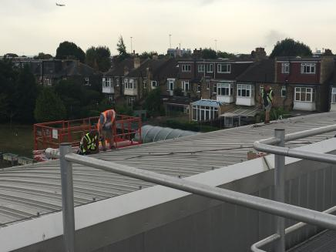
Fielding Primary – 30 kWp August 2018

Slide 11
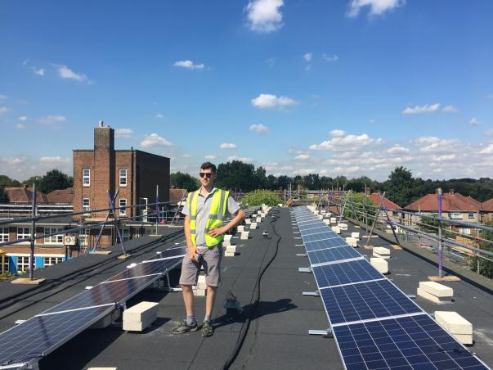
Lady Margaret Primary– 30 kWp August 2018

Slide 12
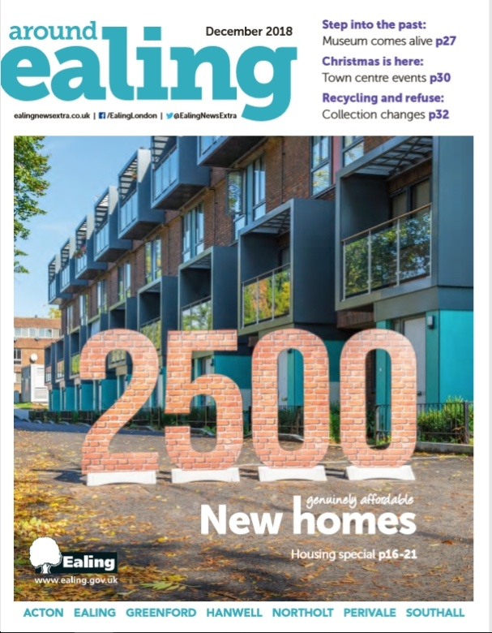
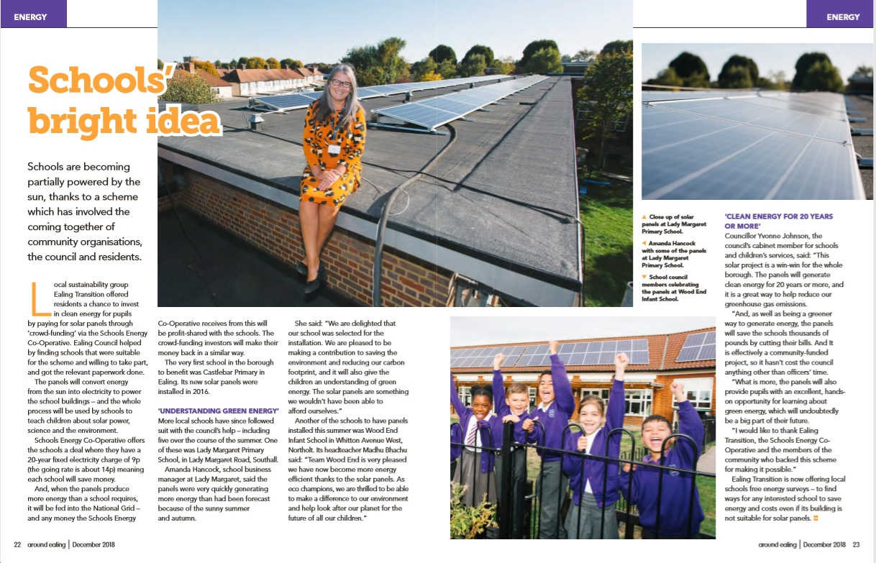

Slide 13
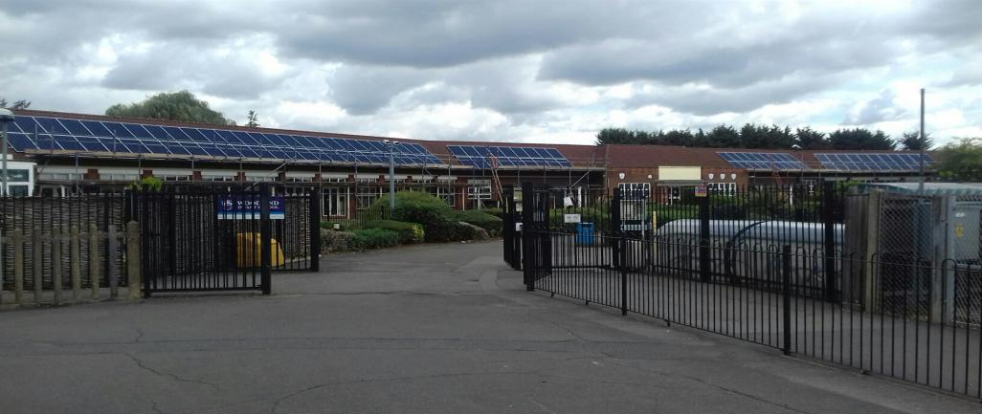
Wood End Infant– 29.7 kWp September 2018

Slide 14


Slide 15
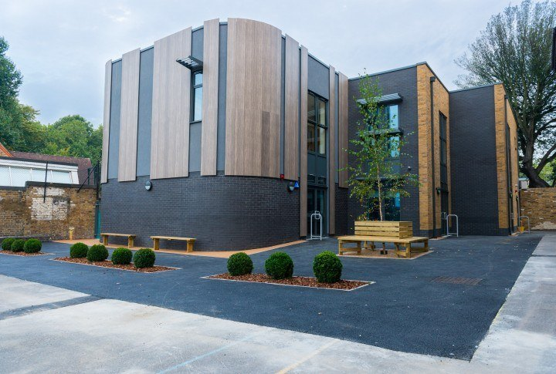
Drayton Green – 22kWp October 2018

Slide 16
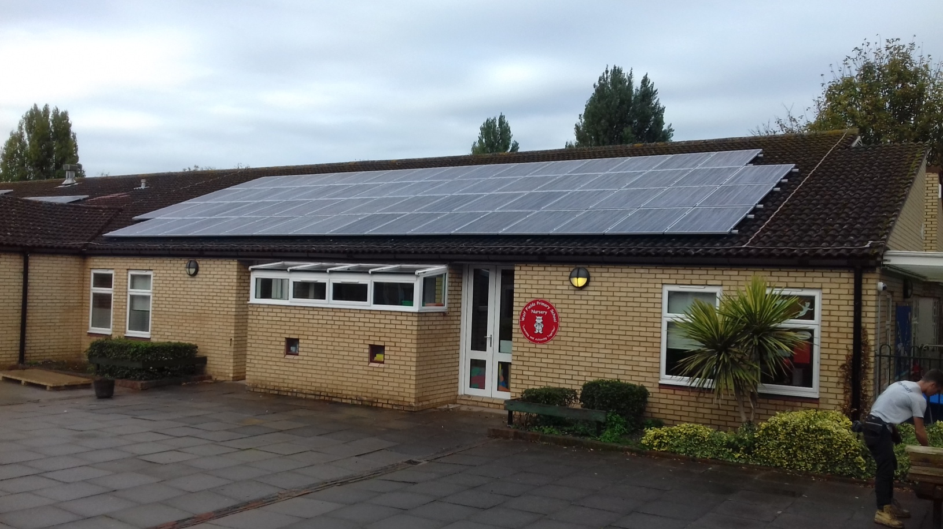
Wolf Fields - 30kWp October 2018

Slide 17
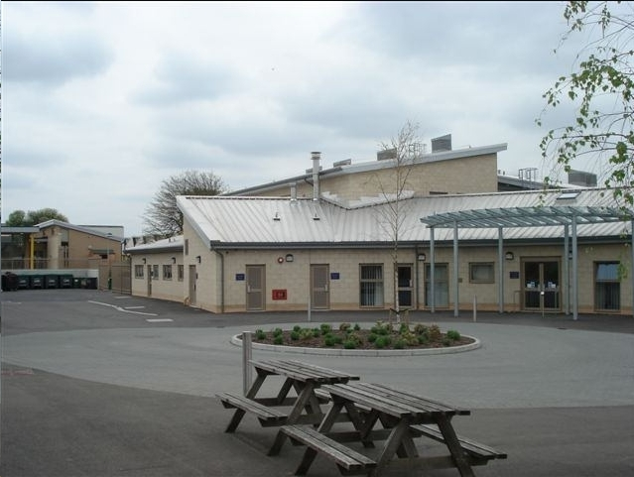
Perivale – 30kWp February 2019

Slide 18
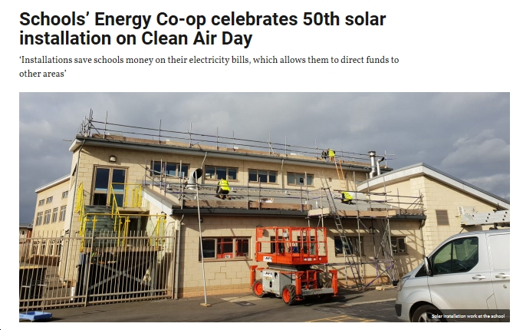

Slide 19
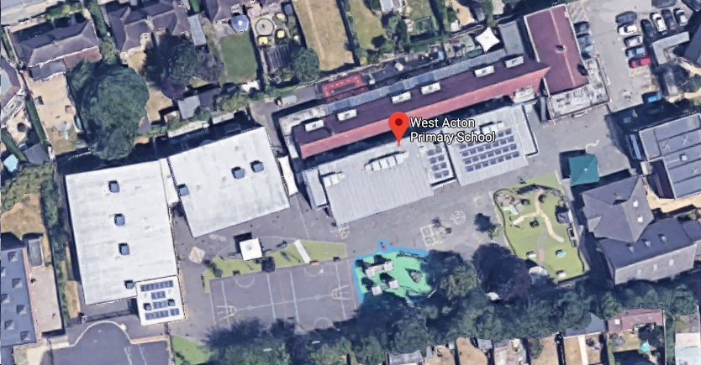
Also in Progress
7 more schools in progress: East Acton are latest to sign
Possibility of extra panels at Grange, West Acton

Slide 20
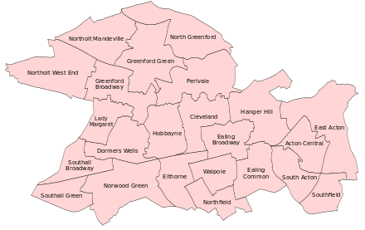

Slide 21



Extending our Reach
15 schools pre-registered across Harrow. Installation starts at Glebe late July
Now in discussion with Wiltshire

Slide 22
The End of FiT
Most of the schools we are progressing were pre-registered
Any new schools must either have an ‘easy’ roof and high daytime usage
Or will require subsidy
Or will have to pay more for electricity e.g. 12p
Or a further decline in the price of panels
Typically this could mean a £5,000 subsidy on a 30kWp system
Carbon offset?

Slide 23

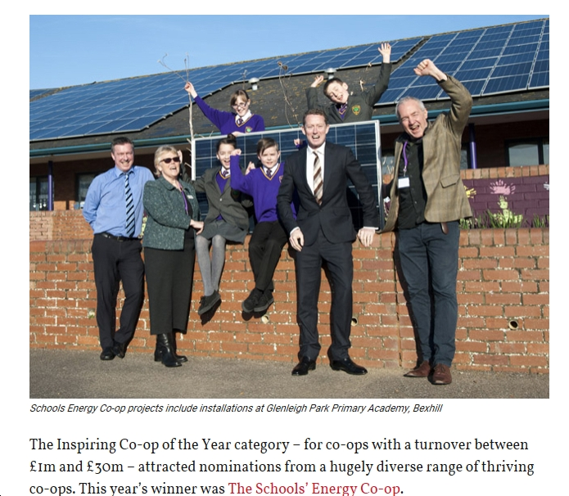
SEC 2019 Winners of ‘Inspiring Co-op of the Year’

Slide 24

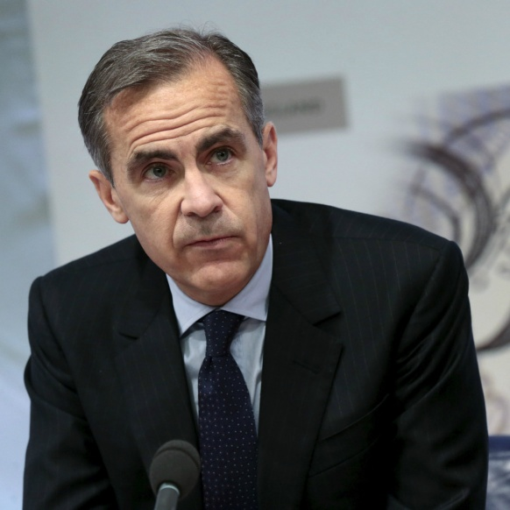
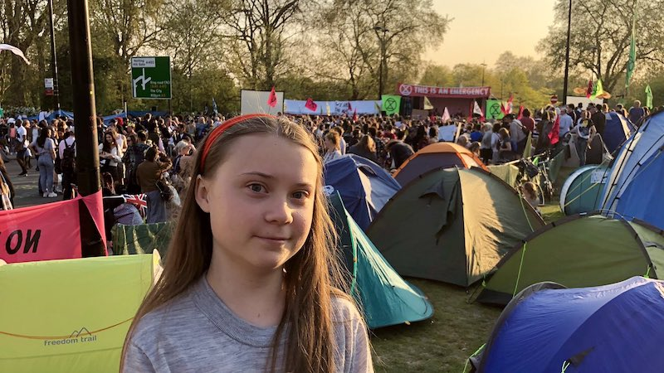
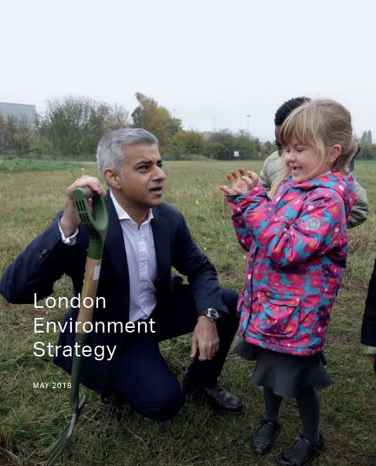
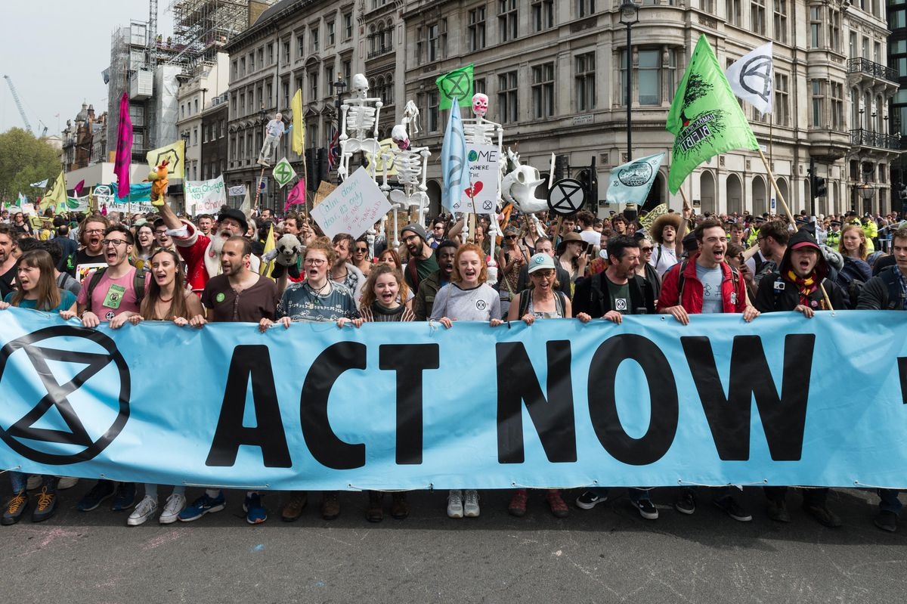
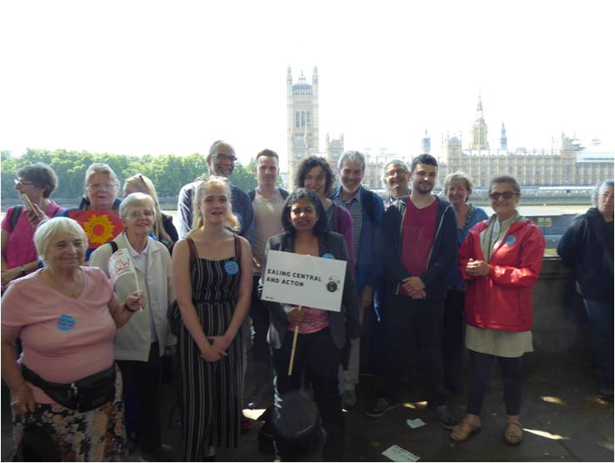
The Bigger Picture
Since this spring, things are moving quickly
The Mayor’s Environment Plan – zero carbon by 2050, 2GW solar target – is a bold first step.
Ealing Transition met Rupa Huq at The Time is Now
Following presentations by Ealing Transition, on 4th April Ealing lined up with over 100 councils nationwide to declare a Climate Emergency.
People are ready to invest in their own futures. Our approach could be scaled, rapidly.

Slide 25






We have been here before!

Slide 26
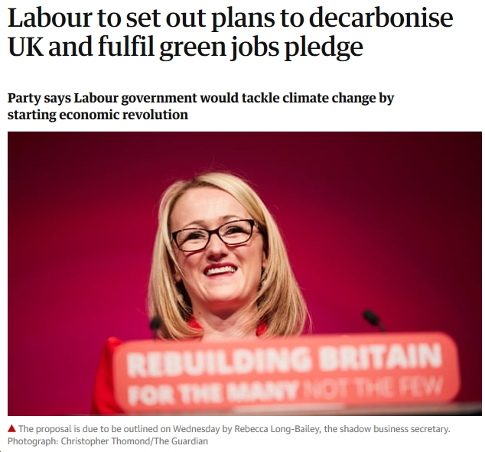

‘The Power of Just Doing Stuff’
'There are no non-radical solutions left to climate change' Naomi Klein

