Slide 1
Decentralising Energy & Communities
Community Energy London Conference 27 June 2019
@exeterepg
Catherine.Mitchell@Exeter.ac.uk
Energy Policy Group, University of Exeter

Slide 2
Net Zero
From a policy perspective, British Climate Change policy now has Net Zero language (an amendment of the 2008 Climate Change Act)
  A big, welcome step
The Committee on Climate Change set out the issues in its latest May 2019 report file:///U:/Downloads/Net-Zero-The-UKs-contribution-to-stopping-global-warming.pdf
What does all this mean for distributed energy resources (DER) and communities?

Slide 3
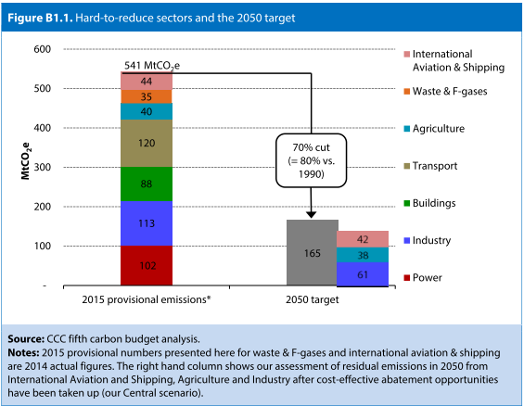
UK CCC Carbon Budgets via the 2008 CC Act – this is the CCC figure which sets out required GHG reductions to meet their Carbon Budgets prior to their May 2019 Net Zero Report

Slide 4
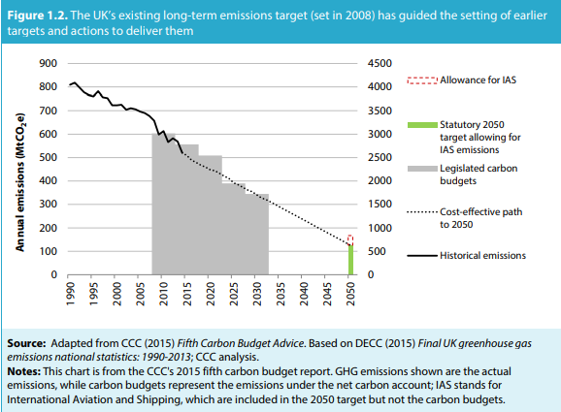
And this was the required emission trajectory prior to the CCC Net Zero Report….
Source: file:///U:/Downloads/Net-Zero-The-UKs-contribution-to-stopping-global-warming.pdf

Slide 5
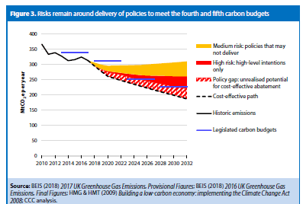
The CCC showed there was a policy gap, even before a Net Zero policy https://www.theccc.org.uk/wp-content/uploads/2018/06/CCC-2018-Progress-Report-to-Parliament.pdf

Slide 6
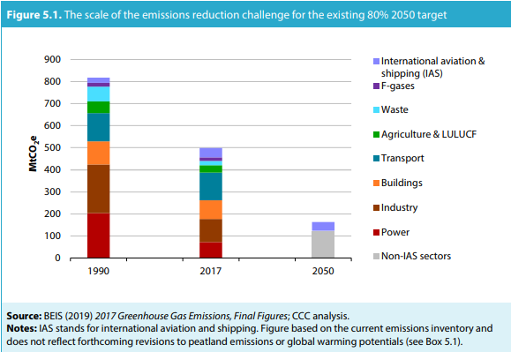
How to get to Net Zero? The CCC May 2019 Report:
Source: file:///U:/Downloads/Net-Zero-The-UKs-contribution-to-stopping-global-warming.pdf

Slide 7
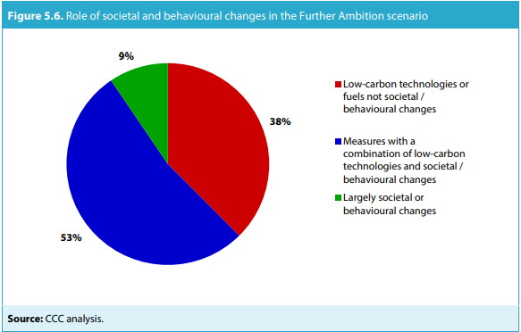
Centrality of People Source: file:///U:/Downloads/Net-Zero-The-UKs-contribution-to-stopping-global-warming.pdf

Slide 8
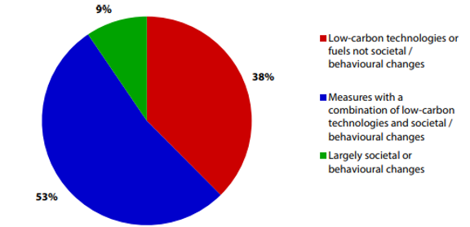
Broadly, the easy stuff has been done
So far
  Electricity based
    Coal to Gas
    Offshore Wind
  Economic Circumstances
It is getting harder :
  Cross-sectoral, so more heat and mobility
  More local (electric vehicles, energy efficiency, demand side response, heat pumps, storage, urban heat networks etc)
  System operation, energy economics, industry features, customer and people involvement all changing so old ways of doing things either no longer work or are expensive

Slide 9
Governance has to change, including transforming from top down to being more balanced with new local governance
Government has to play an active role but the decision-making process has become too skewed to top down
People (and their communities / local authorities) are the key to rapid GHG reduction to Net Zero
  Top down regulation can take us some of the way (as it has done)
  In the end, people are paying for this and they have to be a willing part of the change
  Without people, we will not manage the transformation to a net zero country
Governance (policy, institutions, regulations, network and market rules and designs) have to alter to reflect this
http://projects.exeter.ac.uk/igov/new-thinking-the-changing-role-of-cities-local-energy/

Slide 10
Policies, institutions, regulations have to be reset
Governance has to be readjusted to encourage the 4Ds and justice
  Decarbonisation
  Decentralisation
  Digitalisation
  Democratisation
Local people and government has to be seen as central to delivery of energy system transformation
Levers have to work to encourage local action and circumstances
  Policies (money), regulation, institutions
  More understanding of what DER is available, and where and at what price
  Access to DER has to be enabled (as buyer, seller or producer)

Slide 11
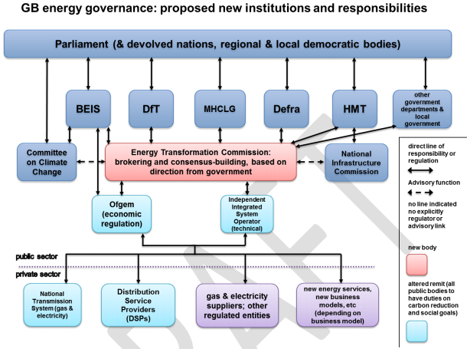
Multiple dimensions, coordination vital but… http://projects.exeter.ac.uk/igov/enabling-the-transformation-of-the-energy-system/

Slide 12
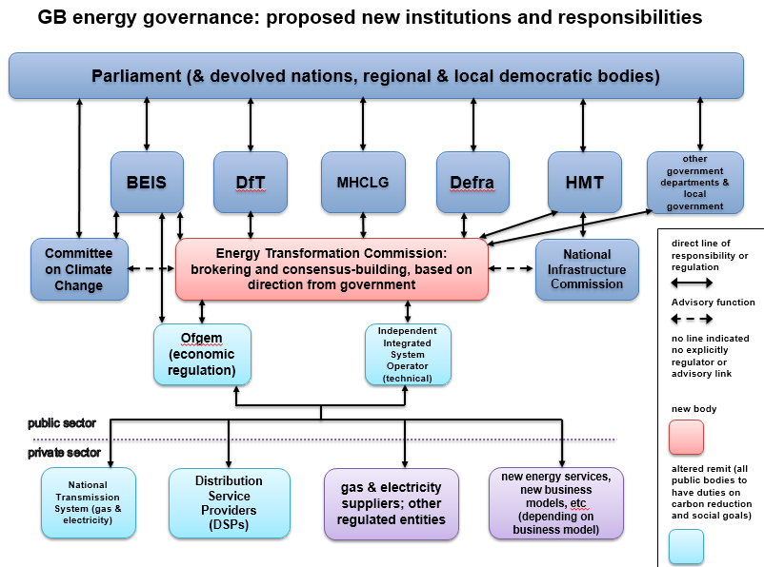
DRAFT – thanks to colleague Jess Britton in IGov – blog (Local governance blog – LTPs and devolved carbon budgets) to be posted soon
Local Authority Energy Governance
Local Authority declaration of a Climate Emergency
Duty to prepare a Local Transformation Plan
Local Area Energy Planning
Freedoms, flexibilities and funding
Local Citizens Assembly on climate change
Devolved Carbon Budgets
Spatial and economic planning
Agreed methodology
Target(s)
Delivery Plan
Monitoring and governance structures
Local Transformation Plan

Slide 13
CONCLUSION:
The future should be bright for community energy

Slide 14
Thanks
Please see http://projects.exeter.ac.uk/igov/
Sign up for Free Governance Course http://projects.exeter.ac.uk/igov/sign-up-for-our-free-4-week-online-course-transforming-energy-systems-why-governance-matters/
See Jess Britton http://projects.exeter.ac.uk/igov/new-thinking-the-changing-role-of-cities-local-energy/
IGov’s view on Net Zero http://projects.exeter.ac.uk/igov/new-thinking-where-is-igov-on-net-zero/

Slide 15
Appendix

Slide 16
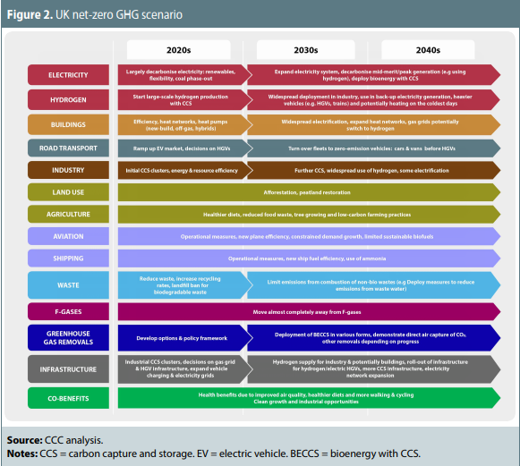
Source: file:///U:/Downloads/Net-Zero-The-UKs-contribution-to-stopping-global-warming.pdf Also see:

Slide 17
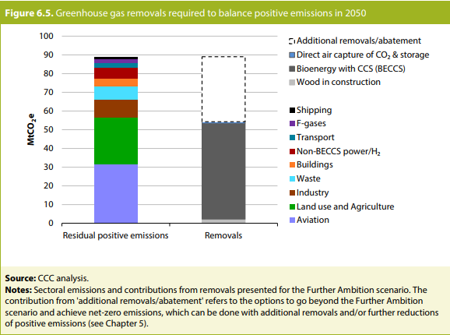
Source: file:///U:/Downloads/Net-Zero-The-UKs-contribution-to-stopping-global-warming.pdf

