Slide 1

Community Energy in a Community Emergency
City Hall London Thursday June 2019

Slide 2
Community Energy: State of the Sector
Emma Bridge
Community Energy England

Slide 3

Community Energy England
Putting people at the heart of the energy system
Founded by the sector to:
Create a create a strong, unified voice
Build capacity and support sector development
Develop cross-sector partnerships
219 member organisations
Energy4All: Winners of the 2018 Community Energy award for Outstanding Contribution
https://communityenergyengland.org/pages/join-us

Slide 4
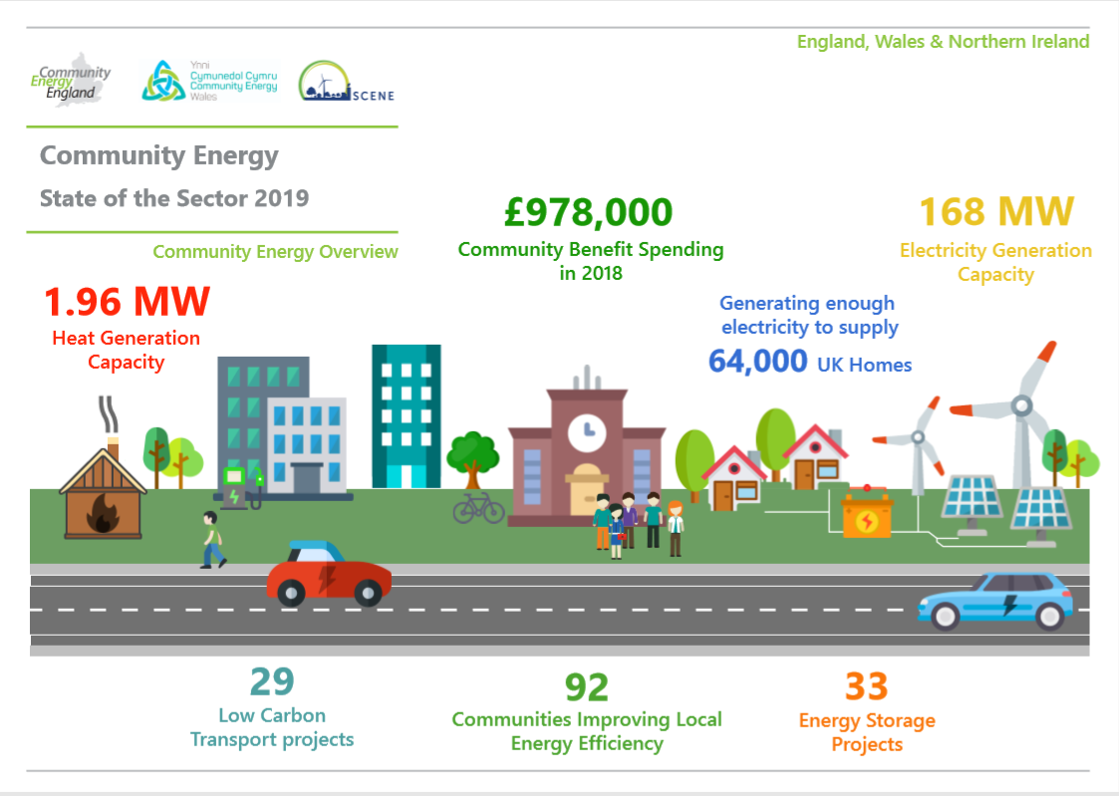

Slide 5
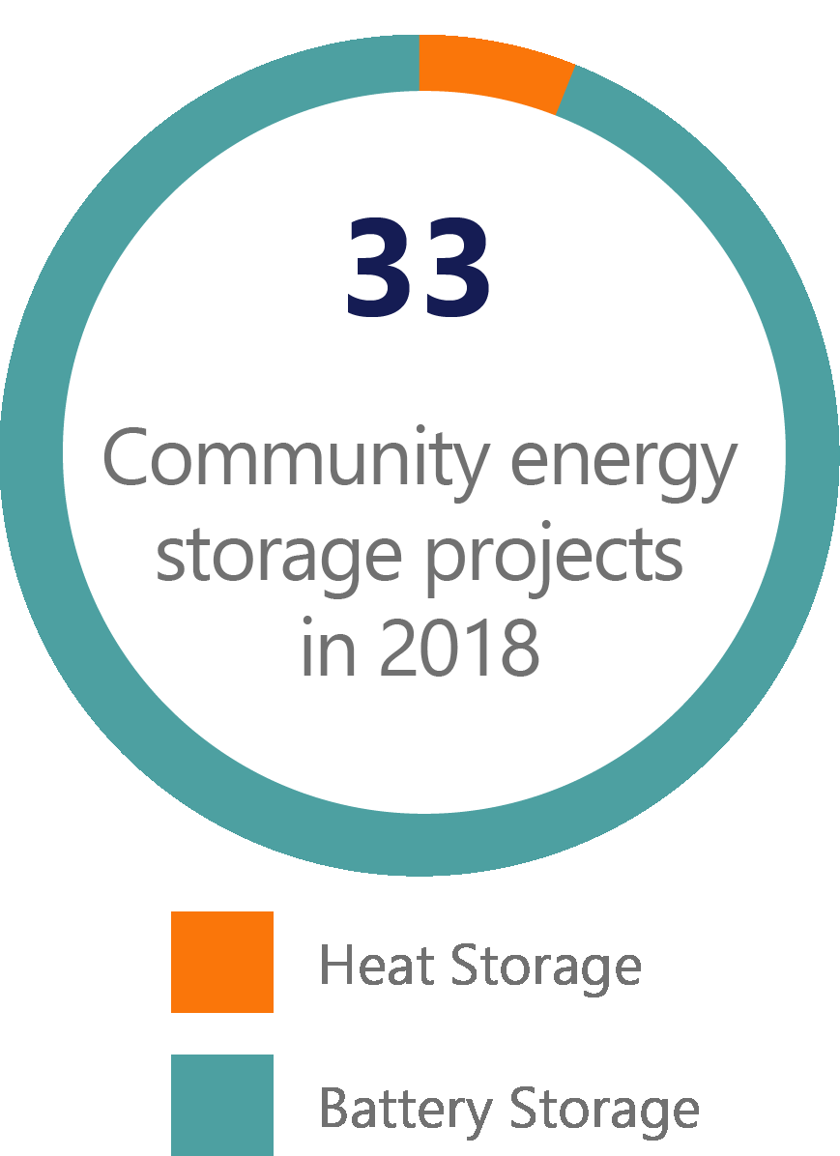
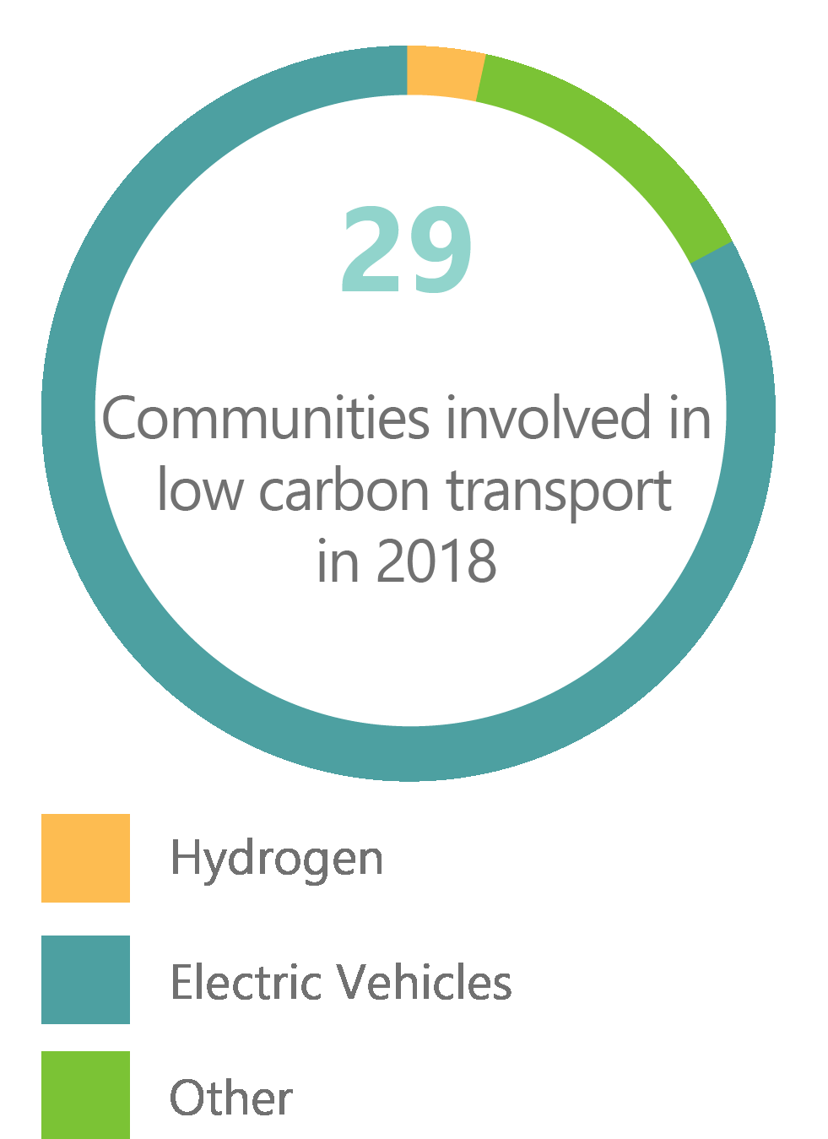
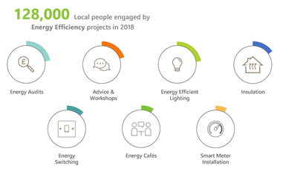
Successes

Slide 6

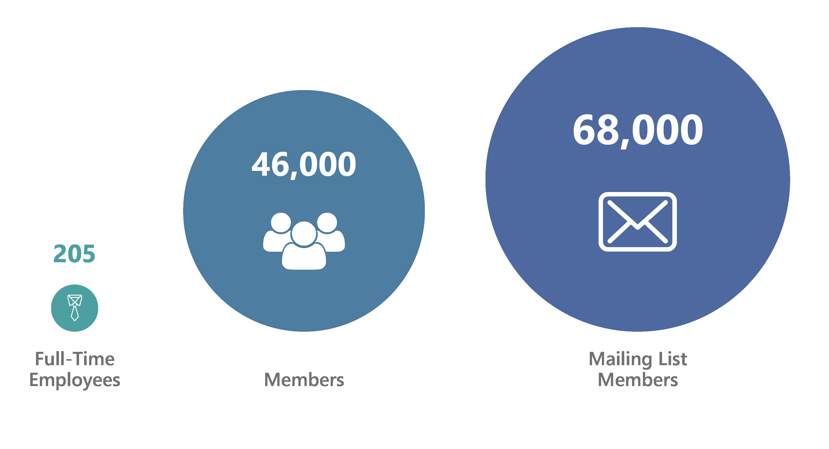
Strengths

Slide 7
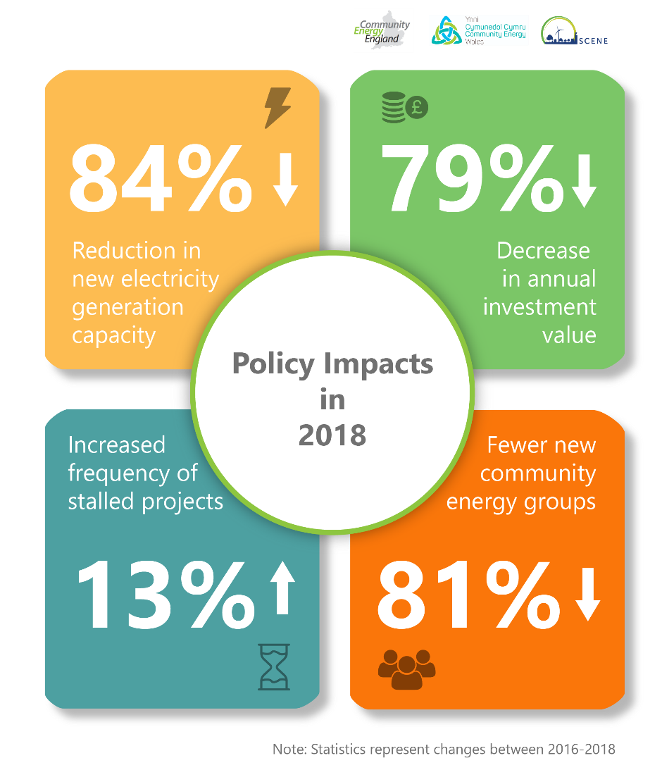
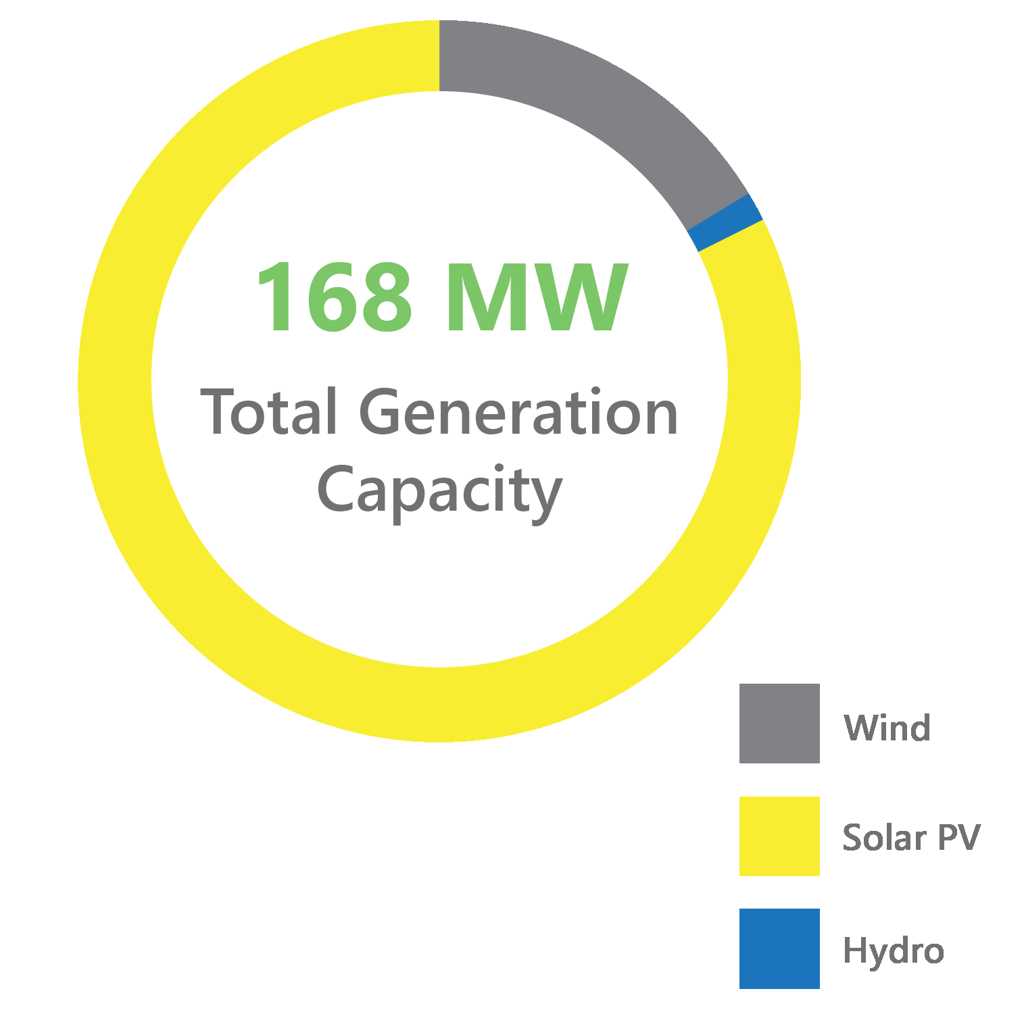
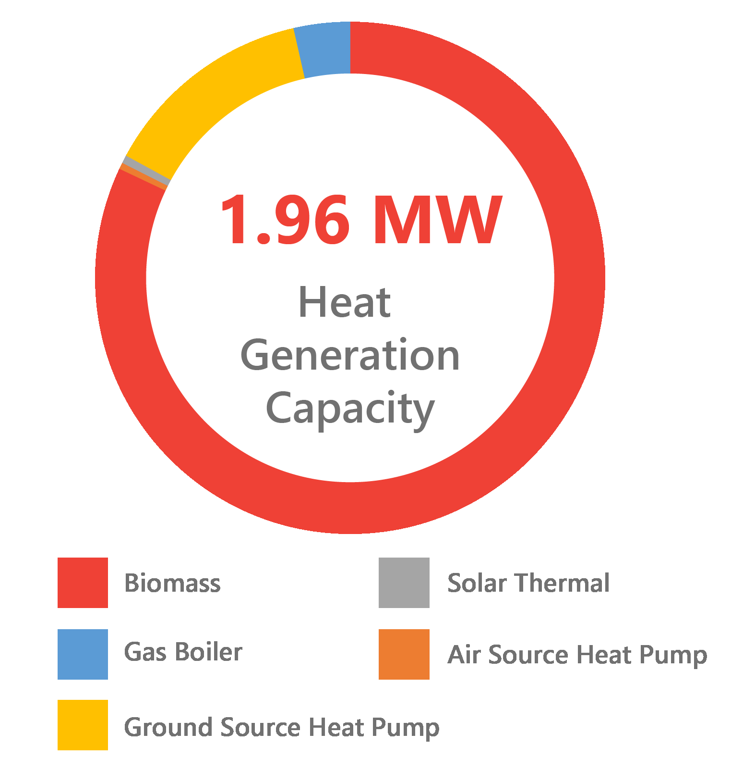
Challenges

Slide 8
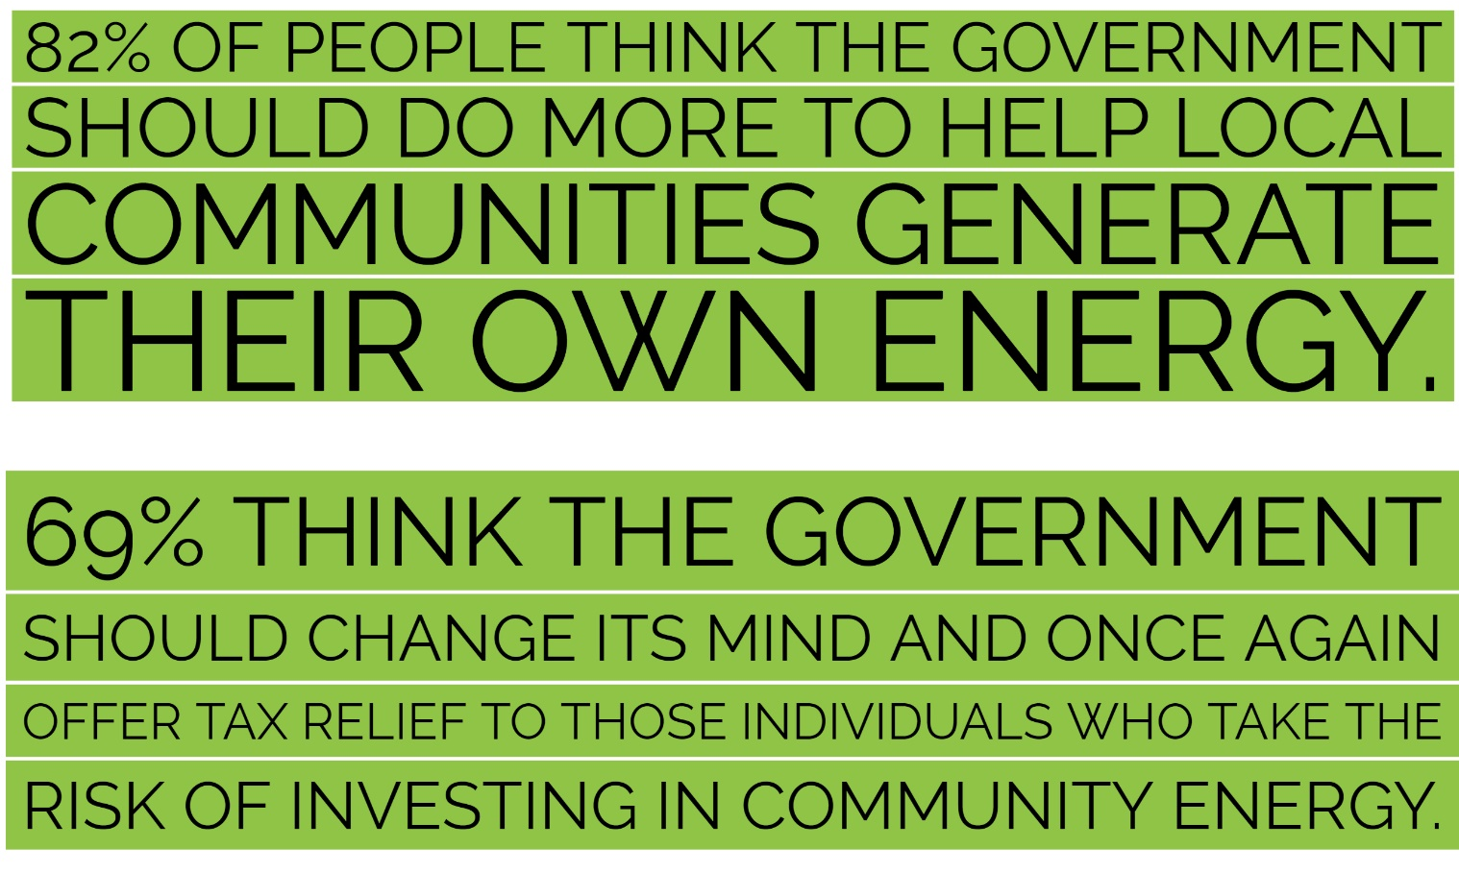
Call to Action: Tax Relief for Community Renewables

Slide 9


Community Energy England
www.communityenergyengland.org
@comm1nrg @emmabridge_1
info@communityenergyengland.org
hub.communityenergyengland.org/community-energy-fortnight/
@CEFortnight

