Slide 1
Recent Past: Immediate futures
Dermot Barnes; Chair
Notes:
Welcome, ladies and gentlemen, you have the unparalleled pleasure of listening to my voice for not just one session today but two. This is not because I have the worlds most mellifluous voice but simply because my comrade in arms; Cara Jenkinson, chair of MHSG cannot be here due to work obligations…I will try to do her justice...
So, what do I have to keep us all awake with today:
I’ll start by introducing our group, and what we have done, and focus on some of the detail of our most recent installation and the financial details of taht particular project and then I want to move on to the scale and scope of the challenge and firmly propose some ways we see of being able to progress this project:

Slide 2
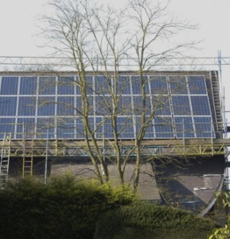
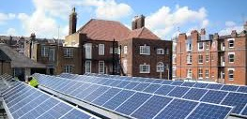
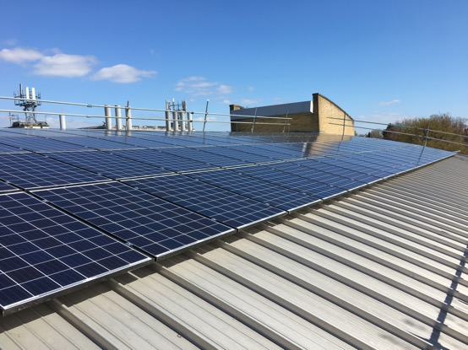

M & S Muswell Hill Broadway- 18kWp
Methodist Church-7kWp
Woodside School- 49.8kWp
Fortismere School-29.92kWp
TOTAL INSTALLED: 105kWp
Notes:
en10ergy is a community benefit company, set up in 2009 by local residents in N10 to address the challenge of climate change at a local level. We install renewable energy on local buildings, using capital raised from share offers to the community.
The income is used to pay back investors with a modest return and to fund local energy efficiency projects, through the Muswell Hill Sustainability Group.

Slide 4
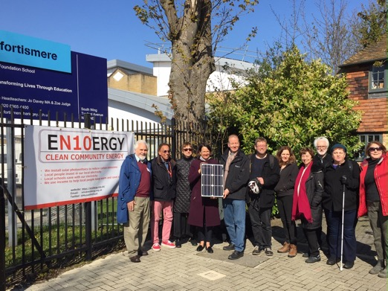
FORTISMERE SCHOOL
Notes:
Over the winter we worked with the school to survey the roof, draw up the legal agreement between ourselves and the school and to select a solar installer.
105 solar panels installed by en10ergy on the school science block this April
COUNCILLOR HEARNE & CATHERINE WEST…joined us for a celebratory photo

Slide 5
Our panels will generate
26,500 kWh per yearof electricity
Equivalent to electricity used by 8 homes…
Saving £28,500 over 20 years
Notes:
So what did this result in….

Slide 6

The numbers
Cost of installation of solar panels: £34,000
For 30kWp of solar panels, associated installation costs and some initial set up costs.
From existing shareholders capital: £25,000
(from shareholders to elected to keep their funds in en10ergy, after second roof at Woodside School proved infeasible)
The Fortismere scheme will offer a return of 3% on the capital remaining invested.
The period of investment is 12 years.
Investments from share holders – interest bearing shares from £250 to £1,000 investment amount,
Notes:
The key ingredients in this particular receipe were:
The Power Purchase Agreement with Woodside School £135,209 (£7,070 in first year).
The Feed In Tariff - £75,659 (£3,445 in first year
En10ergy subscription - in the current regulatory environment the Feed In Tariff scheme, originally aimed at supporting UK growth of renewable power, no longer allows a reasonable, timely return for investors. Hence en10ergy will put income from previous schemes into this one to enable a 3% return over 12 years.

Slide 7
School perspective
Savings for Fortismere School
Year 1 – estimated savings of £860
Years 1 to 20 – estimated savings of £28,500K
Years 20 to possible 40 – uncosted savings…££££££ for the school...
Educational Benefits
The installation will include smart monitoring and data collection that can also be used for school projects
Notes:
En10ergy will sell as much generated electricity as the school can use at 9.75p kWh for the 20 years of the scheme, and then give the panels to Fortismere to use zero cost electricity as long as the panels continue working.

Slide 8
Scale of the challenge:
London solar to date: circa .66gWp
GLA Target is 1GW by 2030 and 2 GW by 2050
Haringey to date: 555kWp
???? For Zero 50
Notes:
To say nothing of the national and international challenges, I’d like to focus briefly on what we are looking at locally and regionally…

Slide 9
Looking forward:
Access to all feasibility studies carried out for all renewables across the Borough
Access to capital/personnel support to allow us to develop council objective compatible business plans
Access to a combination of grants and zero cost loans to allow us to leverage our future income streams
A genuinely open, transparent and collaborative relationship at counciller and officer levels…
Particularly at Planning Department Level...
Notes:
To allow en10ergy and other groups to succeed to deliver Community Energy in a post FiT world, we need help with the following:
All of this is volunteer driven…so we need resources.....
And just to confirm that we have the ambition.....here are a few local opprtunities.....

Slide 10
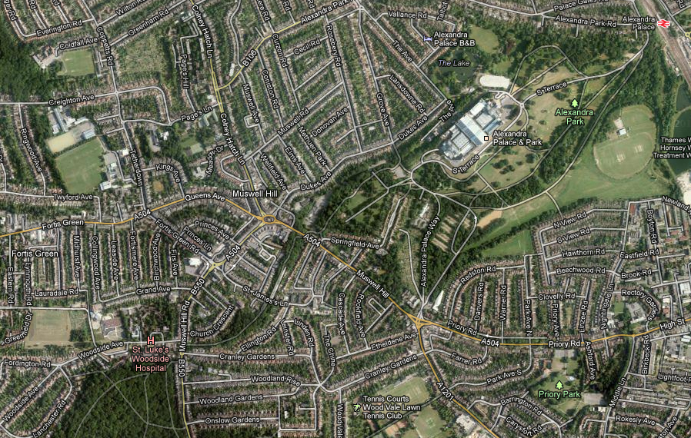
SOME LOCAL OPPORTUNITIES
  Project 1
  Project 4
  Project 2
  Project 3
  Project 5
Notes:
These are based on a proposal I put together to your predecessor Councillor Hearne; Joe Goldberg…some 8 years ago now.....they need updating but are still there to be realised.....
10

Slide 11
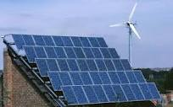
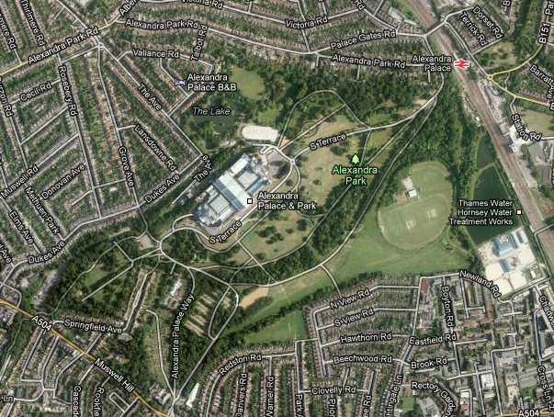
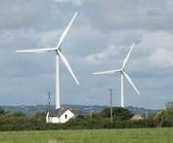
  Local Renewable Energy Solutions 1
  Solar energy
  Wind energy
Notes:
11

Slide 12
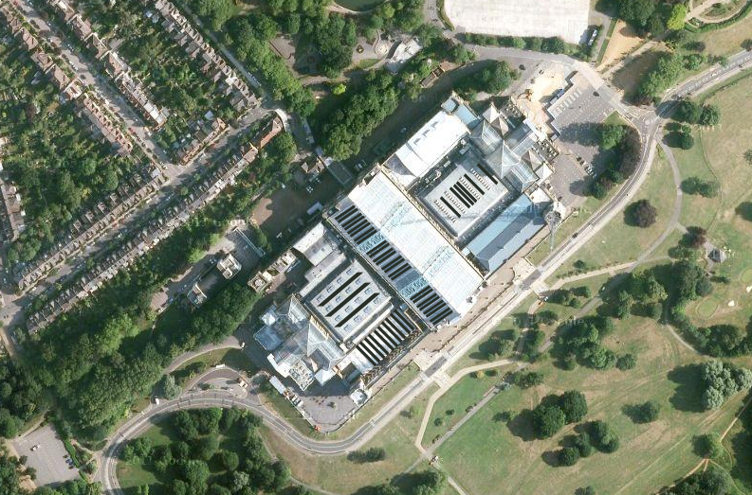
  Local Renewable Energy Solutions 1
  Solar energy
Notes:
12

Slide 13
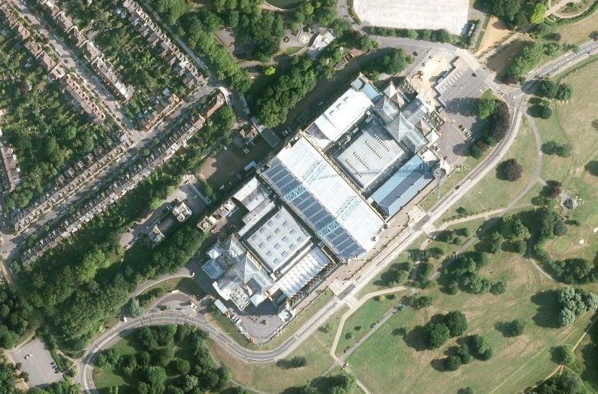
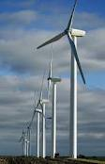
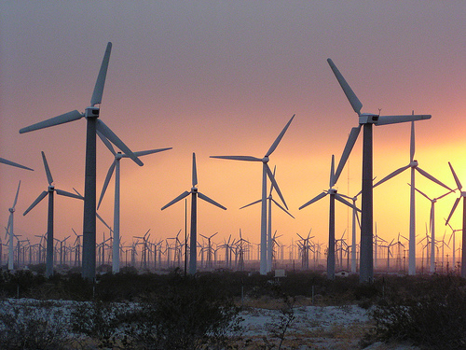
  Local Renewable Energy Solutions 3
  Wind energy
Notes:
13

Slide 14
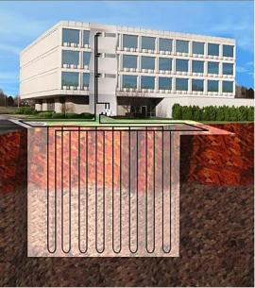
LOW CARBON TERRACE
EWI rear elevations
Window upgrades
Roof insulation
South mounted ST
GSHP
Sponsored/staged
  Ground Source Heat
Notes:
14

Slide 15
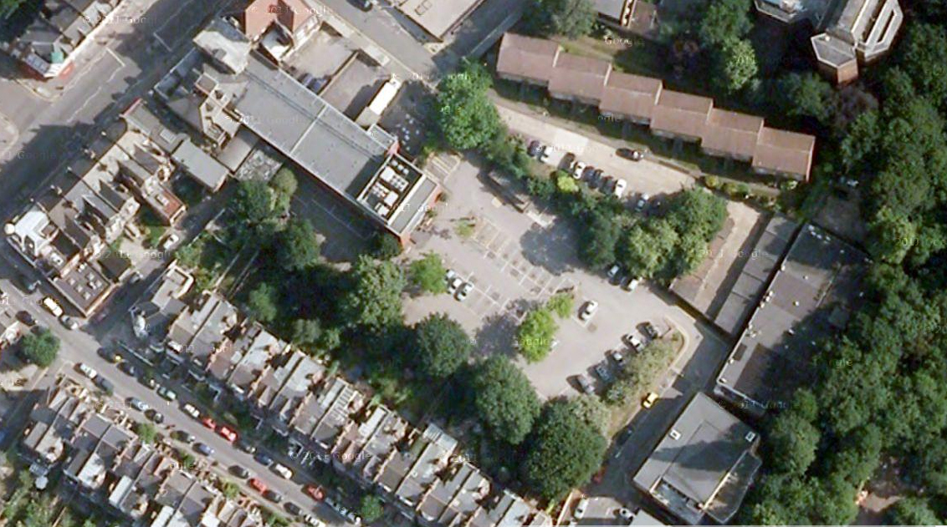
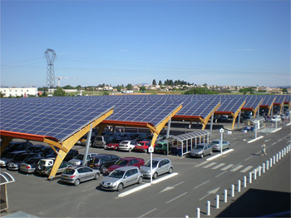
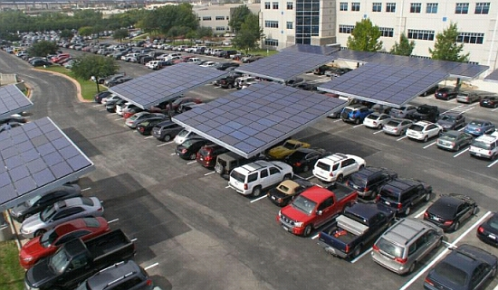
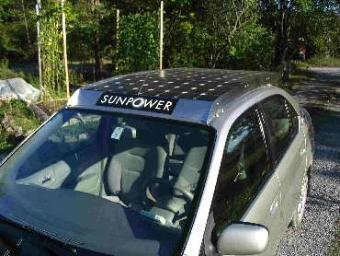
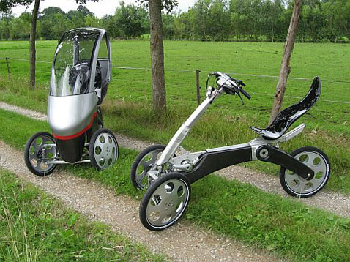
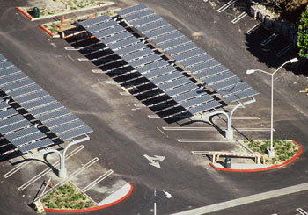
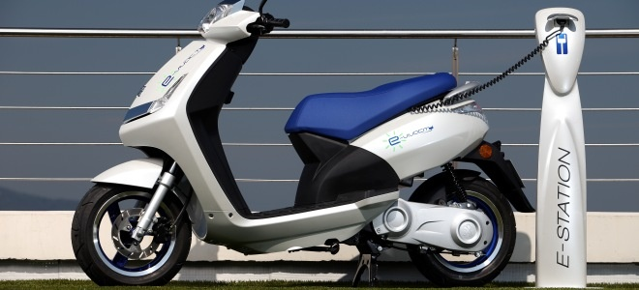
LOW CARBON TRANSPORTATION HUB
Notes:
15

Slide 16
Why 1
The sun delivers more energy to Earth in one hour than humanity consumes over the course of a year.
A land area about the size of Spain would power the entire Earth renewably.
WHAT ARE WE WAITING FOR…???

Slide 17
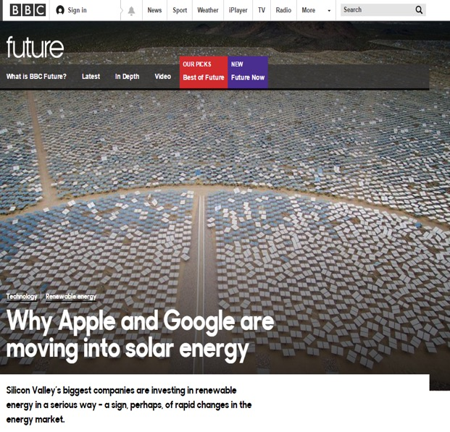
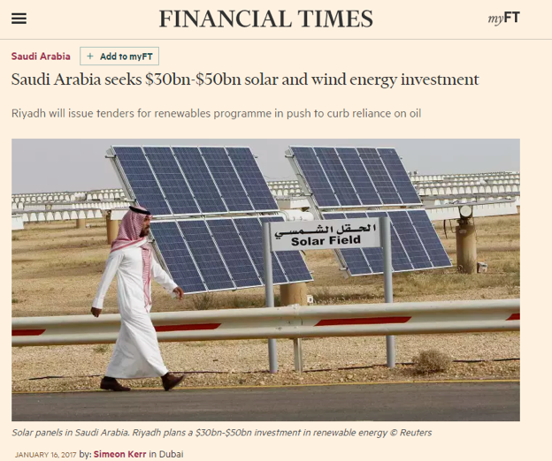
Why 2

