Slide 1

Creating a sustainable community
CEL 2nd July 2019

Slide 2
Created the LCBG-enabling more than 300 lower cost energy saving measures
100 Homes Programme- carbon footprinting, surveys, workshops, exhibitions
Some facts about climate change
Some of what we
do
Insulation, glazing, heating system and renewables support. Expert speakers and a vibrant community feeling
Support for the councils objectives

Slide 3
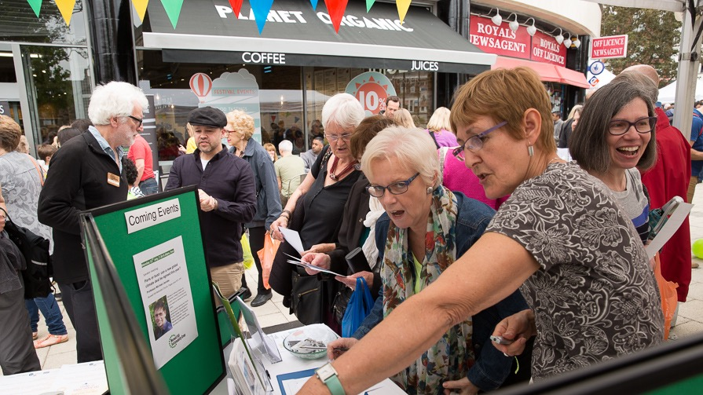
You might have seen us out and about…
Notes:
Regular street stalls, Midsummer Muswell, Very Merry Muswell

Slide 4
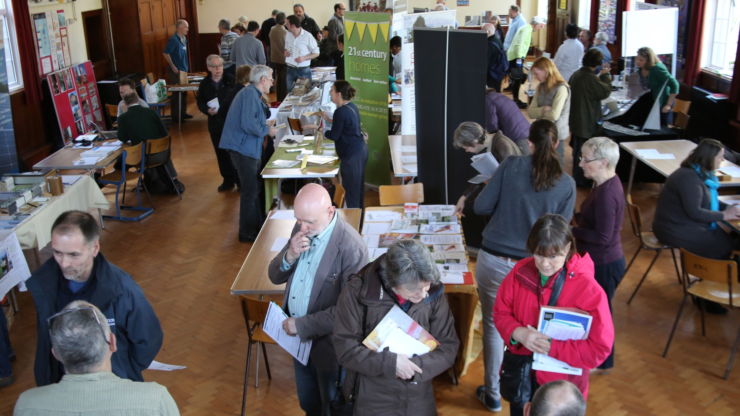
Home energy efficiency events

Slide 5
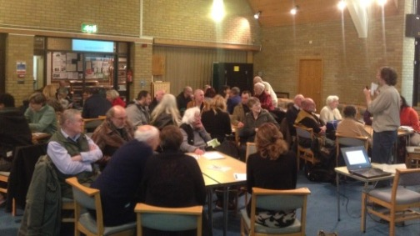
Hot tips for warm homes workshops

Slide 6
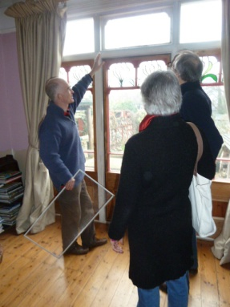
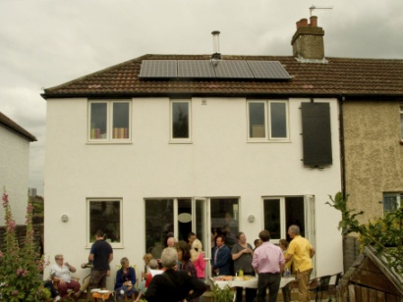
Green Open Homes visits

Slide 7
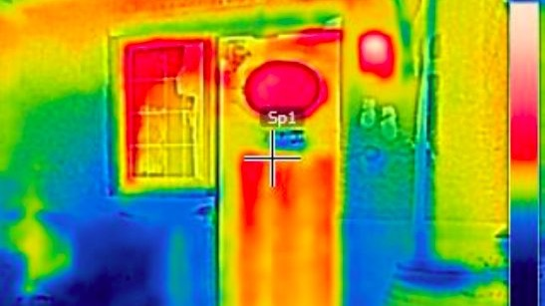
Thermal Imaging

Slide 8
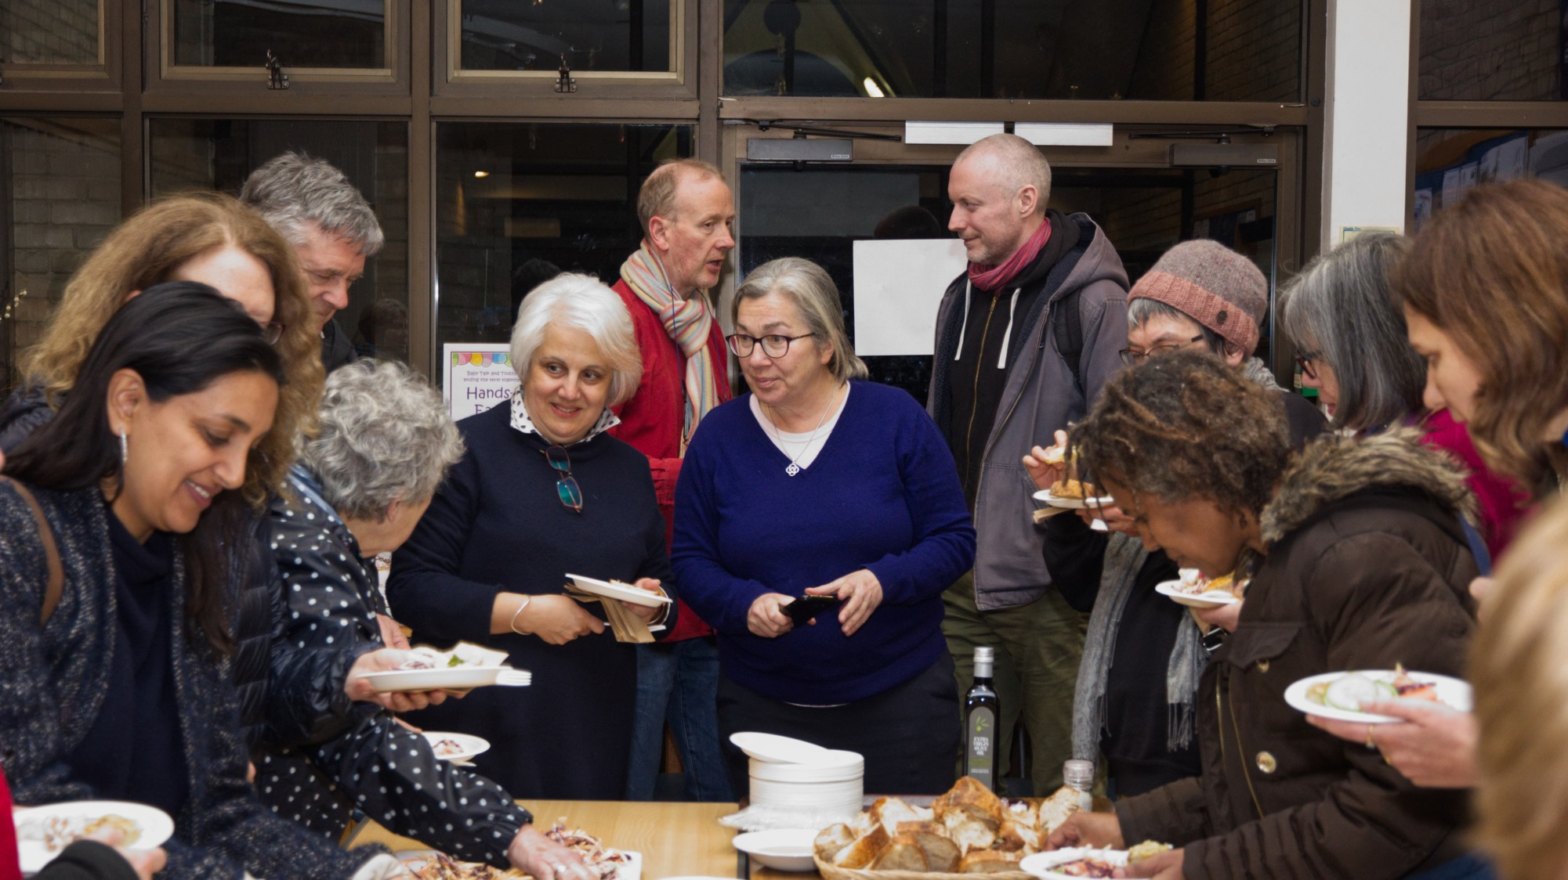
Speaker meetings: ‘A celebration of Sustainable Eating’
Notes:
Talks on sustainable food, electric vehicles, psychology of climate change, plastics waste, many others.

Slide 9

What’s involved
Measuring
Advice on priority actions you can take
Support
Goal setting
12 month follow up
Notes:
So how does it work? When a household enrols on the project we start with finding out your carbon footprint. We then suggest some actions you may want to consider and we provide the support to help you take those actions.

Slide 10
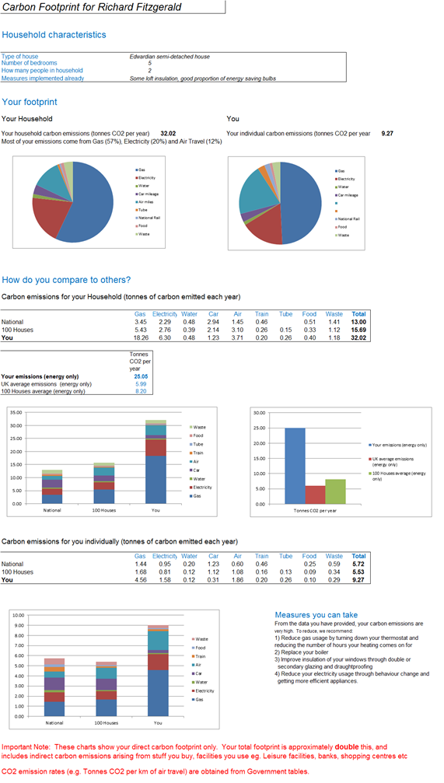
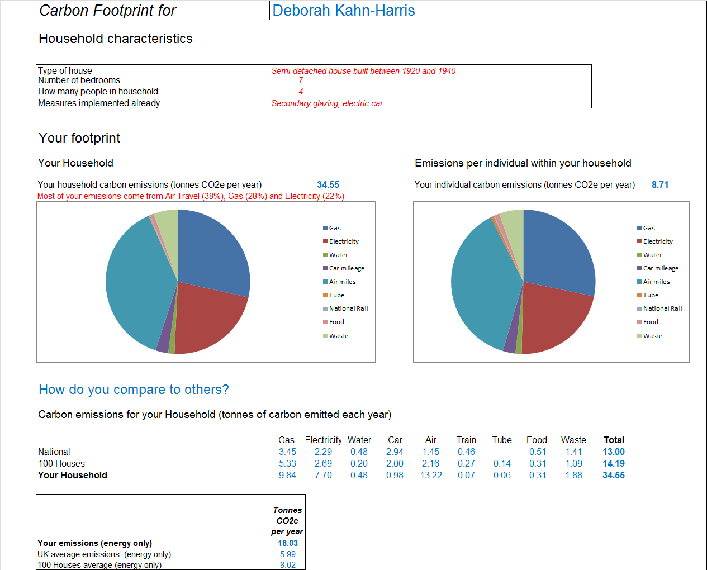
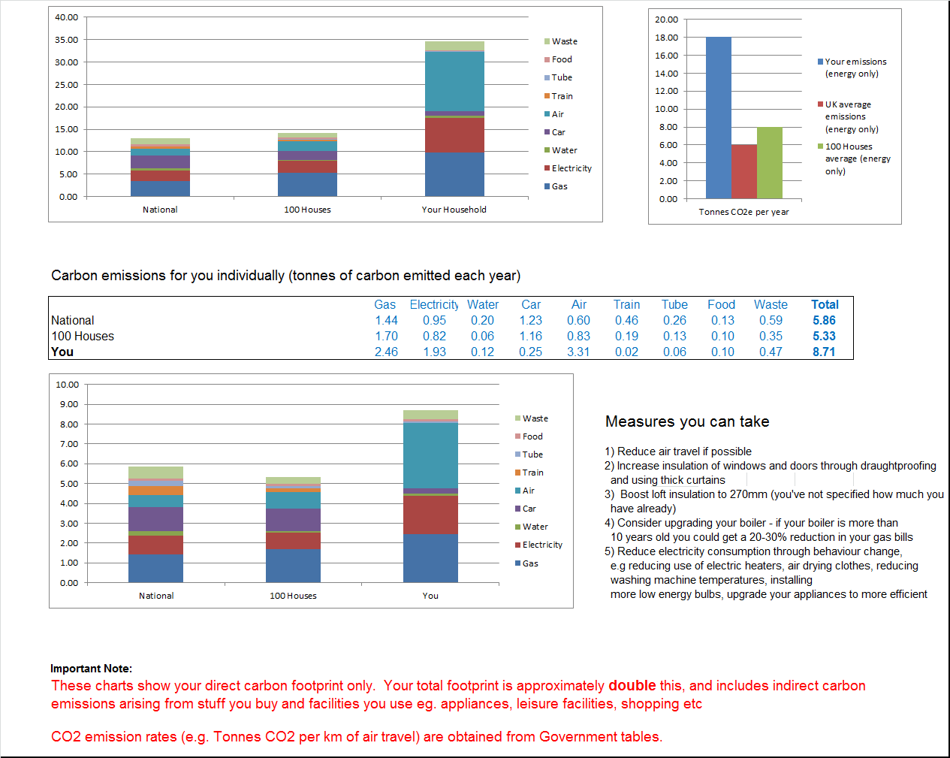
Carbon Footprint Report 1
Carbon Footprint Report 2
Notes:
Difference between different householders living in neighbouring streets

Slide 11
Muswell Hill 100 Homes so far…
Overall carbon footprint down by 16%
Emissions from air travel down by 35%
Emissions from car travel down by 26%
Emissions from home energy down by 2% (against a 15% increase nationally due to extremely cold winter last year)

Slide 12
100 Homes-What measures have people taken?
Measure | How many of us have installed over last year?
Boost loft insulation | 29%
More low energy bulbs | 29%
Draughtproofing | 32%
Double or secondary glazing | 29%
Underfloor insulation | 16%
Wall insulation | 3%
New Boiler | 29%
Reduce Air Miles | 39%
Reduce Car Miles | 32%
Solar Photovoltaic | 19%
Solar Thermal | 10%

Slide 13


Slide 14
New members are always welcome
Membership is £10/year (individual) or £12 (two people at the same address)
Join us!
Join Us!
Subscriptions help us pay for venue hire, printing etc.
Subscriptions help us pay for venue hire, printing etc.
www.mhsgroup.org @MuswellHillSust. Find us on Facebook and Instagram

