Slide 1
SE24: Walworth Methodist Church Community Solar Project
Alan Jones, Director, SE24

Slide 2
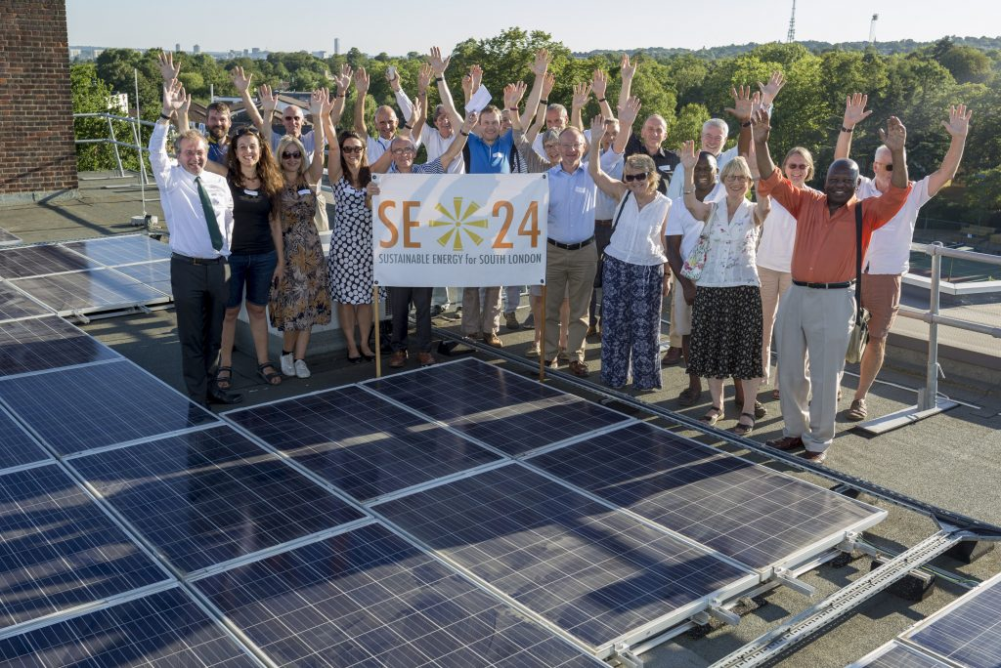



Who we are.
Started in 2014
Registered as Community Benefit Society in 2015
With a little help from our friends:
Ovesco
Repowering London
SELCE

Slide 3
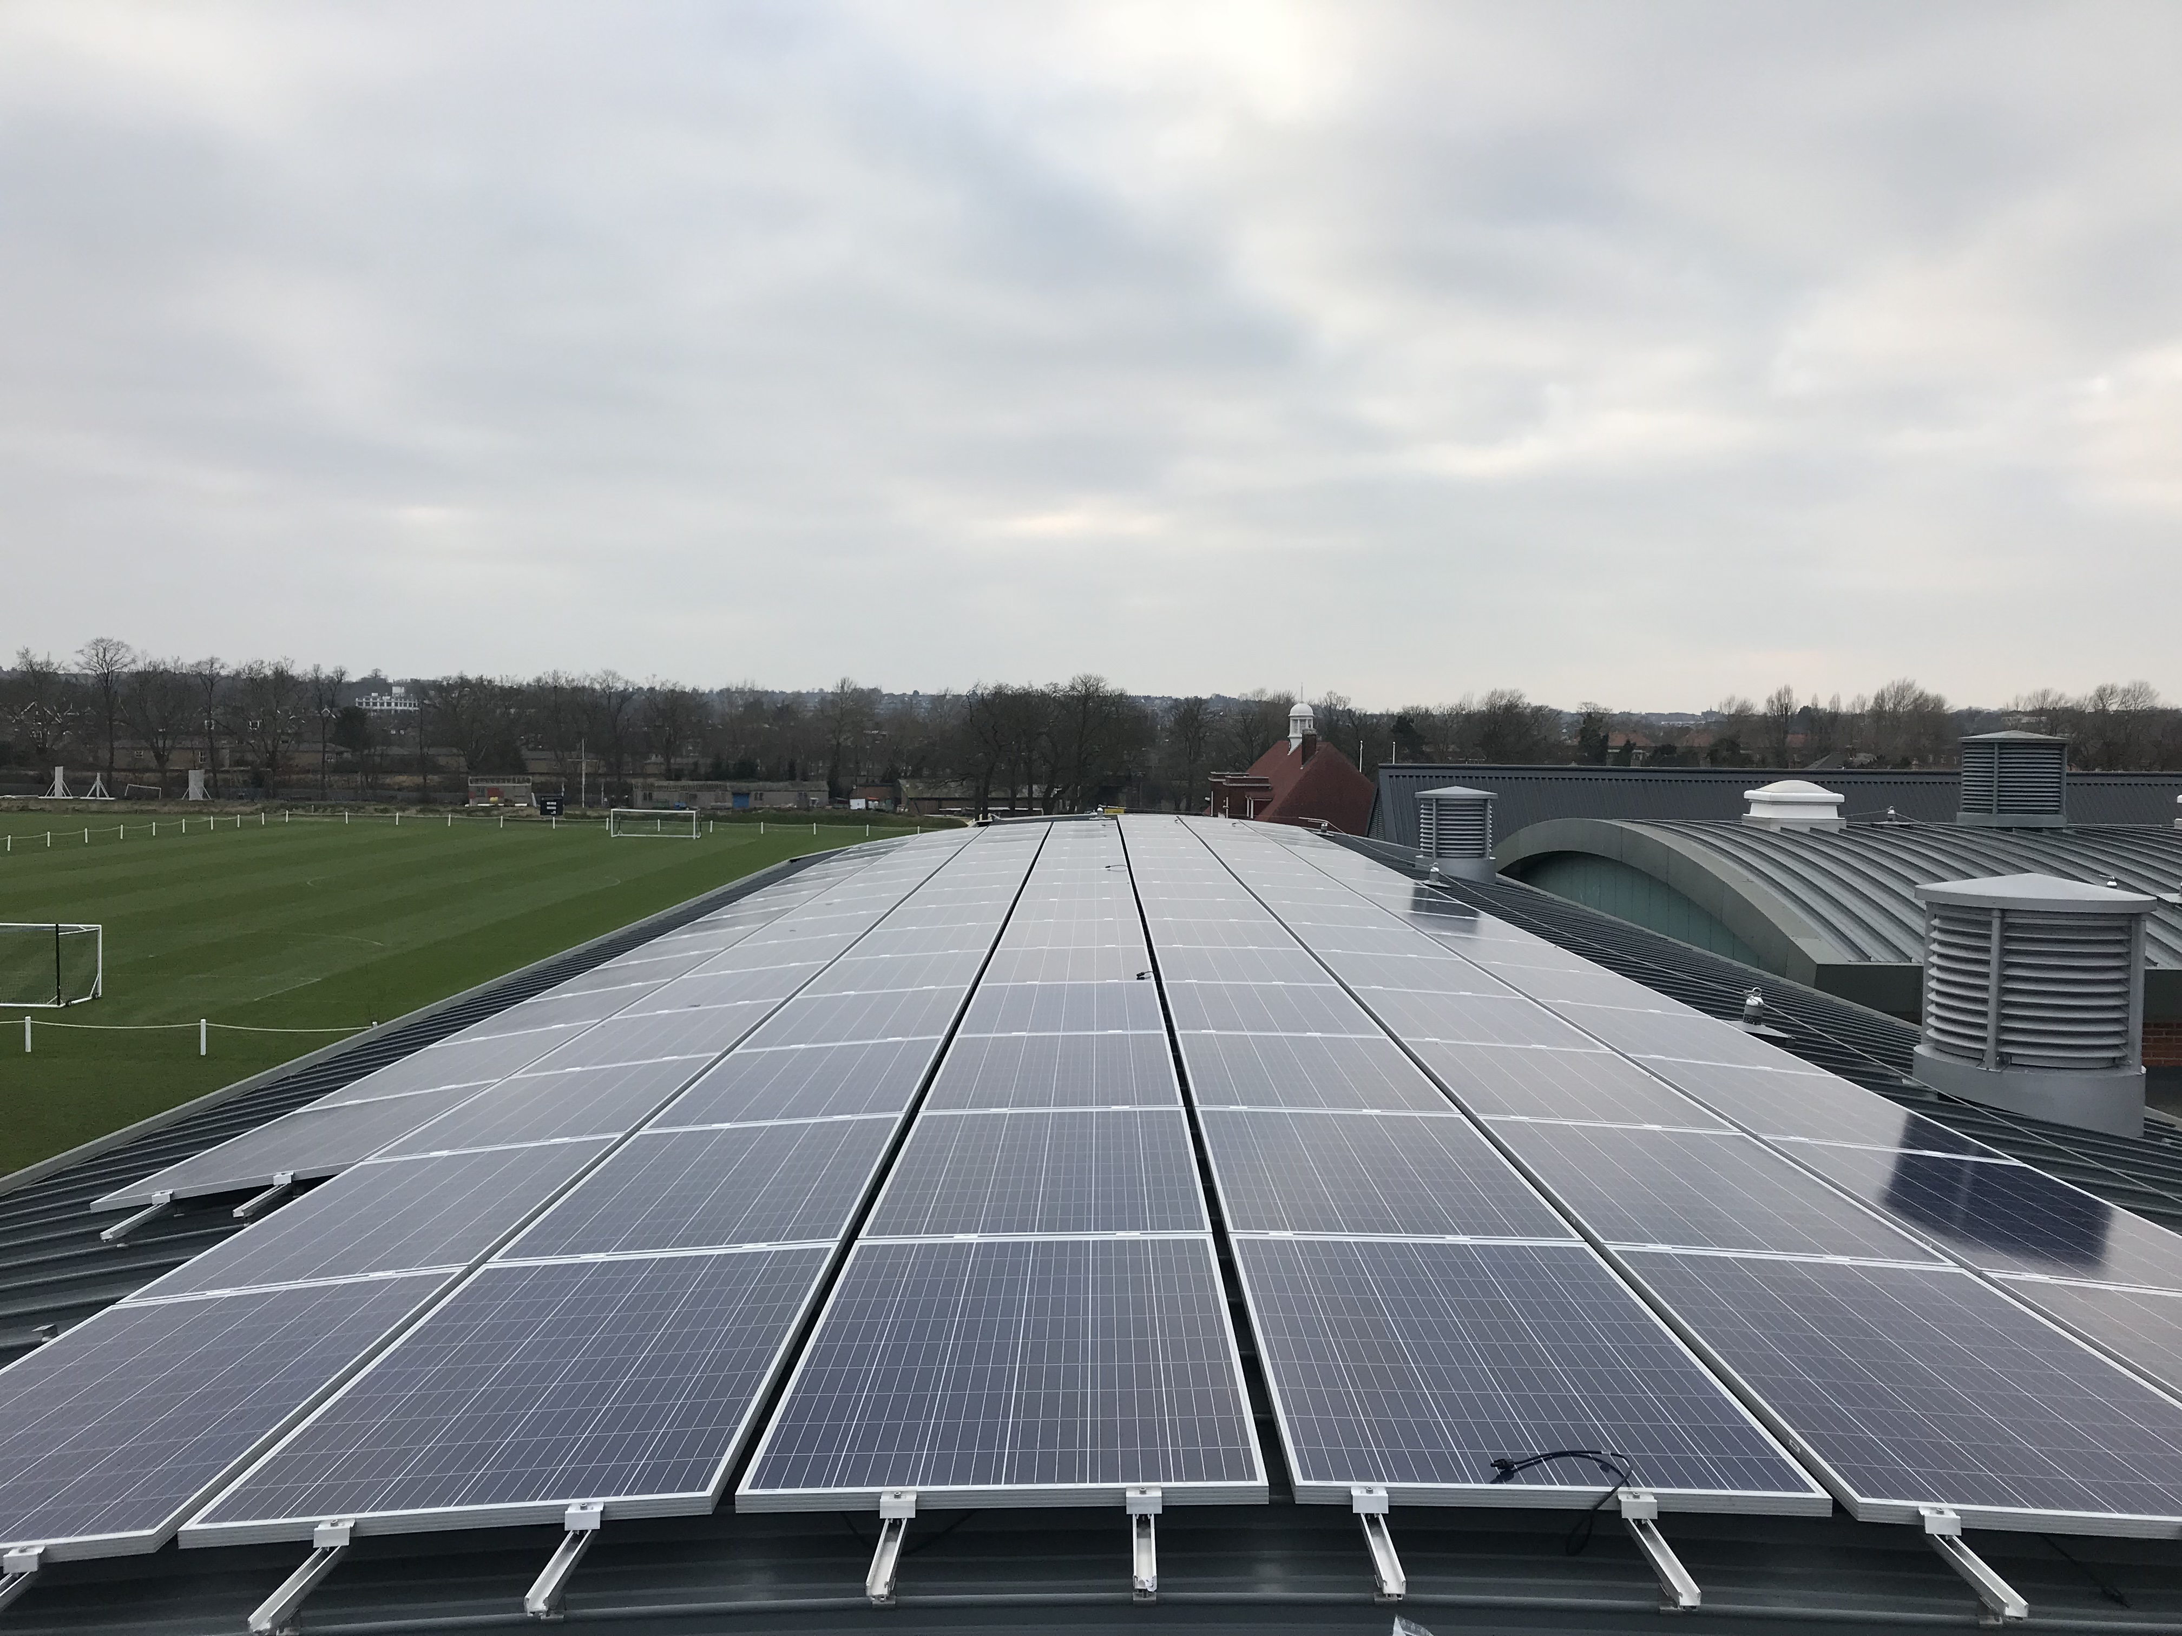
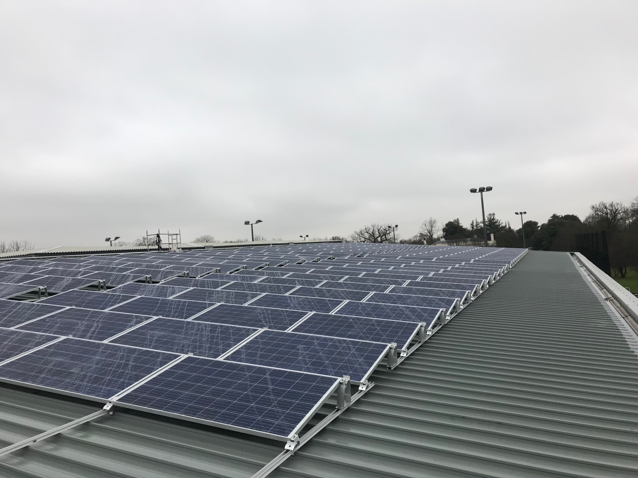
SE24: What we do
Vision:
Sustainable Energy – SE24 aims to reduce our carbon footprint by encouraging and setting up local renewable energy projects. We are currently focusing on installing solar PV panels on community buildings.
Social Engagement – SE24 aims to use Community Fund revenues to tackle energy poverty and educate on energy efficiency.
Social Enterprise – SE24 aims to create jobs and plough money back into the local community through installing and maintaining solar equipment, improving insulation, draft proofing and other measures.

Slide 4
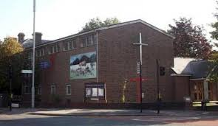
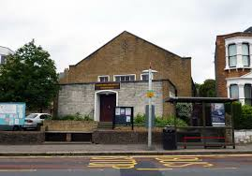
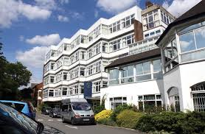
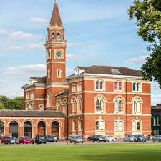
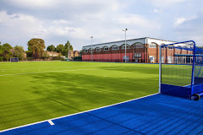
SE24: What we’ve done…
Herne Hill Methodist Church Hall, 2016 (10kW)
Herne Hill United Church, 2016 (10 kWp)
St Christopher’s Hospice, 2018 (50kWp)
Dulwich College Lord George, 2018 (50kWp)
Dulwich College Sports Centre, 2018 (50 kWp)
A
B
C
D
E

Slide 5
SE24: Ending of FIT Regime
Ending of FITs overshadowed closing of UCEF in 2016.
UCEF provided crucial support for early feasibility and development work.
GLA came to rescue at end of 2017 with LCEF Phase 1

Slide 6
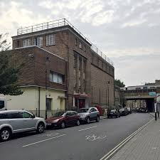
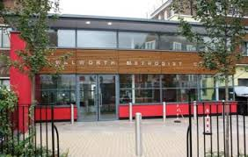
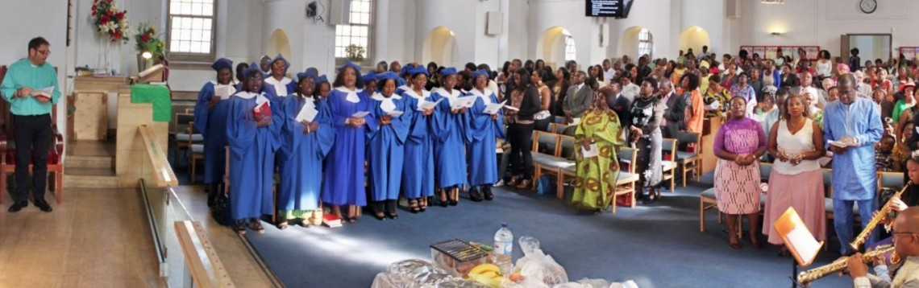
SE24: Walworth Methodist Church (WMC) Project
Earlier church projects provided template for this scheme.
WMC is large, multi-building facility with a mainly African congregation of 700.
Diverse use of buildings:
Southwark Carers
Southside Young Leaders
Southwark Food Bank
Adult education
Scouts
Lunches for elderly
Mission Housing Association

Slide 7
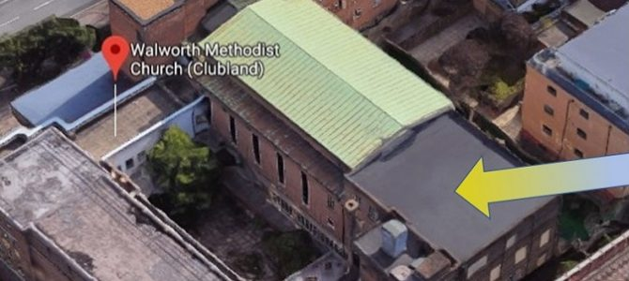
SE24: Walworth Methodist Church (WMC) Project
Fit with Methodist Church National Carbon Reduction project.
Jan 2018: Awarded LCEF Phase 1 funding.
Also secured money works from BA Carbon Fund.
Feasibility assessments and surveys started in Spring 2018.
Establishing legal possession of roof space has proved most time-consuming part of process.
Project Pre-registered for FITs over 20 years.

Slide 8
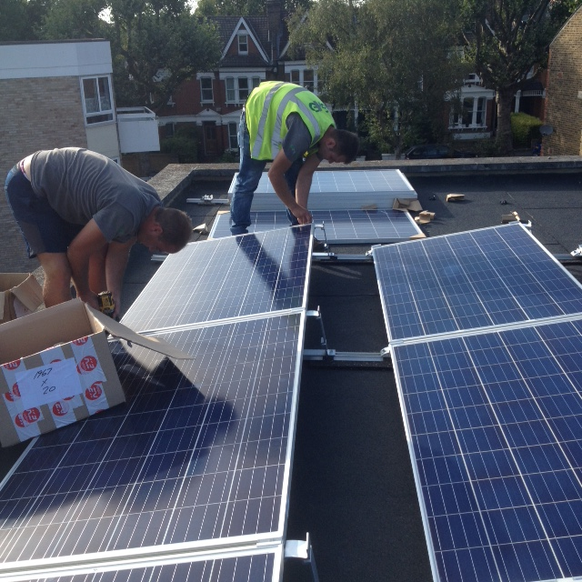
SE24: Walworth Methodist Church (WMC) Project
WMC Scheme:
25 kWp (76 PV panels)
21MWh p.a.
Equivalent to electricity consumption of 6 houses.
Save c.150 tons of CO² over 20 years.
Save church c.£10k over 20 years.

Slide 9
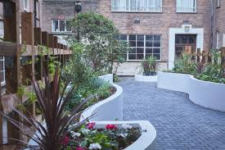
SE24: Walworth Methodist Church (WMC) Project
Other Benefits:
SE24 Community Fund to support apprenticeship training of person to maintain Southwark Peace Garden
Other SE24 Community Funds will be used for tackling Fuel Poverty

