Slide 1
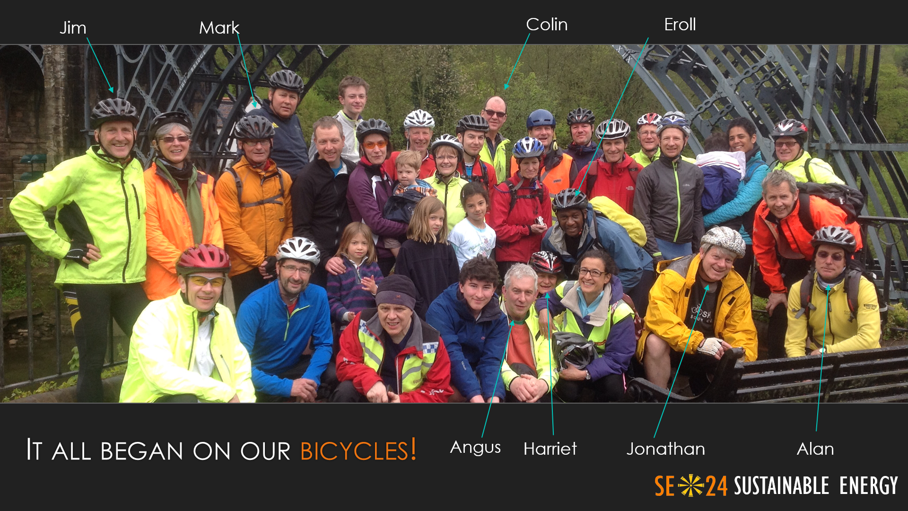
Sustainable Energy 24 (SE24): Who we are

Slide 2
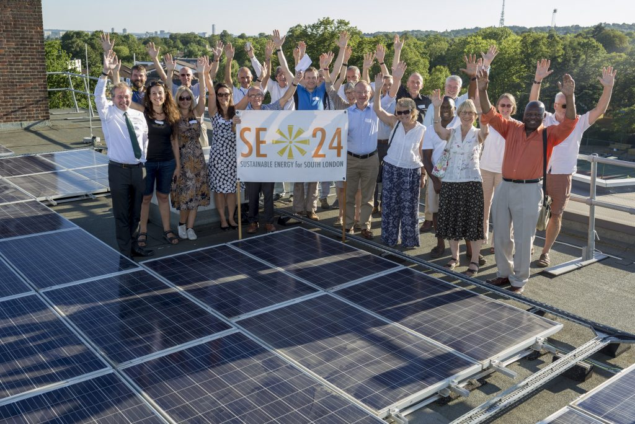
SE24: What we do
Vision:
 Sustainable Energy – SE24 aims to reduce our carbon footprint by encouraging and setting up local renewable energy projects. We are currently focusing on installing solar PV panels on community buildings and businesses.
 Social Enterprise – SE24 aims to create jobs and plough money back into the local community through installing and maintaining solar energy equipment, improving insulation and draft proofing and other measures.
 Social Engagement – SE24 aims to use Community Fund revenues to tackle energy poverty in vulnerable households and educate on energy efficiency.

Slide 3
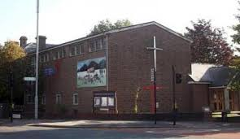
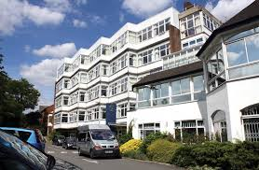
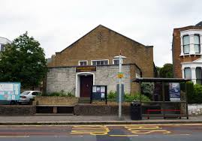
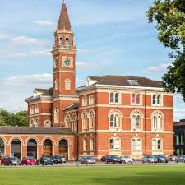
SE24: Previous Projects
Hill Methodist Church Hall 2016
Herne Hill United Church 2016
St Christopher’s Hospice 2018
Dulwich College 2018
A
C
B
D

Slide 4
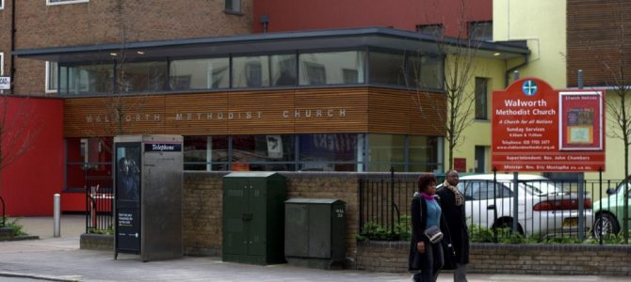
2019: Walworth Methodist Church
Roof-mounted 25 kWp solar PV.
Cost £22k, supported through LCEF Phase 1 and BA Carbon Grant funding.
To be completed in July 2019.
20-year lease and O&M obligations

Slide 5
Walworth Methodist Church: Benefits and Lessons Learned
Lessons Learned:
Ensure you have in-house Project Champion
Legals will take far longer than you think!
Work hard on communications.
Consider impact of access and DBS in schools and working-at-height regulations.
VAT refunds are a great initial asset.
Benefits:
12 tonnes CO² avoided p.a.
Church save £1.3k p.a. on electricity costs
£1.5k p.a. towards Peace Garden Project and associated training activities.
Contributes to broader SE24 Community Fund of £5k p.a. for tackling fuel poverty.

