Slide 2
Introductions
Name
Organisational Affiliation
1 sentence that summarises where you are at with energy advocacy

Slide 3
Agenda
Welcome and introduction - Alex Hartley CEL Fuel Poverty Co-ordinator [5 mins] 12.30-12.35pm
Benefits of using a funding focused Project Initiation Document (PID) before starting to seek funding: don't put the cart before the horse!
Alex Hartley CEL Fuel Poverty Co-ordinator [10 mins] 12.35-12.45pm
Breakout groups using the PID template and case study [25 mins] 12.45-1.10pm
Hearing from funders and key things they want to see in bids:
Energy Redress Graham Ailing [6 mins] 1.10-1.16pm
Perrine Rauzy - Action Funder [6 mins] 1.16-1.22pm
Green Funders.org Environmental Funders Network [6 mins] 1.22-1.28pm
UK Power Networks Michael Horwood [6 mins] 1.28-1.34pm
Q&A [10 mins] 1.34-1.44pm
If we don't have a speaker name from you for Friday, yet please provide this asap.
Alternative sources of income such as referring people for grants with GLA’s Warmer Homes - Dr. Giovanna Speciale Selce [10 mins] -1.44-1.54pm
Summary, upcoming sessions, bookable 121 advice sessions and thanks [5 mins] 1.54-1.59pm.
2pm Close

Slide 4
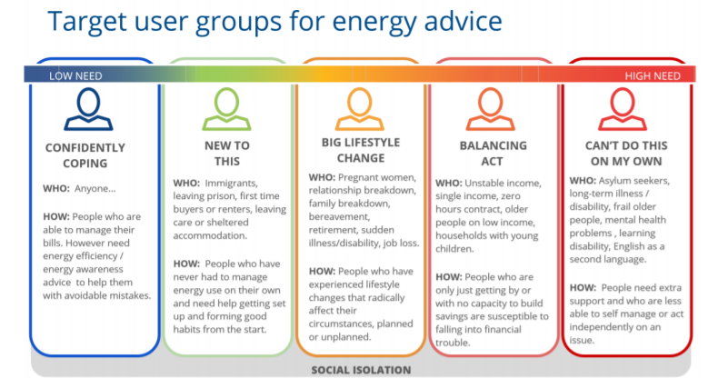

Slide 5
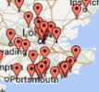
(a)Based on gaps in provision
Do a quick google search: Is there any other organisation “working” your area? Competitors are:
Local authority (e.g., Croydon)
Groundwork London
Other community groups (e.g., Bromley by Bow, HEET, Citizens Advice)
Housing providers
Local authority
….be sceptical

Slide 6

(b) Based on Geography
Understanding the geographical need.
Where in your area, is fuel poverty most prevalent
To assess this use
https://parallel.co.uk/fuel-poverty/#12/51.58605/-0.11032/0/60
(please note this is based on 2019 data)
OR
Look at the subregional fuel poverty statistics
https://www.gov.uk/government/statistics/sub-regional-fuel-poverty-data-2022
alongside the LSOA map
https://londondatastore-upload.s3.amazonaws.com/instant-atlas/lsoa-atlas/atlas.html

Slide 7

(c) Based on The availability of a local partner

Slide 8
Interventions into Fuel Poverty
Energy and water market engagement (help them get the best deal)
Discounts on energy and water
Debt advice,
Advocacy
Advice about metering and smart meters
Behavioural advice
Light measures
Grant funding for major measures
White goods applications)

Slide 9
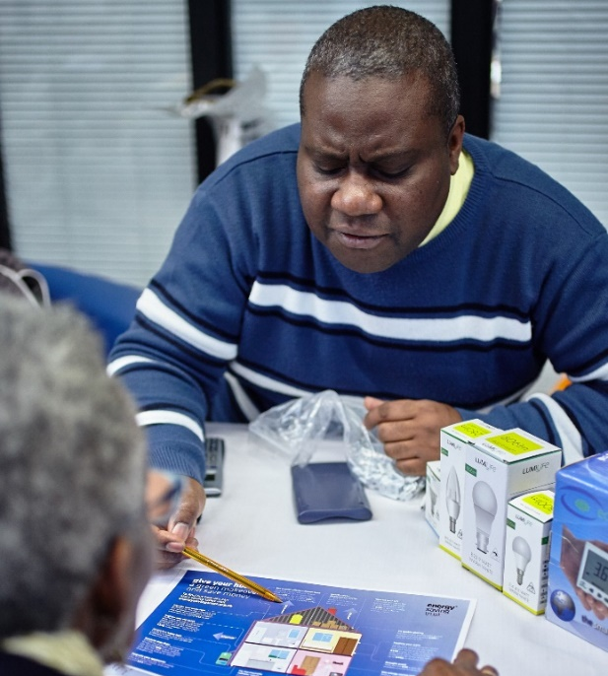
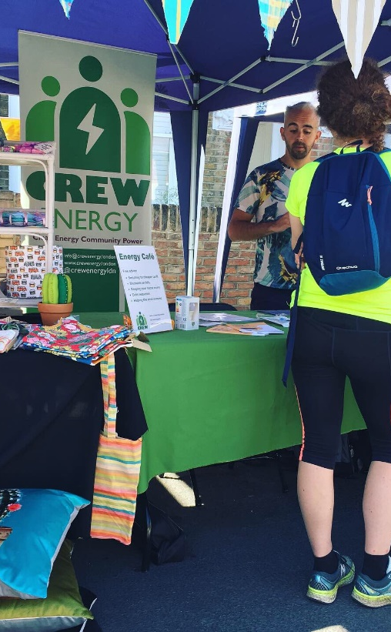
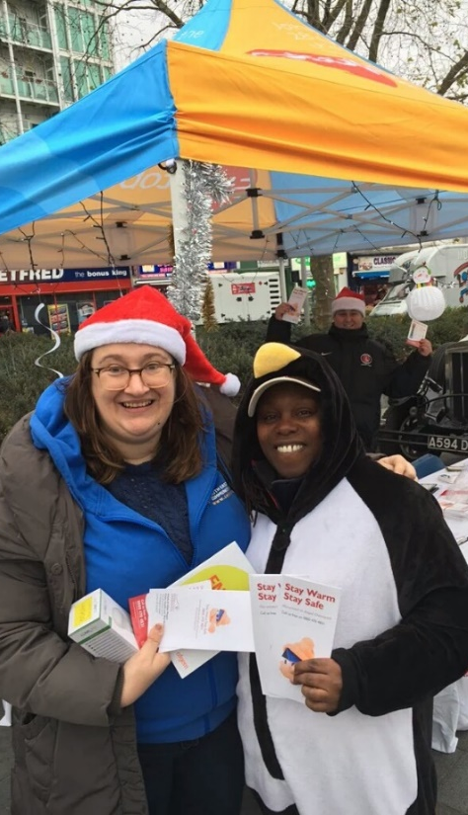
Types of Project
Workshop
Energy Cafes
Home Visits
Energy Champion
Hybrid Poverty Alleviation projects

Slide 10
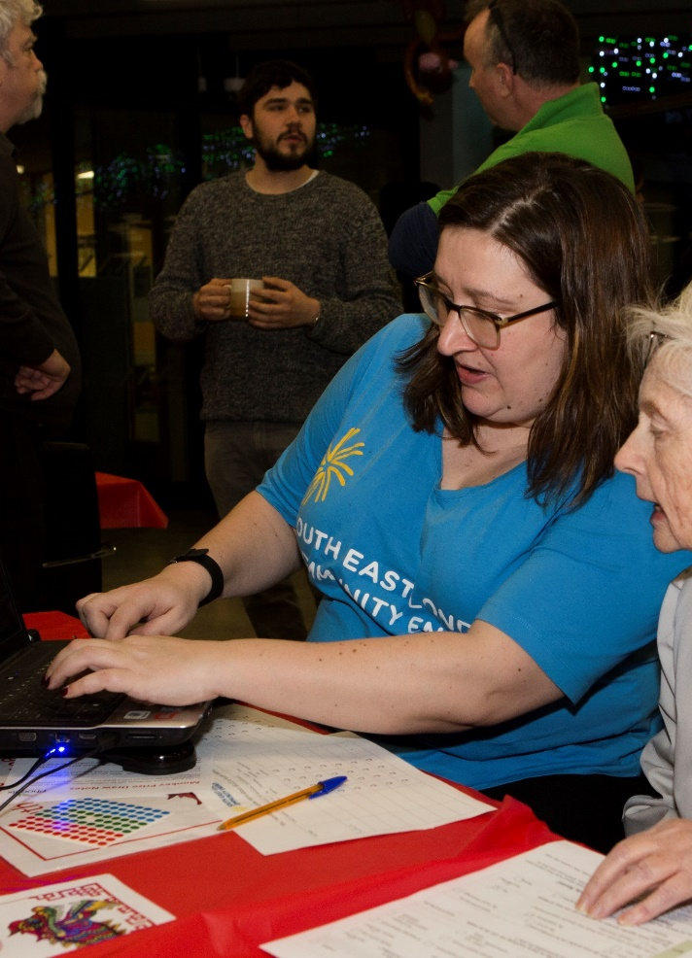
Exercise
IN BREAK OUT ROOMS using the project initiation document look at the case study and how you might fill out the 2 sections as directed by your room guide and scribe for the sections and need and deliverables.
This completed document then acts as your source document for any funding bid application.
Time 25 mins

