Slide 1
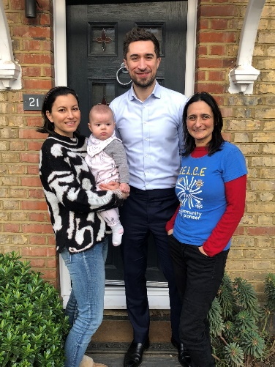

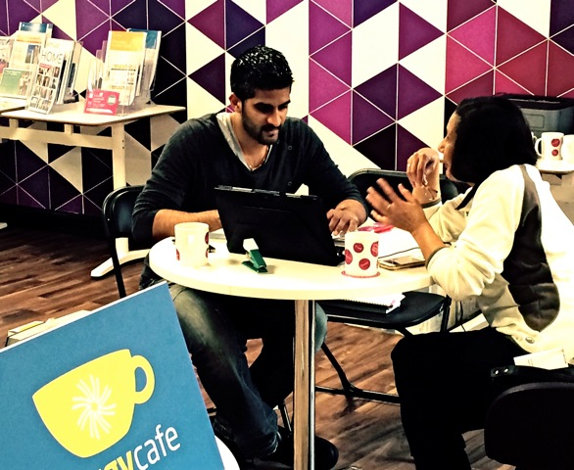
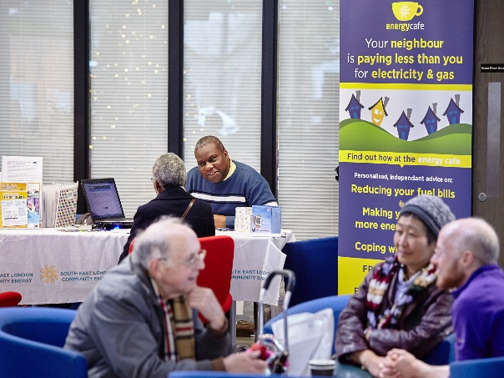
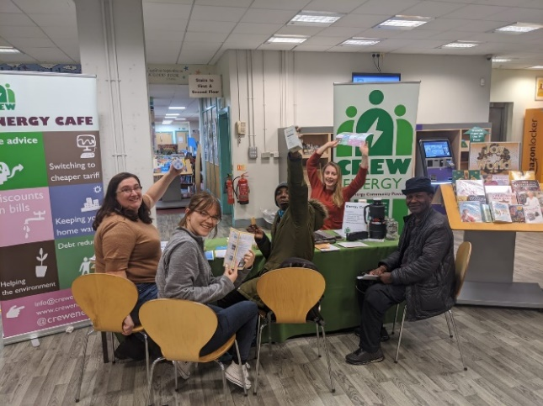


Selce Designing fuel poverty projects

Slide 2
Recap from Last Week
Defining fuel poverty
Current trends
Geographical spread
Meeting a gap in provision
Working with partners
Types of provision
Notes:
Gi

Slide 3
Today’s Session
A good project is one that recognises the areas of most need and fills the gaps. Todays session will take you through the following steps to developing a fuel poverty alleviation service
Get commitment from your board.
Finalise on what you are going to deliver.
Get funding
Develop comms materials and develop an outreach strategy.
Get relevant policies in place.
Consider health and safety and insurances.
Get training.

Slide 4
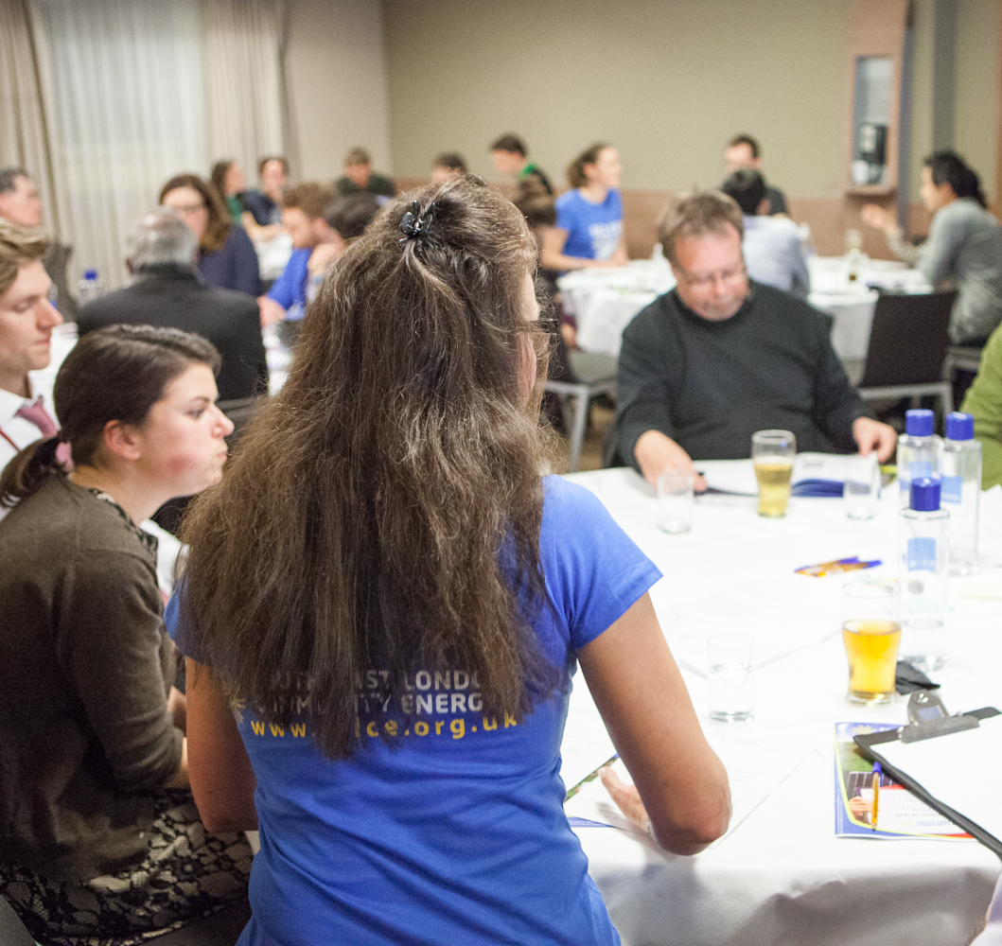
Step 1: Get the Commitment of Your Board/Community
Question for you: Why do you want to alleviate fuel poverty?
Reasons
As a response to consultation
As a source of income?
Kudos?
Because you want to help people?
As a strategic part of your vision and mission for the change you want to see in your local area?
Notes:
Alex

Slide 5
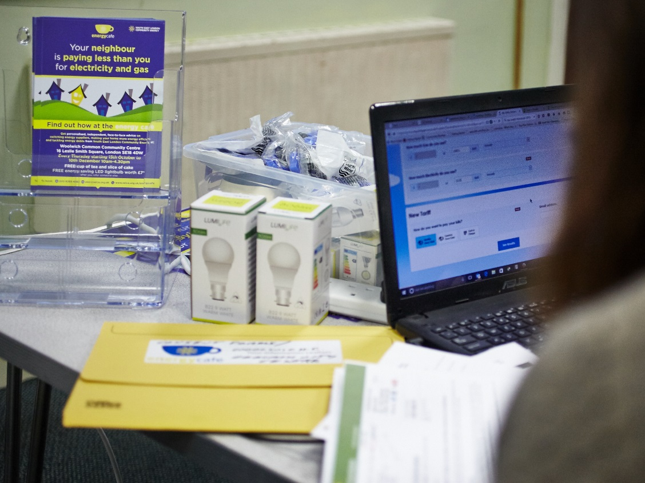
Step 2: Decide what and where?

Slide 6
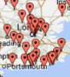
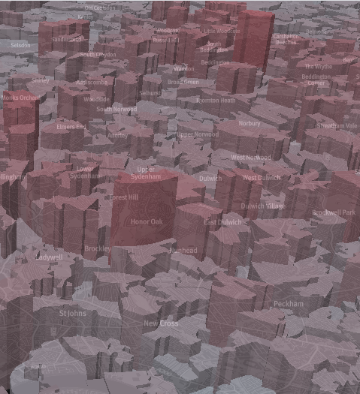
Recap: Ways to decide on where to deliver
Where most of the fuel poor live
Where there is a gap in provision
Where there your partner(s) organisation(s) are based
Any conclusions?
Notes:
Gi

Slide 7
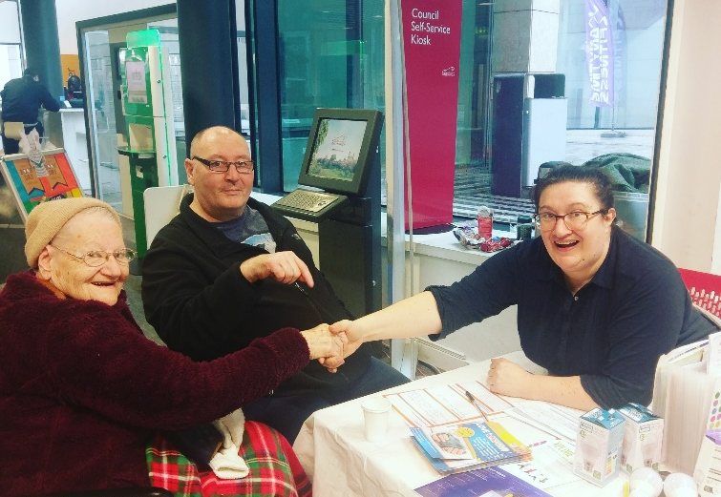
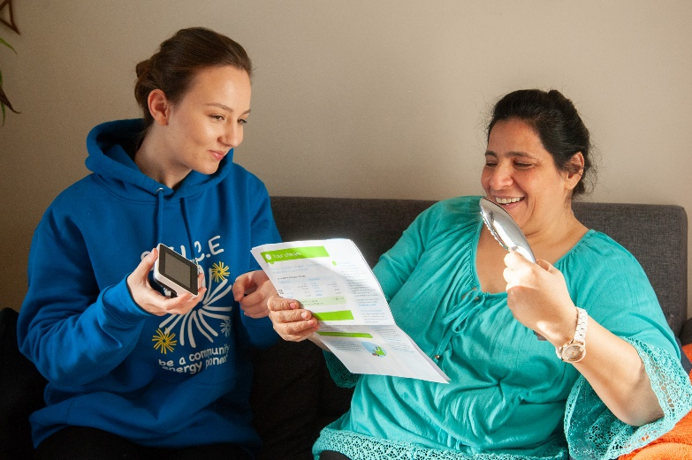
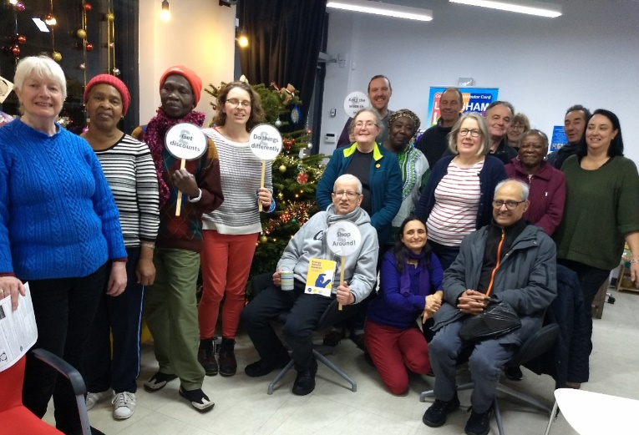
Recap: Ways to decide what to deliver
Workshops
Energy cafes
Champion Programme
Home visits
Break outs for homework review
Notes:
Gi

Slide 8
(Please tick if required) | Workshops | Champion Programme | Energy Cafe | Home Visit
Laptop
Projector
Car
Measures
Place to store measures
Volunteers
Drinks and snacks
Publicity/outreach
Volunteer expenses
Notes:
Gi

Slide 9
 | Workshops | Champion Programme | Energy Cafe | Home Visit
Low
Medium
High
Notes:
Gi

Slide 10
 | Workshops | Champion Programme | Energy Cafe | Home Visit
Electricity and gas tariff price comparison
Application Warm Home Discount or Watersure or WaterHelp
Advice about behavioural measures to reduce demand.
Work to enable clients to effectively manage fuel debt.
Application for priority services
Assessment and application for grants to replace old inefficient (expensive to run) white goods.
Advocate for clients in disputes with energy companies
Provide information about Smart Meters
Referrals to other local support services.
Emergency electric heater loan scheme
A basic fire safety check and appropriate referral to “Fire Safe and Well” services;
Practical help on the use of heating systems or controls;
Practical demonstrations of how to cut mould or damp
Assessment and applications for funded major measures (insulation, renewable heat or solar PV)
Advocacy with landlords/social housing providers in the case of violation of decent homes standards or minimum energy efficiency standards
Installation of light measures
Notes:
Gi

Slide 11
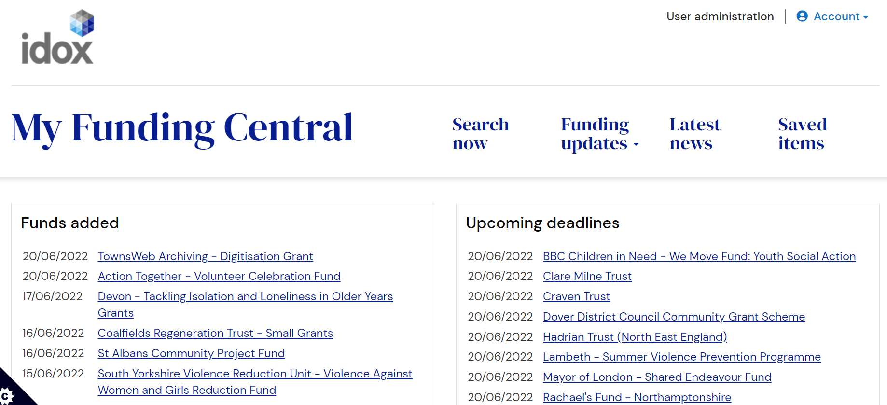
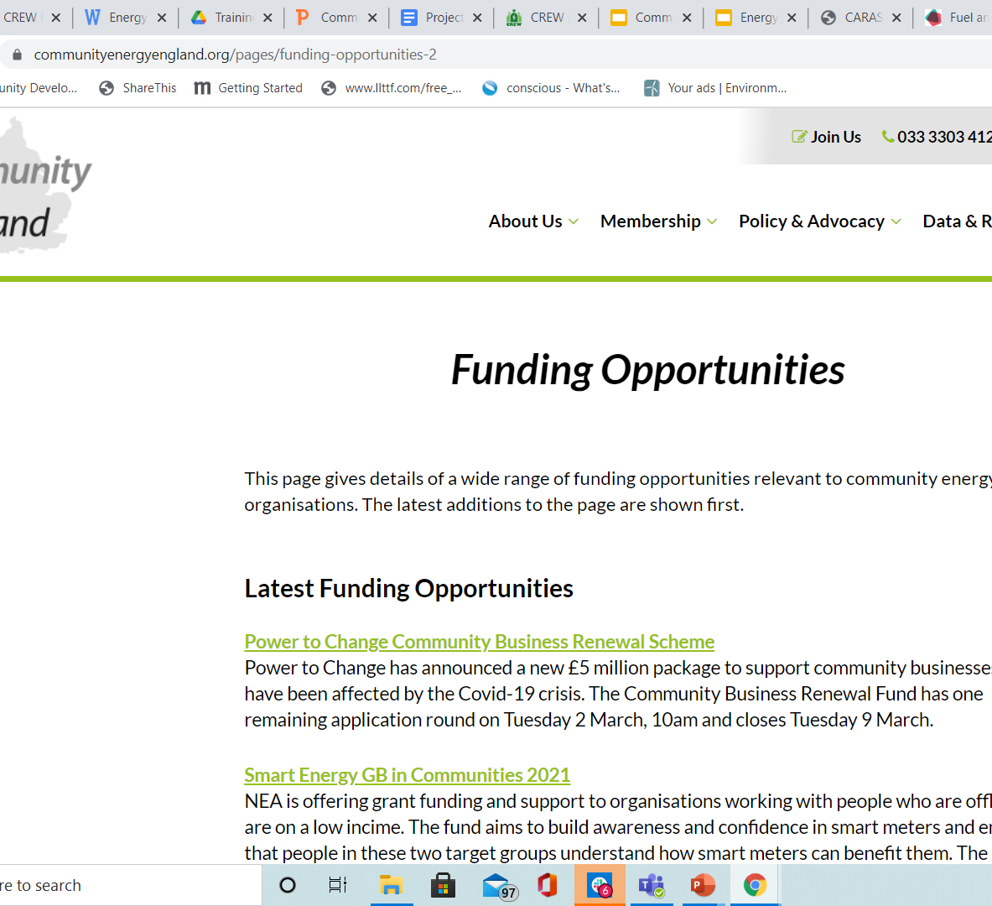
Funding Sources
Energy Industry Funders e.g. BGET
Redress
UKPN Power Partners
Government Funding (BEIS, Defra, DLUHC)
Big Energy Saving Network
Local Funders
LCEF
Local funds such as Deptford Challenge Trust
Trust for London
Your LA (e.g. CIL or commissions)
National Funders
National Lottery (Awards for All)
Esmee Fairbairn
Notes:
Gi

Slide 12
Top Tips for Funding
Define your project first then find a funder
Understand the need and rationale for delivery
Define the outcomes (not deliverables)
Budget carefully
Have a plan for measuring your impact
Sources of Information
https://communityenergyengland.org/pages/funding-opportunities-2
https://www.communityenergy.london/funding-opportunities/
https://www.idoxgroup.com/news/idox-group-launches-charity-funding-database/
Go to CEL workshop
Notes:
Gi

Slide 13
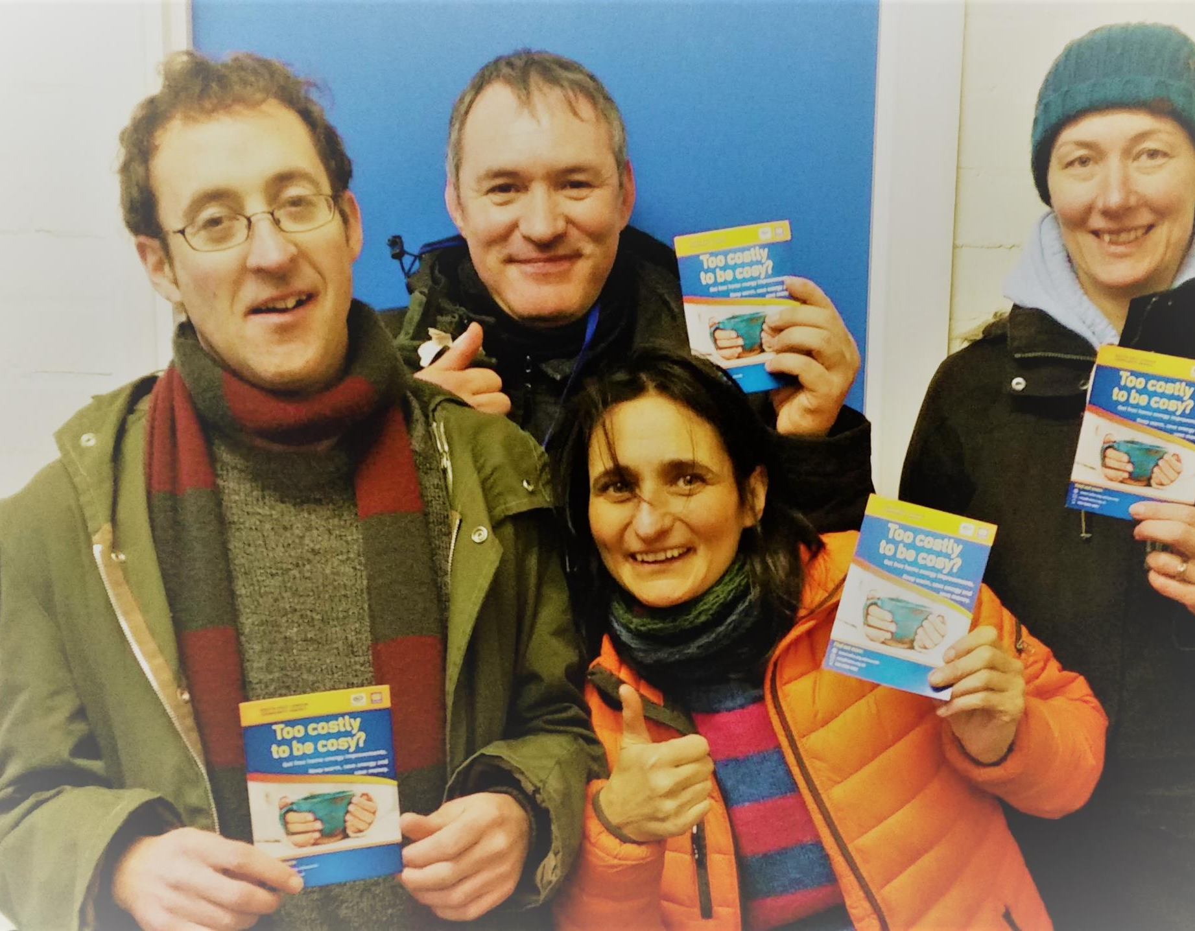
Step 4 Communications and outreach
Make this easy for yourself
by taking a ‘champion’ approach
working with partners who can act as trusted intermediaries.
Situating your service in a place of ‘high’ vulnerable foot-fall
But you will also need an outreach strategy whichever approach you take.
You need comms Materials
Socials
Press – community newsletters as well as press
Paper (but note leafletting domestic properties is pointless)
Pack for board/ volunteers/ clients (peer referrals)
Notes:
Alex

Slide 14
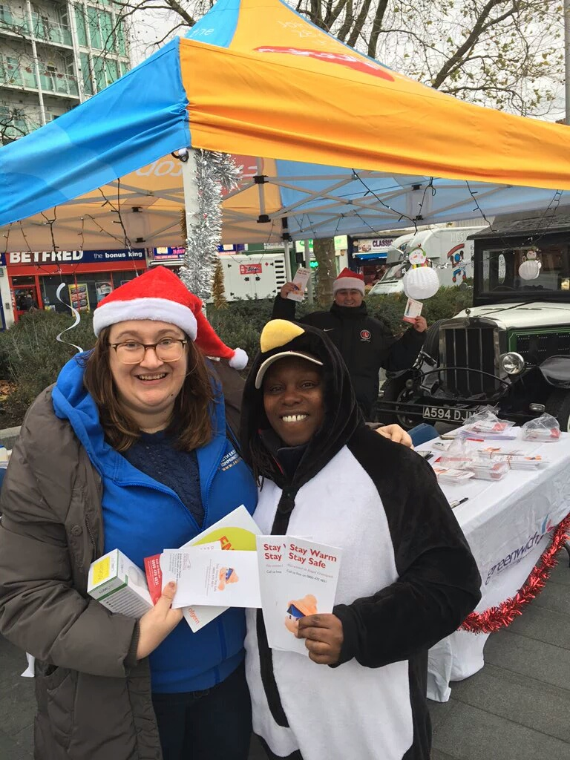
Ways to reach the fuel poor
Engage with
local authority and council housing provider
Your local CVS/ Social prescriber
Children’s Centres
Food banks
Mutual aid groups
Tenants and Residents Groups or housing associations
Job Centres
Community Groups that serve those most at risk of fuel poverty (recap!)
Notes:
Alex

Slide 15
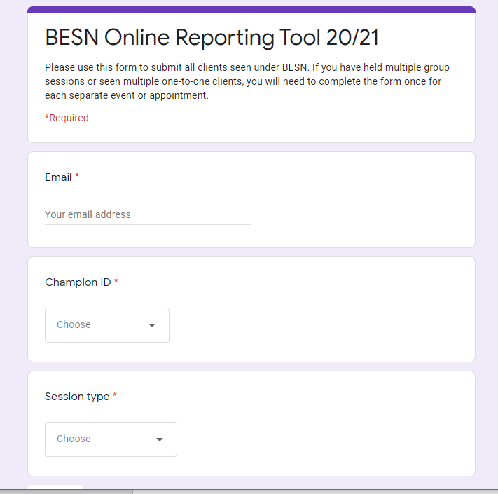
Step 5: Data collection and reporting
A way of Collecting Data or A Case Notes System or a CRM
Data collection system – usually given to you by the funder
A case notes system
A CRM
Don’t underestimate the time this will take
Notes:
Gi

Slide 16


Step 6: Policies and Procedures
For the following you will need:
a policy,
to implement it
(c) train all advisors/ volunteers to implement it
Data protection
Safeguarding (Note Safe CIC)
Health and Safety
Volunteers (?)
Notes:
Gi

Slide 17
Consent and Data Protection Exercise
Imagine
an energy café in a local library.
recording case notes based on a Googleform using your laptops
also have a case notes form in paper based format. These case notes contain personal information.
You ask all participants to fill out a paper-based feedback form at the end of the session.
What consent and data protection measures do you need to put in place?
Notes:
Break outs

Slide 18
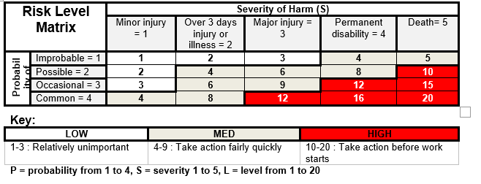
Health and Safety and Insurances
Keep a risk log for your organisation.
Do activity risk assessment (activity and project)
Lone working process or app e.g. OK Alone
Insurances:
Public liability
Employer liability
Potentially professional indemnity
Zurich Together is cheap
Notes:
Gi

Slide 19

Risk Assessment Exercise
Jamboard Exerice:
Again you are running an energy café (one staff and two volunteers). You serve tea and coffee, you have three laptops, a pull up banner and leaflets. You store all of this stuff in two plastic boxes in the library store-room
Make a list of all the risks to staff volunteers and clients that might occur in the context of this energy café
Notes:
Gi

Slide 20

Getting Skilled-up
A project will need
A qualification
Some experience
NEA Level 3 City and Guilds Certificate in Energy Awareness or DEA
Supervision (shadowing then one-to-one mentoring through your first energy advice sessions)
Mentoring for your organization
Support with fundraising
Notes:
Alex

Slide 21
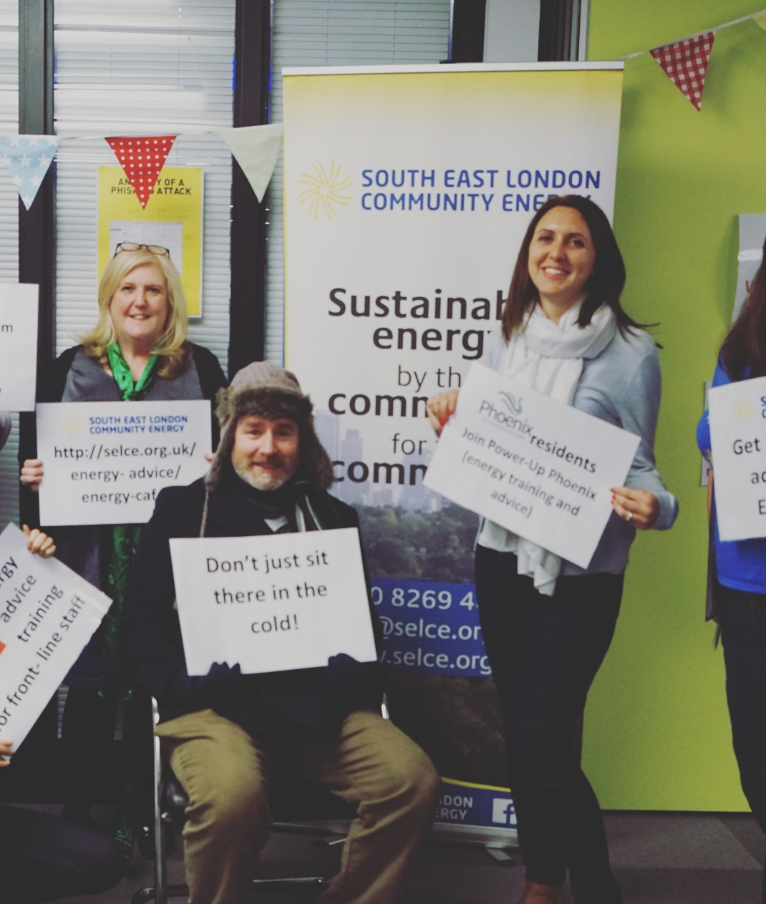
What’s Next?
Contact Alex as CEL Fuel Project Coordinator
Go to the CEL Fuel Poverty projects training
Apply to be CEE trained advisor
Get mentoring from other groups (The Hive)

